Slide 1
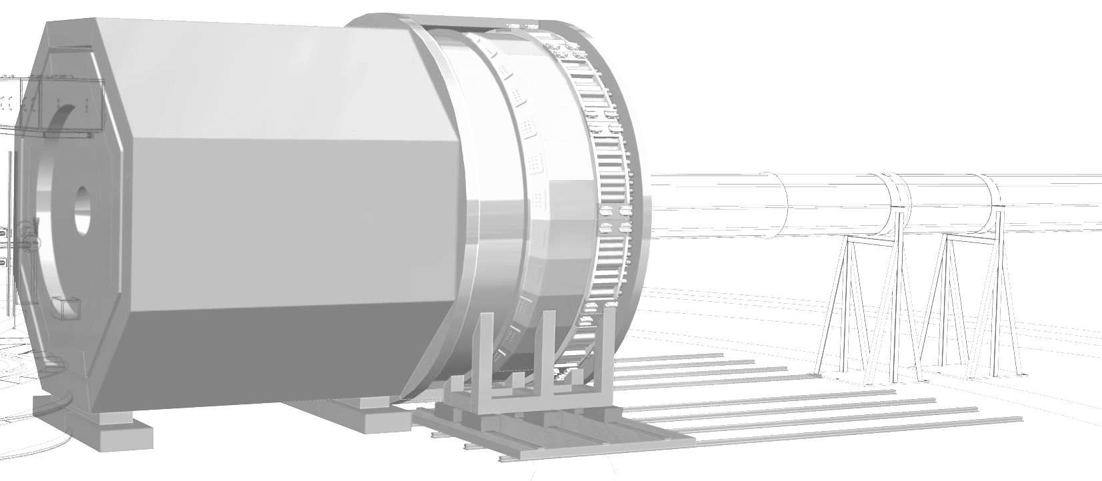



GEM-readout development
Data Acquisition
Jefferson Lab SoLID Pre-R&D Review
August 7th, 2020
Ed Jastrzembski
Data acquisition working group
JLab FE-DAQ Group

Slide 2
Outline
SoLID preRD goals for VMM3
VMM3 overview and use in the ATLAS experiment
Concept for VMM3 readout
VMM3 prototype board
Options for VMM3 readout card
VMM3 evaluation boards
APV25 readout of GEMs in SoLID
Appendix (rate calculation)

Slide 3
SoLID preRD goals for VMM3
Flux of 1 MHz/cm2 results in rates of several MHz for some GEM strips
Need to minimize front-end dead time and be able to read out high data volume resulting from trigger rates beyond 100 KHz
The VMM3 chip offers a fast 6-bit A/D conversion of the peak amplitude, resulting in a dead time of ~50 ns
Need to implement VMM3 prototype to test if this fast direct readout mode produces data with quality sufficient for tracking in high backgrounds
If it does, identify possible final readout solution of VMM3 for SoLID

Slide 4
VMM3 chip
VMM3 block diagram
ASIC for ATLAS New Small Wheel
Radiation hard similar to APV25 : > 100 Mrad
64 channels
Low noise over wide range of input capacitance (<1 pF to ~1 nF)
Shaping times : 25 ns, 50 ns, 100 ns, 200 ns
Pulse amplitude proportional to charge at input
Gains : 0.5, 1, 3, 4.5, 6, 9, 12, 16 mV/fC
6 bit ADC (25 ns conversion) and 10 bit ADC (250 ns conversion), 8 bits TDC (1 ns resolution), 12 bits Beam Crossing time stamp
4 MHz of rate per channel thanks to multilevel FIFO
Continuous or triggered readout on normal data path
Latency up to 16 μs in triggered mode
Fast direct outputs (64 channels) for ATLAS trigger (6b ADC, ToT)
Normal data link up to 320 Mb/s
Direct
Normal

Slide 5
ATLAS New Small Wheel Trigger and Readout
(VMM direct outputs)

Slide 6
ATLAS New Small Wheel Trigger and Readout (simplified)

Slide 7
Concept for VMM3 readout
Dual readout paths
OR
on detector
off detector

Slide 8
6-bit Direct output data format
160 MHz
Flag
320 Mb/s (data on both edges)
Hit time
(6.25 ns resolution)

Slide 9
FPGA function
Direct output data from the VMM3 chips is continuously written into a circular buffer in the FPGA.
Let L be the trigger latency (L < 8 μs) and w be the data capture window size (w < 0.8 µs)
Upon receipt of a trigger at time t, data corresponding to the time period [t – L, t – L + w] is captured and formatted for transmission off the chip
Conceptually
trigger
L
w
t hit
channel 1
channel 2
channel 3
channel 4
etc.
t

Slide 10
FPGA function
If rising edge of flag for direct output data is within capture window, serial data that follows is accepted
In practice, de-serialize 6-bit data at input – trade increased width of buffer for slower clock rate (160 MHz)
Time of hit is recorded as time relative to window start (7 bits)
Include bits for channel number (8 bits), number of hits for channel (5 bits), status bits (4)
Header with trigger time stamp (32 bits), trigger number (16 bits)
(See Appendix for details)
Data transmitted to GBT chip on 10 serial e-links (320 Mb/s each)
(High-speed serialization by GBT (3.2 Gb/s) – fiber transmission (VTRx) to FELIX PCIe readout card)

Slide 11
Data rates
Let r be the hit rate for a channel (MHz), and w be the data capture window size (µs)
Assume that all 256 channels (4 VMM3) have the same hit rate r, and that w < 0.8 µs
Using the bit assignments described in the Appendix, we can find the relationship of r, w, and the maximum trigger rate such that the GBT link is completely saturated (3.2 Gb/s):
Trigger rate (max) = (3200 Mb/s) / (4912 + w*r*3328 b)
For the expected hit and trigger rates in SoLID, direct output data from 4 VMM3 chips can be transferred across 1 GBT link with a comfortable margin

Slide 12
VMM3 Prototype Board
For simplicity we use 2 VMM3 chips

Slide 13
VMM3 Prototype Board
Xilinx Kintex UltraScale FPGA (KCKU035)
  Compatible with receiving low level SLVS signals from VMM3
  Good immunity against radiation induced ‘latch-up’
  Detect and correct radiation induced SEUs (Single Event Upsets) in configuration memory with Xilinx IP
  Use redundant design techniques (TMR –Triple Modular Redundancy) to mitigate against SEUs in user logic
  Footprint compatible with KCKU040 FPGA with 20% more internal resources
Support components also sensitive to the effects of radiation
  Power components (linear regulators, DC-DC converters)
  Commercial grade (COTS) power components can fail – no mitigation techniques available
  Many radiation measurements on COTS components have been made (CERN database, space research); show large lot-to-lot variations
  Space grade components are too expensive and hard to get
  Can use rad hard CERN FEAST DC-DC converter modules for all power
  5 voltages required: VMM: 1.2V analog, 1.2V digital; FPGA: 0.95V, 1.2V, 1.8V, 2.5V

Slide 14
CERN FEAST DC-DC Converter Module
38 mm
17 mm
Modules take up a large area of board space
Many tests of the prototype and detector don’t need rad hard power components
Solution: place all power components on a power mezzanine board
  Many pin connector assures low resistance, low inductance between boards
  can build a COTS version now and replace it on the prototype with a FEAST version when needed
  can build a version that just accepts cables from remotely located power supply

Slide 15
VMM3 Prototype Board

Slide 16
VMM3 Prototype Board

Slide 17
VMM3 Prototype Board Status and Plans
PCB design well underway
Layout of PCB and routing of signals between VMMs and FPGA (Jeff Wilson, FE-DAQ group)
Thanks to ATLAS collaborator USTC (China) for the CAD file for their production version of the sTGC front-end card. From it we extracted the CAD model of the VMM3 chip as well as information about the layout (power, ground) for the sensitive mixed-signal VMM3 chip.
FPGA firmware design started (no redundancy). VHDL code for 10GbE interface already exists (Ben Raydo, FE-DAQ).
---------------------------------------------------------------------------------------------------------------------------------------------------------------------------------------------------------------------------------------------------------------
Planned high-rate x-ray tests at University of Virginia with10GbE readout, COTS power (fall 2020)
Integrate FELIX PCI-e readout card into JLab DAQ software (fall 2020)
Triple Modular Redundancy firmware (early 2021)
Rad hard power mezzanine; radiation tests with FELIX readout (spring 2021)

Slide 18
Options for VMM3 Readout Card
(1) Connect GEM to readout card with cable. Locate readout card in lower radiation zone.
(2) Split readout card into 2 pieces
carry digital signals across with cable or flex circuit
locate section with FPGA in lower radiation zone
GEM
cut
(3) Convert FPGA design into rad hard ASIC
initiated contact with designers of the VMM, ROC, and TDS ASICs to find out about the process and cost

Slide 19
VMM3 Evaluation Boards
Acquired 2 VMM3 evaluation boards (MMFE1, GPVMM3) during JLab shutdown
Set up Linux virtual machine (VirtualBox) at home on Windows 10 PC to run VMM configuration and acquisition software (VERSO)
Able to configure VMM on evaluation board and acquire data using built in pulser of VMM chip (normal data path)
Data has problems – no scope available to look at diagnostic outputs on board
Project paused to get high-speed VMM readout prototype started
Now have later version of the VERSO software
Work in progress …
One evaluation board (MMFE1) will be connected to GEM detector in Hall A during upcoming run and will be read out using VERSO software in high radiation environment

Slide 20
VMM3 Evaluation Boards
The GPVMM3 evaluation board routes the direct outputs of 12 VMM3 channels to a connector
We will cable this connector to an Xilinx FPGA evaluation board to read out the 6-bit ADC data (no hardware to design)
The FPGA on the Xilinx evaluation board is from the UltraScale series and so can natively receive the low level SLVS signals that the VMM3 outputs
We will read out the FPGA evaluation board using 1GbE, so high-rate operation is possible. VHDL code for 1GbE interface already exists (Hai Dong, FE-DAQ).
Firmware development required – this code can be reused in the prototype design
This will give us a first look at the VMM3 direct outputs

Slide 21
APV25 preRD
APV25 - 128 channel pipelined analog sampling chip with trigger buffering
In peak mode 1 sample per channel per trigger
141 analog data per trigger ( 128 channels + header + error flag )
40 MHz clock: 141 x 25 ns = 3.6 us per trigger
APV25 should be able to handle up to 278 KHz average trigger rate (peak mode)
N samples per channel can be obtained by applying N chip triggers on consecutive clock cycles for every physics trigger. Max trigger rate = 278 / N. (Caution: buffer overflows)
Already demonstrated 6 sample readout at 25 KHz trigger rate (APV25 trigger rate = 150 KHz) in HPS experiment using SLAC readout system
Must demonstrate 100 KHz minimum trigger rate with one sample readout using JLab system
Need to optimize readout for maximum data throughput

Slide 22
APV25 readout
APV25
MPD
SSP
CPU
10GbE
2.5 Gb/s
VME bus
(up to 16)
Zero suppress
Current SBS readout (Super Big-bite Spectrometer)
(up to 32)
1.6 Gb/s
shared
Max 4 APV25 per MPD @ 100 KHz trigger (1 sample)
APV25
MPD
VTP
2.5 Gb/s
10 Gb/s
(up to 16)
Zero suppress
fiber
to VXS
10/40GbE
Proposed SoLID readout
(up to 4)
(up to 16)
MPD – Multi-Purpose Digitized
SPS – Sub-System Processor
VTP – VXS Trigger Processor

Slide 23
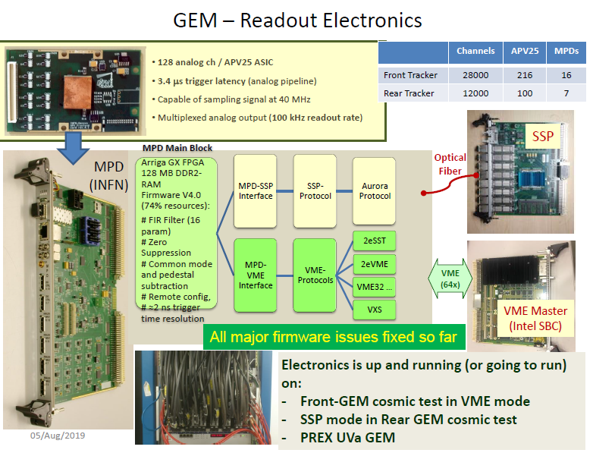

Slide 24
Appendix – VMM Data Rates

Slide 25
Appendix

Slide 26
Appendix

Slide 27
REFERENCE SLIDES

Slide 29
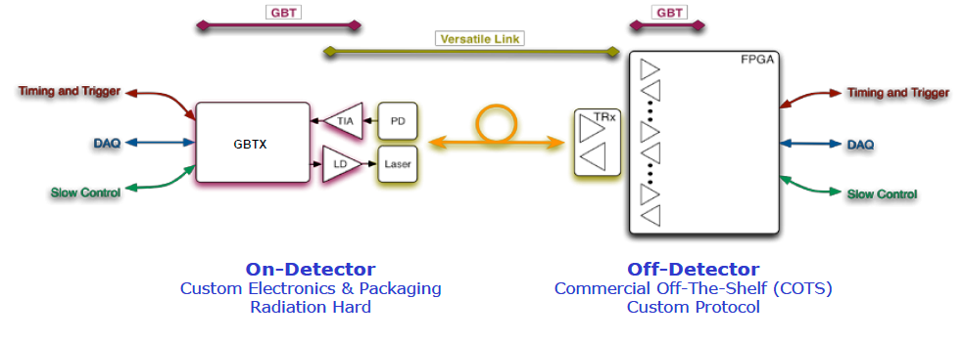
GBT - VTRx link
FELIX
Single bidirectional rad hard optical link simultaneously provides data paths for:
- Timing and Trigger Control (TTC)
- Data Acquisition (DAQ)
- Slow Controls (SC) – configuration and monitoring
Fixed Latency

Slide 30
FELIX
Front-end ASICS
FELIX hardware implemented in PCIe Gen3

Slide 31
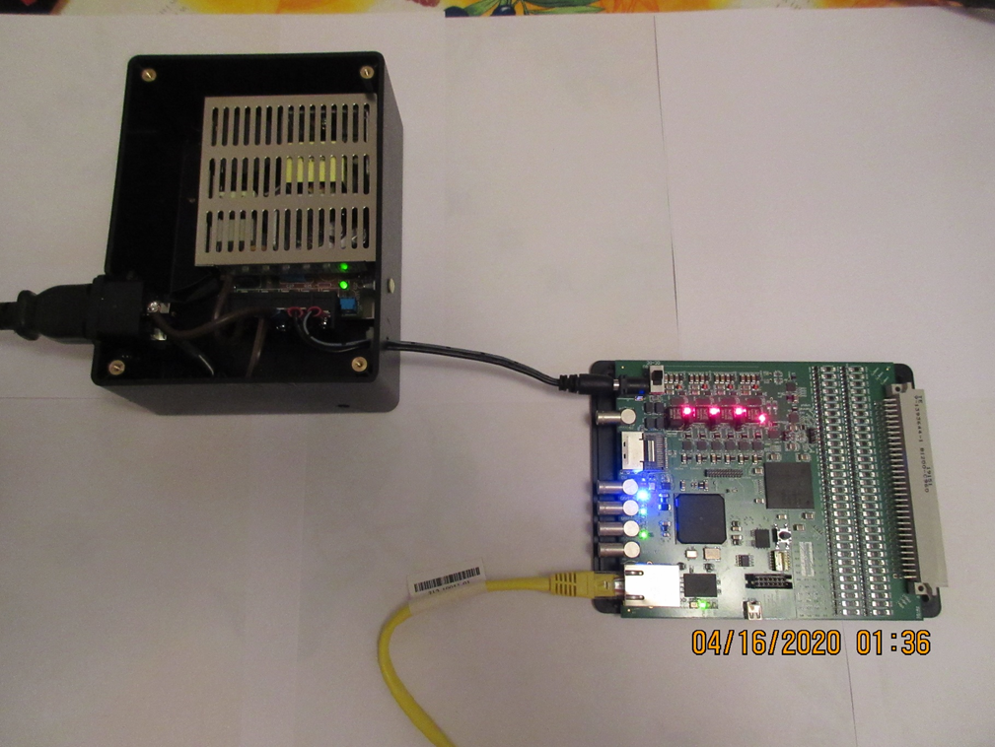
VMM3 Evaluation Board
With home made power supply during JLab shutdown

Slide 32
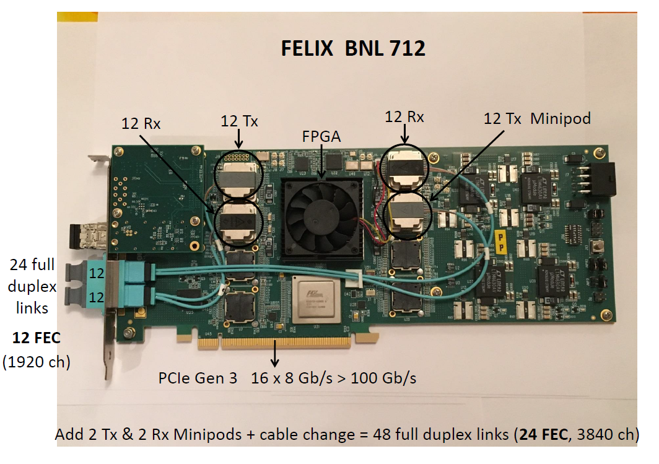

Slide 33
SLVS signaling and FPGAs
Vcm = midpoint voltage of differential signal pair
Vdiff = difference voltage of differential signal pair
Vcm (SLVS output max) < Vcm (LVDS input min)
So SLVS output cannot reliably drive LVDS input of FPGA.
(Xilinx note XAPP894 says that for the Spartan-7 series, the use of an external terminator lowers LVDS input Vcm (min) to 100 mV. This would allow the LVDS inputs to receive SLVS signals. It is not clear that this also applies to other 7 series FPGAs (Artix, Kintex) as it is NOT specified in the datasheet.)
Vcm (SLVS input max) < Vcm (LVDS output min)
Vdiff (SLVS input max) < Vdiff (LVDS output min)
So LVDS outputs must be attenuated and level shifted to be received by SLVS inputs.
(Accomplished with a resistor network.)
Inputs on Xilinx UltraScale and Ultrascale+ series FPGAs can natively receive SLVS signals.

Slide 34
APV25 chip output

