Slide 1
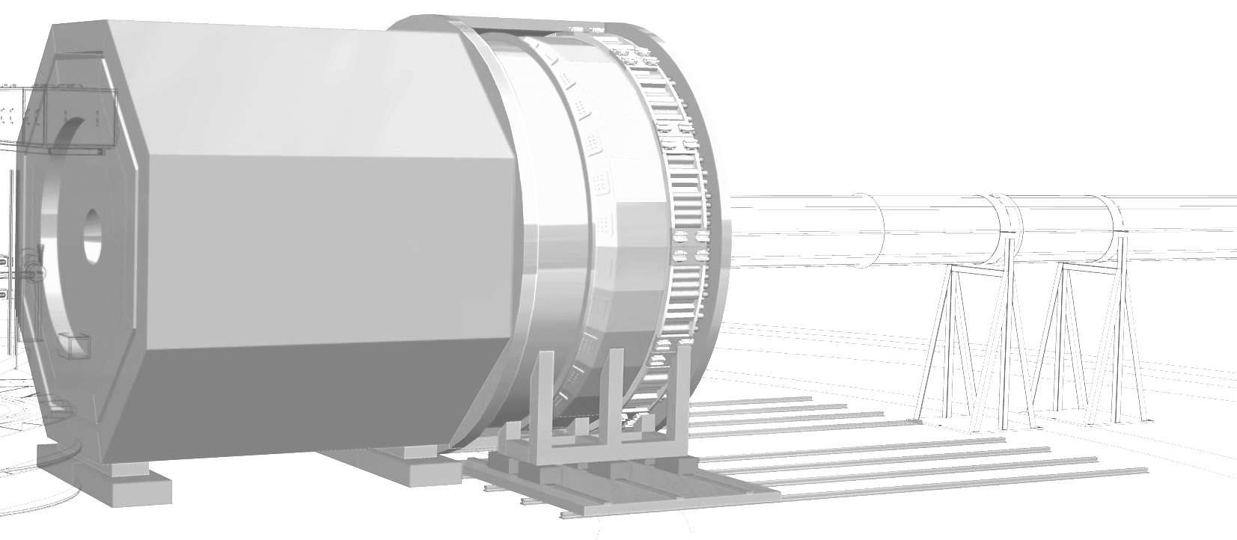



SoLID DAQ preRD tasks and remaining work
Data Acquisition
Jefferson Lab SoLID Pre-R&D Review
August 7th, 2020
Alexandre Camsonne
Data acquisition working group
Hall A Jefferson Laboratory

Slide 2
Outline
Tasks / milestone
GANTT chart task and COVID impact
Tasks status
ASOC
Workforce
Spending
Conclusions

Slide 3
Tasks and milestones
A : VMM high rate test
  A1 : procure evaluation board April 1st 2020
  A2 : develop direct readout / study behavior in high background February 15th 2021
  A3 : determine maximum trigger rate June 1st 2021
B : APV rate capability
  B1 : develop Fast Readout August 1st 2020
  B2 : demonstrate 100 KHz rate December 1st 2020
C : FADC development
  C1 : Fast VXS readout August 15th 2020
  C2 : Calorimeter trigger September 15th 2020
  C3 : PVDIS trigger and test February 15th 2021
  C4 : PVDIS trigger and test 2 sectors May 15th 2021
  C5 : SIDIS trigger and test July 15th 2021
D : Gas Cerenkov
  D1 : readout for Cerenkov test April 1st 2020
  D2 : Cerenkov data with high background June 15th 2020
  D3 : MAROC data with high background July 15th 2020
  D4 : evaluation improvement with MAROC pixel readout April 15th 2021
E : NALU Time of flight chip
  E1 : install evaluation board April 1st 2020
  E2 : sample high background data August 1st 2020
  E3 : timing resolution April 15th 2021

Slide 4
Medcon6
Medcon5
Feb 1st
Mar 1st
Apr 1st
May 1st
June 1st
July 1st
Aug 1st
Sept 1st
Oct 1st
Nov 1st
Order VMM3 eval board
Develop direct readout
A1
Testing with GEM on bench cosmics
Implement APV25 fast readout
B1
Test APV25 trigger rate capability
Fast FADC VXS readout
C1
Calorimeter trigger
Cerenkov trigger
D1
Test with scintillator and cosmics
D2
Analysis
Setup Cerenkov FADC crate
Test Cerenkov beam
Setup MAROC with sum
Test Cerenkov beam with MAROC
D3
setup AARDVARC evaluation board
E1
Test with scintillator and cosmics
Test with scintillator in beam
E2
Analysis

Slide 5
2020 2021
Dec 1st
Jan 1st
Feb 1st
March 1st
April 1st
May 1st
Jun 1st
July 1st
August 1st
Test VMM3 with
high background
A2
Optimize VMM3 readout
A3
Maximum rate achievable with VMM3
APV25 maxRate with SBS
electronics
Test AV25 trigger rate capability
B2
1
SIDIS maximum trigger rates
With 2 sectors
C2
C3
C4
Cerenkov trigger
C2
PVDIS trigger 2 sectors
SIDIS trigger
PVDIS trigger
PVIDIS maximum trigger rates
With 2 sectors
Comparison summed vs pixel readout for Cerenkov
Analysis
D4
Analysis
E3
Comparison timing resolution ARDVAARC and FADC
In high background

Slide 6
Medcon6
Medcon5
Feb 1st
Mar 1st
Apr 1st
May 1st
June 1st
July 1st
Aug 1st
Sept 1st
Oct 1st
Nov 1st
Order VMM3 eval board
Develop direct readout
A1
Implement APV25 fast readout
B1
B2
Fast FADC VXS readout
C1
Calorimeter trigger
Cerenkov trigger
D1
Test with scintillator and cosmics
D2
Setup Cerenkov FADC crate
Test Cerenkov beam
Setup MAROC with sum
Test Cerenkov beam with MAROC
D3
E1
Test with scintillator and cosmics
E2
E2
setup AARDVARC evaluation board
Test with scintillator in beam

Slide 7
2020 2021
Dec 1st
Jan 1st
Feb 1st
March 1st
April 1st
May 1st
Jun 1st
July 1st
August 1st
A1
Testing with GEM on bench cosmics
Optimize VMM3 readout
A3
Maximum rate achievable with VMM3
A2
Develop direct readout
Test VMM3 with
high background
APV25 maxRate with SBS
electronics
Test AV25 trigger rate capability
B2
1
SIDIS maximum trigger rates
With 2 sectors
C2
C3
C4
Calorimeter trigger
Cerenkov trigger
C2
PVDIS trigger 2 sectors
SIDIS trigger
PVDIS trigger
PVIDIS maximum trigger rates
With 2 sectors
Comparison summed vs pixel readout for Cerenkov
Analysis
D4
Analysis
E3
Comparison timing resolution ASOC and FADC
In high background

Slide 8
Tasks and milestones
A : VMM high rate test
  A1 : procure evaluation board and test direct readout April 1st 2020 – delayed November 2020
  A3 : develop prototype determine maximum trigger rate December 1st 2020 – ongoing
  A2 : study behavior in high background February 15th 2021 – delayed June 15th 2021 on going
B : APV rate capability
  B1 : develop Fast Readout August 1st 2020 – delayed December 2020 ( after FADC VXS readout )
  B2 : demonstrate 100 KHz rate November 1st 2020 – delayed February 1st 2021
C : FADC development ( shift by 2 months )
  C1 : Fast VXS readout August 15th 2020 – delayed October 15th 2020 – ongoing
  C2 : Calorimeter trigger September 15th 2020 – delayed December 1st 2020
  C3 : PVDIS trigger and test February 15th 2021 – delayed April 15th 2021
  C4 : PVDIS trigger and test 2 sectors May 15th 2021 –delayed June 15th 2021
  C5 : SIDIS trigger and test July 15th 2021 -

Slide 9
Tasks and milestones
D : Gas Cerenkov Test support ( shifted by 2 months due to COVID, beam resumed August 1st )
  D1 : readout for Cerenkov test April 1st 2020
  D2 : Cerenkov data with high background June 15th 2020 – delayed August 1st 2020 – on going
  D3 : MAROC data with high background July 15th 2020 – delayed October 15th (
  D4 : evaluation improvement with MAROC pixel readout April 15th 2021
E : NALU ASOC Time of flight chip
  E1 : install evaluation board April 1st 2020
  E2 : sample high background data August 1st 2020 – October 15th 2020
  E3 : timing resolution April 15th 2021

Slide 10
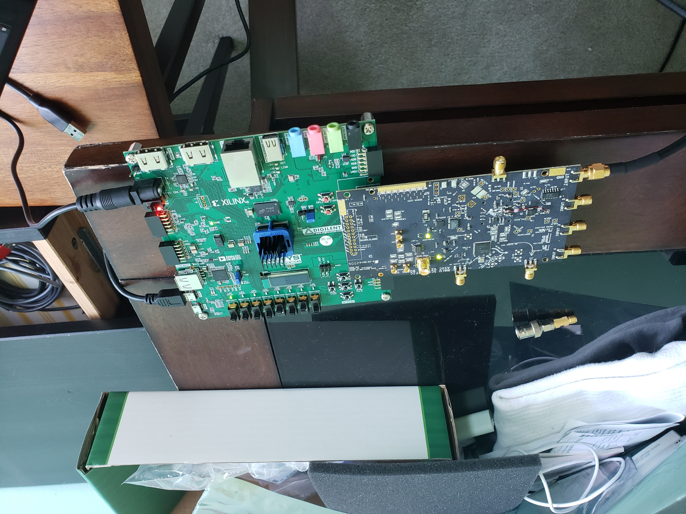
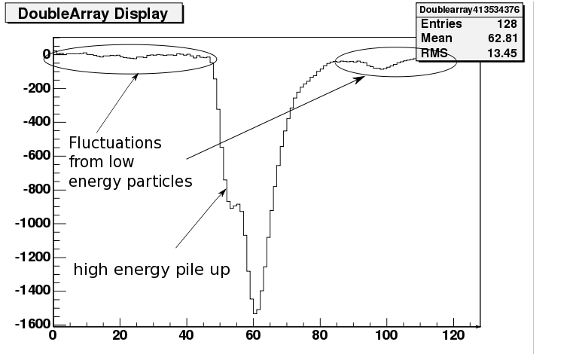
TOF ASOC chip
Scintillator for TOF : want to evaluate effect of pile-up on timing resolution and compare FADC vs ASOC
Testing ASOC instead of AARDVARC : more suitable for scintillator readout with PMTs
Borrowed ASOC board from NALU
Acquired Nexsys FPGA eval board
Software installed and board running
Currently testing with pulser
Test with detector and plan to record high background sample with beam before October 15th

Slide 11
Workforce
 | Month electronics engineer | Months DAQ staff | Physics staff | Postdoc
Tasks |  |  |  |  | 2020 | 2021 | 2020 | 2021
Ecal trigger | 1 | 1 | 0.5 | 1 | 1 |  | Barcus
GEM performance | 3 | 1 | 0.5 | 1 | 1 |  | UVA
GEM X-ray test | 0 | 0 | 0.5 | 1 | 0 | 1 | UVA
VMM setup | 1 | 1 | 0.5 | 1 |  | 1 |  | UVA
FADC VXS readout | 3 | 1 | 1 | 1 | 1 |  | Liu
FADC performance | 3 | 1 | 0.5 | 3 | 2 | 1 | Liu
Data transfer silo | 0 | 1 | 0.5 | 1 | 0 | 1 | Barkus |  |  | 2020 | 2021
Cerenkov readout | 5 | 1 | 0.5 | 2 | 0 | 2 | Hall A postdoc |  | Liu | 3 | 5
PVDIS trigger prototype | 2 | 1 | 0.5 | 2 | 0 | 2 | Liu |  | UVA | 5 | 1
Data reduction algorithm | 6 | 3 | 0.5 | 3 | 1 | 2 | UVA |  | Barcus | 6
L3 farm need evaluation | 0 | 1 | 0.5 | 2 | 2 |  | Hall A postdoc |  | Hall A postdoc | 2 | 4
Test stand - beam test | 1 | 1 | 0.5 | 2 |  | 2 |  | Liu
Deadtime for PVDIS | 3 | 2 | 1 | 3 |  | 3 |  | Liu | Total | 16 | 10
SIDIS trigger prototype | 2 | 1 | 0.5 | 2 |  | 2 |  | Hall A postdoc
MRPC readout | 6 | 3 | 0.5 | 1 |  | 1 |  | Hall A postdoc
SPD readout and test | 3 | 1 | 0.5 | 1 |  | 1 |  | Hall A postdoc
Total months | 39 | 20 | 9 | 27 | 8 | 19
JLab staff : Ed Jastzremski, Benjamin Raydo, Bryan Moffit, Alexandre Camsonne

Slide 12
Spending profile

Slide 13
Conclusion
Long lead items ordered
Most workforce identified
UMASS DAQ test stand being set up
VMM3 protype board ongoing for test with high rate
Fast VTP readout scheme ongoing will be reused for fast APV25 readout with VTP
About 2 to 3 months delay due to COVID

