Slide 1
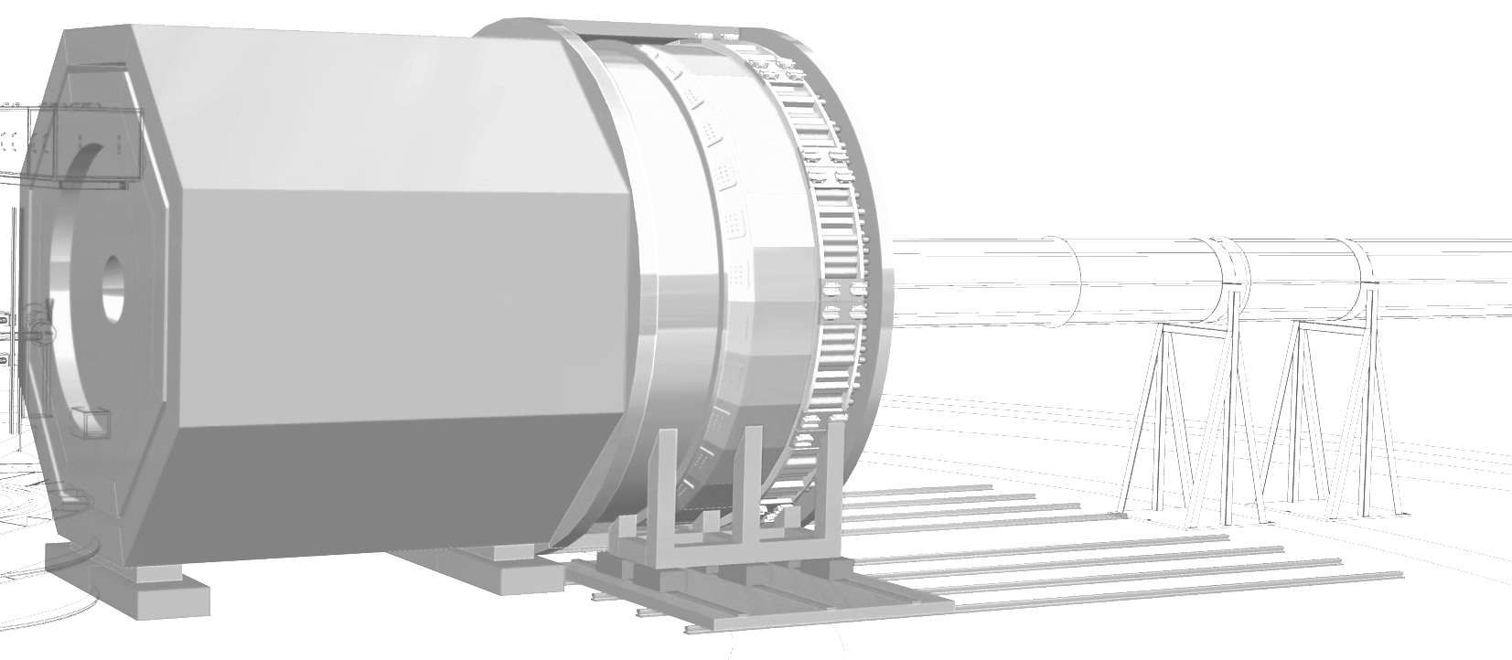



SoLID Pre R&D – DAQ
Overview
Data Acquisition
Jefferson Lab SoLID Pre-R&D Review
August 7th, 2020
Stpehen Wood
Jefferson Lab

Slide 2
Outline
Overview of SoLID DAQ
Overview of Pre-R&D Plan for DAQ
Current Status

Slide 3
SoLID Data Acquisition
~190 K GEM Tracking channels
1800 calorimeter modules
Particle trigger: Cluster in calorimeter with gas Cherenkov and scintillators
Data rate ~ 4Gbyte/second
Semi-Inclusive DIS (SIDIS) configuration
Pion Electron coincidence
~100 kHz rate – accidentals dominated
Parity Violating DIS (PVDIS) configuration
Trigger on single electron
~500 kHz rate → 15 or 30 mostly independent data acquisition systems. < 20 kHz/system

Slide 4
Trigger and data rates
 | PVDIS | SIDIS | J/ψ
Trigger rate maximum | 20 KHz | 100 KHz | 30 KHz
Data rate | 3.3GB/s | 3.36GB/s | 3.90GB/s
Running time | 169 days | 125 days | 60 days
Total raw data | 48.2 PB | 36.2 PB | 40.4 PB
Expected SIDIS rate is 85 kHz
Table numbers are without compression. If compressing may reduce data rates and size by 2.5

Slide 5
GEM Tracking
GEM detectors not in trigger
Data from GEMs dominate data volume
Must function with 100 kHz trigger rate and fluxes of 0.5 Mhz/cm² (PVDIS)
GEM Readout options:
APV25 with MPD readout boards
Used for SBS program
APV25 out of production
VMM3 chip with JLab readout boards
Better timing resolution
(6.25 ns vs 25 ns)
Notes:
In SIDIS mode make cluster trigger, communicate between sectores. In PVDIS, need to send DAQ info between sectors.

Slide 6
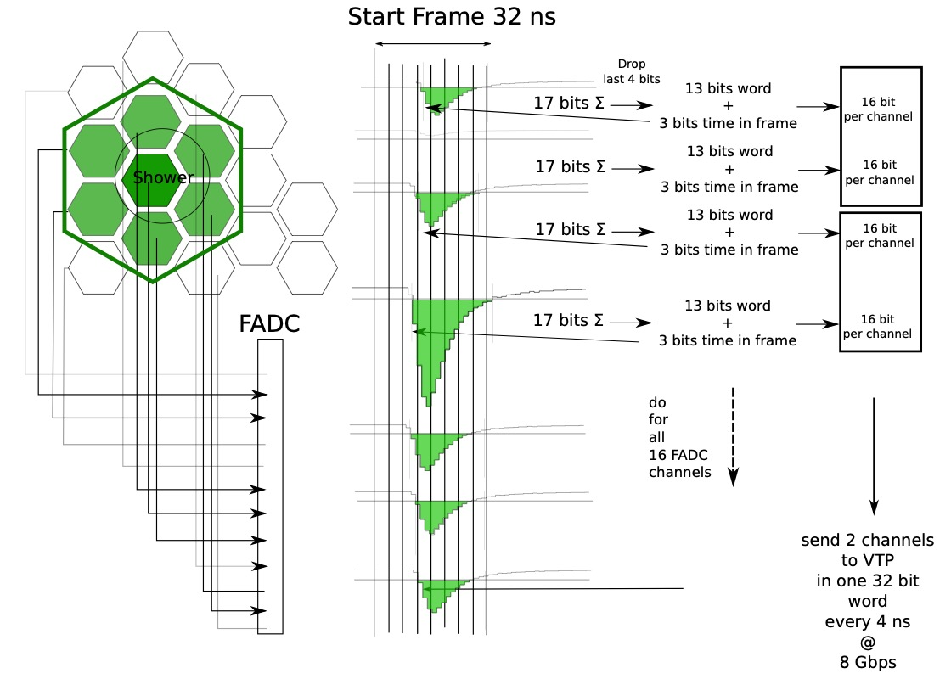
Flash ADC and trigger
Most non tracking detectors read by JLab pipelined flash ADCs. ADCs detect pulses and emit continuous stream of digital information for triggering. (In addition to richer data when triggered.)
Trigger formed in trigger processors.
Trigger information shared between adjacent sector DAQs
PVDIS – independent DAQ systems
Must share trigger information between adjacent sector DAQs AND triggered data.
Must confirm deadtimeless ADC readout at 100 kHz trigger rate

Slide 7
Data Acquisition Pre R&D Plan
Prototype DAQ
Develop Fast FADC readout (VXS instead of VME backplane)
High resolution TDC readout
MAPMT readout
Trigger prototyping, deadtime studies
Support Cherenkov tests
Establish Viable GEM Readout
VMM3:
Verify trigger and hit rate capability with direct VMM readout mode
APV25 chip, MPD readout (SBS):
(Backup scheme)
Firmware development to confirm trigger rate.

Slide 8
Current Status
VMM3 testing well underway. Prototype board being designed.
Fast readout MPD/APV25 with VTP under development (100 kHz trigger and 1Gbyte/sec per VTP
FADC250 VXS readout under development
Test stand setup at University of Massachusetts
Started ASOC chip TOF performance and following firmware development in Hall D.
In beam Cherenkov tests in progress

