Slide 1
PionLT EDTM Analysis Summary
Jacob Murphy
2022/01/04

Slide 2
EDTM Rate to Disc
Current EDTM GUI asks for desired nominal EDTM rate to disc
Sets EDTM pulse clock to that rate * lowest prescale factor
$EDTM_{acc}=\frac{EDTM_{sent}}{PSF_{min} }$
For physics production runs, our coin trigger is always non-prescaled (PS=0), so The nominal rate accepted is the same as the pulse clock rate for EDTM
In reality, the rate of EDTM events saved to disc is a function of all PS factors
$EDTM_{acc}=\frac{EDTM_{sent}}{PSF_{1} }+\frac{EDTM_{sent}}{PSF_{2} }$ - $\frac{EDTM_{sent}}{PSF_{1}∗PSF_{2}}+\frac{EDTM_{sent}}{PSF_{3} }$- $\frac{EDTM_{sent}}{PSF_{1}∗PSF_{3}}$ - $\frac{EDTM_{sent}}{PSF_{3}∗PSF_{2}}+\frac{EDTM_{sent}}{PSF_{1}∗PSF_{2}∗PSF_{3}}$
Note for two triggers, only the first 3 terms survive
This was confirmed by the first EDTM study

Slide 3
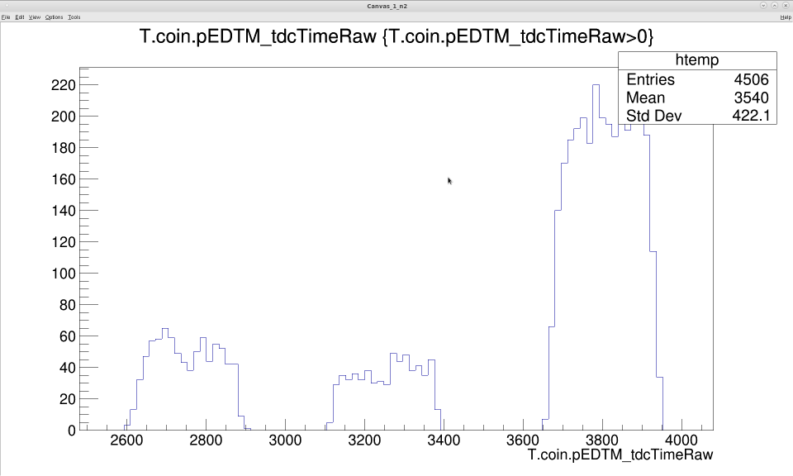
Arrival Time of Triggers to DAQ
PS4 = 2
PSF4 = 3
1/3 of 4/5 of ½ of events sent
PS1 = 3
PSF1 = 5
1/5 of ½ of events sent
PS5 = 1
PSF5 = 2
½ of events sent
If DAQ is busy accepting an event for one trigger, events in other triggers do not count towards prescaling. Therefore, only EDTM pulses not saved by earlier triggers are seen by later triggers

Slide 4
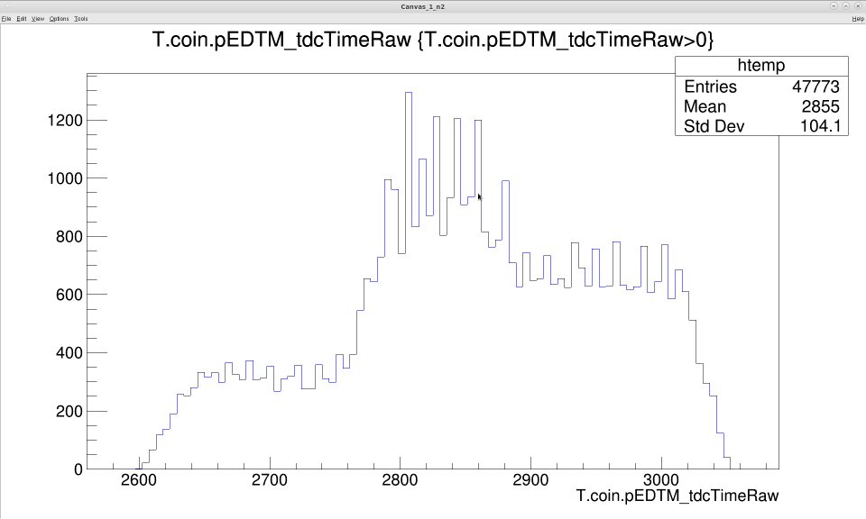
PS4 = 1
PSF4 = 2
½ of ½ of events sent
PS2 = 1
PSF2 = 2
½ of events sent

Slide 5
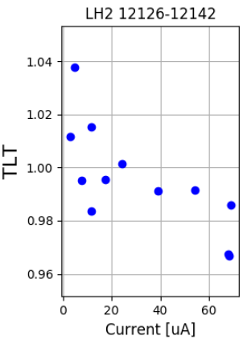
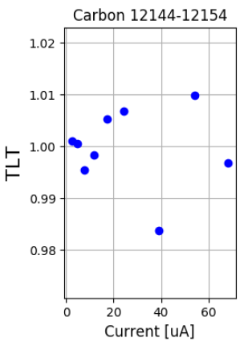
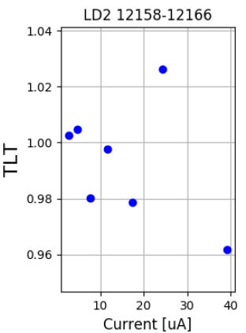
Lumi Scan #1 Total Live Time
TLT still greater than 100%
Physics triggers mixed with EDTM accepted
Rate correction needs to be applied
Misunderstanding of EDTM sent values
Previous equation doesn’t account for physics adjusting EDTM events prescaled away
Physics events mixed with clocked EDTM pulses should fluctuate EDTM saved to disc, even at 100% TLT

