Slide 1
Trigger Design for The High-Rate Beam Test in Hall C
Jixie Zhang

Slide 2
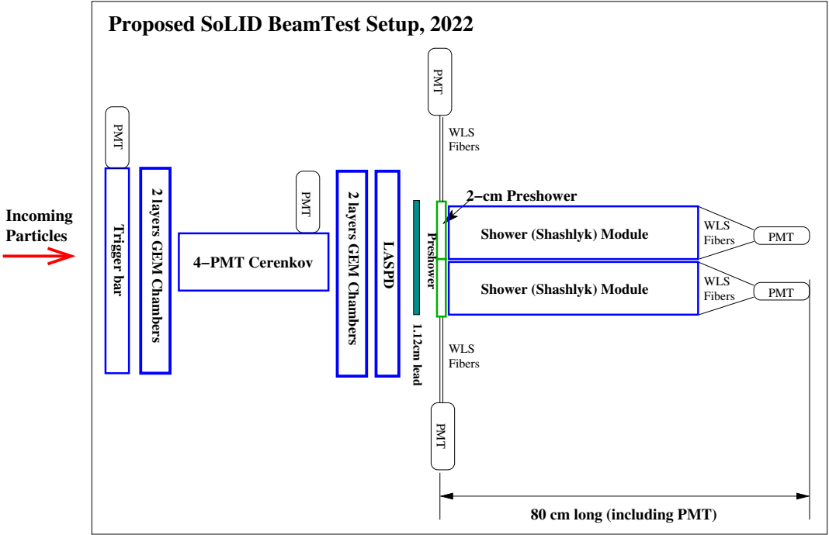
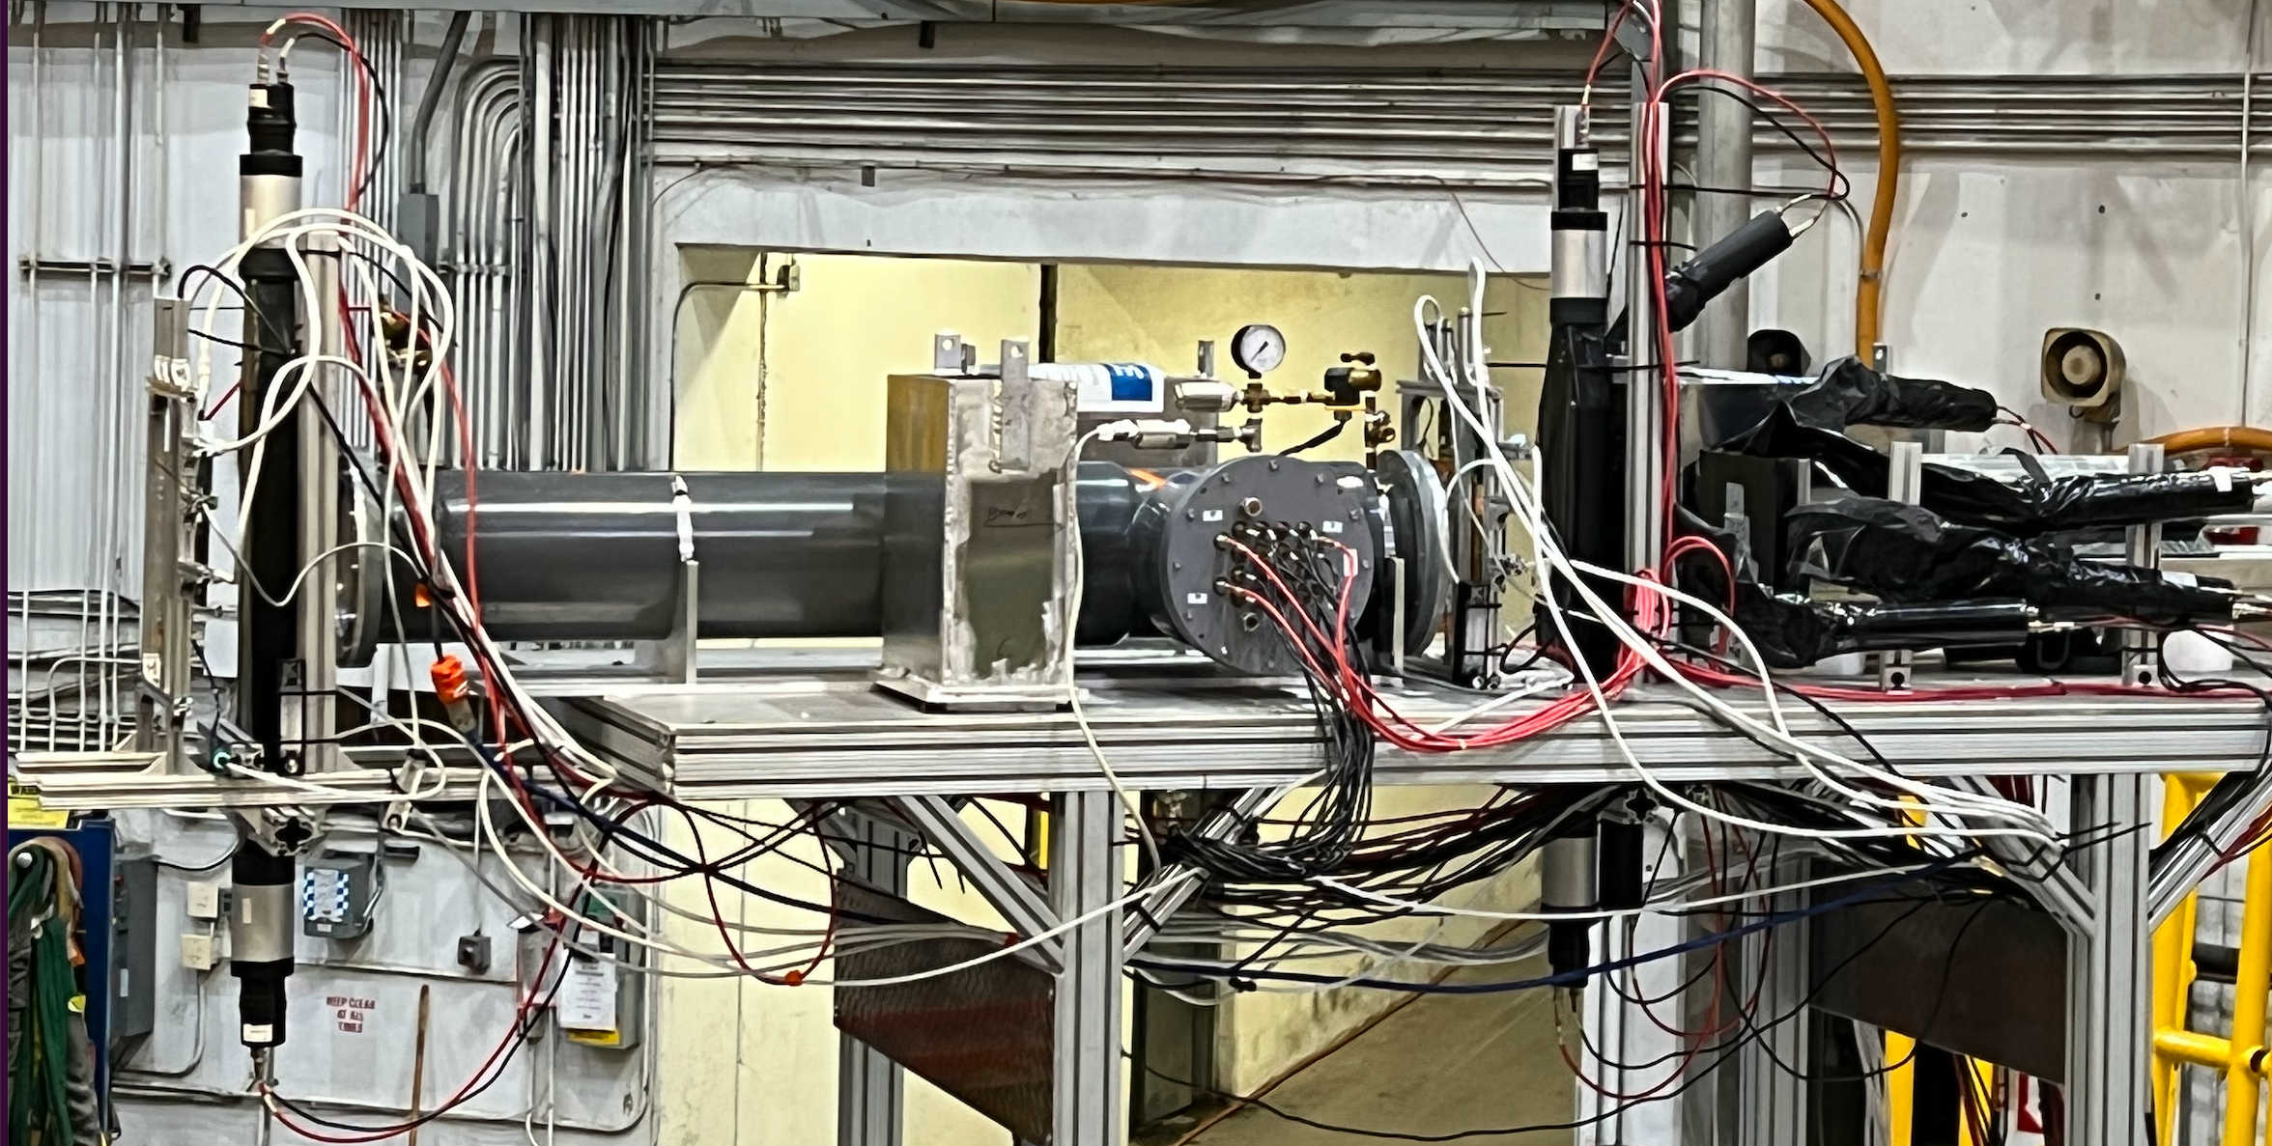

Slide 3
Low rate trigger setup (Hall C beam-left 82.2 deg)
sideview
frontview
frontview
top PMT
top PMT
and
and
Trigger Type 2 (bit 010)
Trigger Type 1 (bit 001)
and
and
Cherenkov
(length not to scale)
Preshower
Shower
top
top
GEM
GEM
SPDs
Preshower
Shower
left
right
left
right
sum of 3 shower blocks
table
bottom PMT
bottom PMT
SC0
SC1
Trigger Type 3 (bit 100)
All discriminator threshold is around 18.2 mV

Slide 4
High rate (current) detector layout (Hall C beam-right 7 deg)
sideview
frontview
frontview
Shower
(not to scale)
top
Cherenkov
(length not to scale)
PreShower
Preshower
Shower
top
LASPD
GEM
GEM
left
right
left
right
SC_A
SC_C
SC_D
SC_B
SC_B
sum of 3 shower blocks
table
List of Detectors (From upstream to downstream):
GEM_00, GEM01;
SC_A (5cm (x) x 7.5cm(y) x 1cm), Cherenkov;
GEM_10,GEM_11;
SC_C (trapezoid shape: 3.5cm wide top side (at end tip, in hall y direction) and 5.5cm wide bottom side (connected to light guide), 18cm height (in hall x direction), 2cm thick);
LASPD, SC_D (Kedi-6 preshower tile, 6.35cm side length hexagon, 2cm thick);
PreShower: Preshower_T(SDU#2), Preshower_left(SDU#1), Preshower_right(THU#1);
Shower: Shower_T(SDU#5), Shower_L(SDU#4), Shower_R(THU#4);
SC_B: (5cm(x) x 10cm(y) x 1cm)

Slide 5
High rate (current) detector layout (Hall C beam-right 7 deg)
sideview
frontview
frontview
Trigger Type 1 (bit 001)
Trigger Type 2 (bit 010)
and
and
Shower
(not to scale)
top
Cherenkov
(length not to scale)
PreShower
Preshower
Shower
top
LASPD
GEM
GEM
left
right
left
right
SC_A
SC_C
SC_D
SC_B
SC_B
sum of 3 shower blocks
table
List of Detectors (From upstream to downstream):
GEM_00, GEM01;
SC_A (5cm (x) x 7.5cm(y) x 1cm), Cherenkov;
GEM_10,GEM_11;
SC_C (trapezoid shape: 3.5cm wide top side (at end tip, in hall y direction) and 5.5cm wide bottom side (connected to light guide), 18cm height (in hall x direction), 2cm thick);
LASPD, SC_D (Kedi-6 preshower tile, 6.35cm side length hexagon, 2cm thick);
PreShower: Preshower_T(SDU#2), Preshower_left(SDU#1), Preshower_right(THU#1);
Shower: Shower_T(SDU#5), Shower_L(SDU#4), Shower_R(THU#4);
SC_B: (5cm(x) x 10cm(y) x 1cm)
Trigger Type
3 (bit 100)
any 2 out of these 3 inputs

Slide 6
High rate trigger type 1: primary electron trigger (sum_cer & sum_shower)
All inputs are after x10 amplifier
Cherenkov_sum
All 16 Cherenkov MaPMT channels (after x10 amplifier) go to one FADC board
cer_0,1,2,3
Sum/FIFO_0(0)
Sum
FIF0_1(3)
cer_4,5,6,7
Sum/FIFO_0(1)
cer_8,9,10,11
DS_0(1)
Sum/FIFO_0(2)
cer_12,13,14,15
DS_0(2)
Logic_0(1)
“and”
Sum/FIFO_0(3)
TI_0(1)
FADC_1 (10,11,12)
DS_0(5)
sh_l
FIFO_2(0)
Sum
FIFO_2(3)
sh_r
DS_0(3)
Go to trigger type 3
FIFO_2(1)
sh_t
DS_0(4)
Go to trigger type 2
FIFO_2(2)
DS_0(14)
Go to trigger type 4
Shower_sum
Separate each DSC channel for different threshold control to each trigger type

Slide 7
High rate trigger type 2: pion trigger (scintillator & sum_shower)
FADC_1(0,2)
shower_sum
Logic_0(2)
“and”
DS_0(4)
SC_B
FIFO_3(0)
DS_0(6)
TI_0(2)
SC_D
FIFO_3(1)
DS_0(7)
DS_0(8)
(behind shower)
Go to trigger type 3
DS_0(15)
Go to trigger type 5
FADC_1 (7,8,9)
PreSh_0
Sum
FIFO_4(3)
FIFO_4(0)
PreSh_1
FIFO_4(1)
DS_0(9)
PreSh_2
FIFO_4(2)

Slide 8
High rate trigger type 3: efficiency trigger, any 2 out of 3 inputs
Logic_0(3)
“2_out_of_ 3”
Cherenkov_sum,
DS_0(2)
Shower_sum,
DS_0(5)
TI_0(3)
SC_D,
DS_0(8)

Slide 9
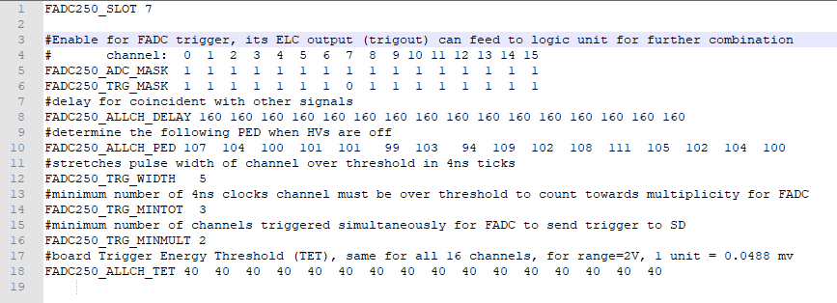
High rate trigger type 4,5,6:
Shower_sum,
DS_0(14)
TI_0(4)
SC_B,
DS_0(15)
TI_0(5)
FADC Slot7,
2 out of 15
TI_0(6)
This one will replace Cherenkov sum eventually

Slide 10
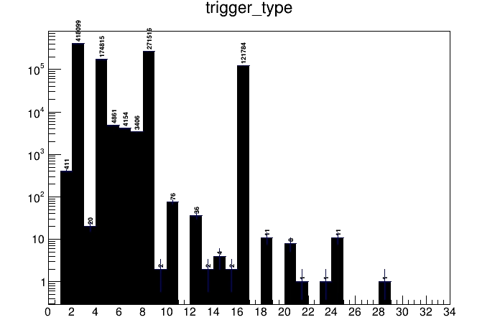
trigger type without prescale
Threshold:
Cer_Sum(30mV),
Shower_Sum(10mV),
SC_D(Kedi6-Tile,10mV),
SC_B(downstream of Shower,10mV)

Slide 11
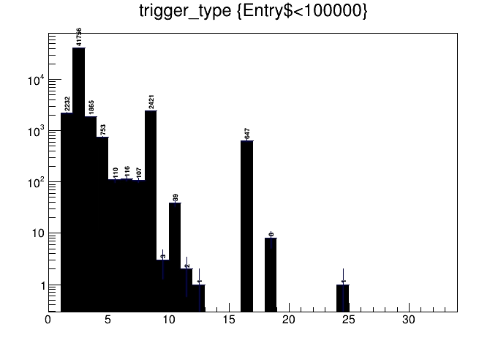
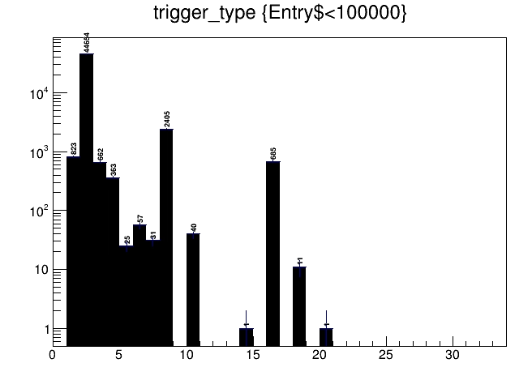
trigger type after prescale facor for trigger bit 1-6: (0,0,5,3,3,0)
Threshold:
Cer_Sum(30mV),
Shower_Sum(10mV),
SC_D(Kedi6-Tile,10mV),
SC_B(downstream of Shower,10mV)
Threshold:
Cer_Sum(100mV),
Shower_Sum(10mV),
SC_D(Kedi6-Tile,10mV),
SC_B(downstream of Shower,10mV)

Slide 12
Back up

Slide 13
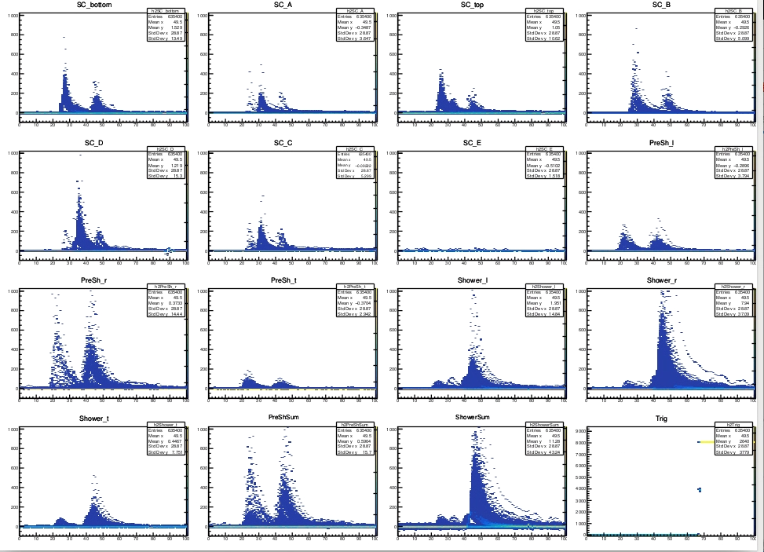
Cosmic 3
Check all detectors
(not Cherenkov)

Slide 14
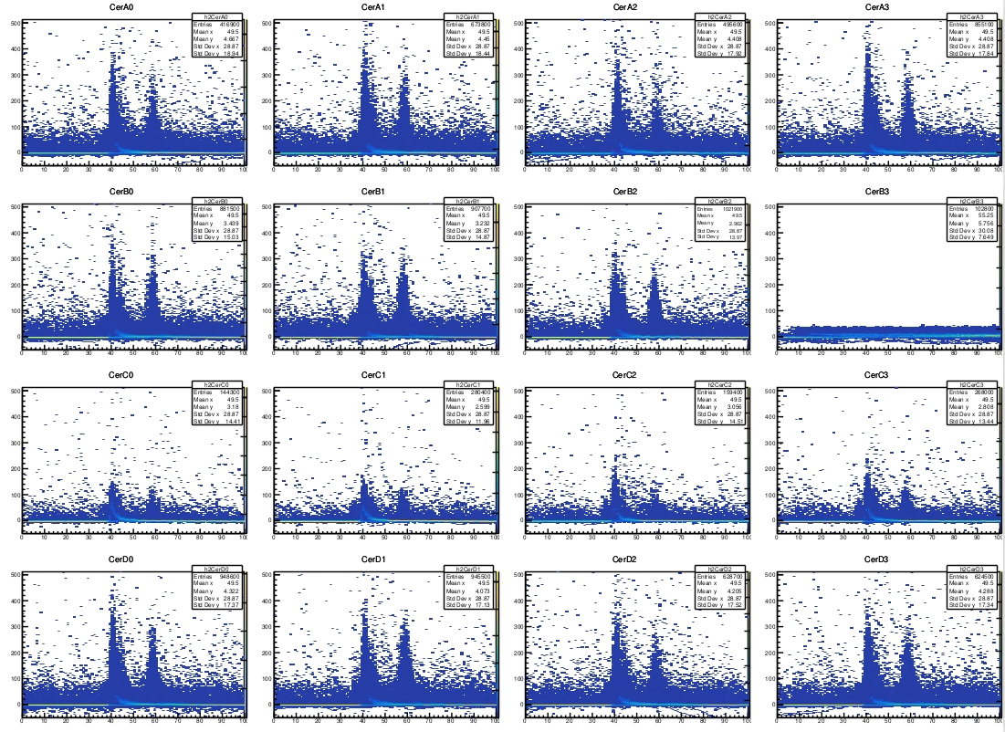
Tune beam on
Carbon Hole target
Cherenkov

Slide 15
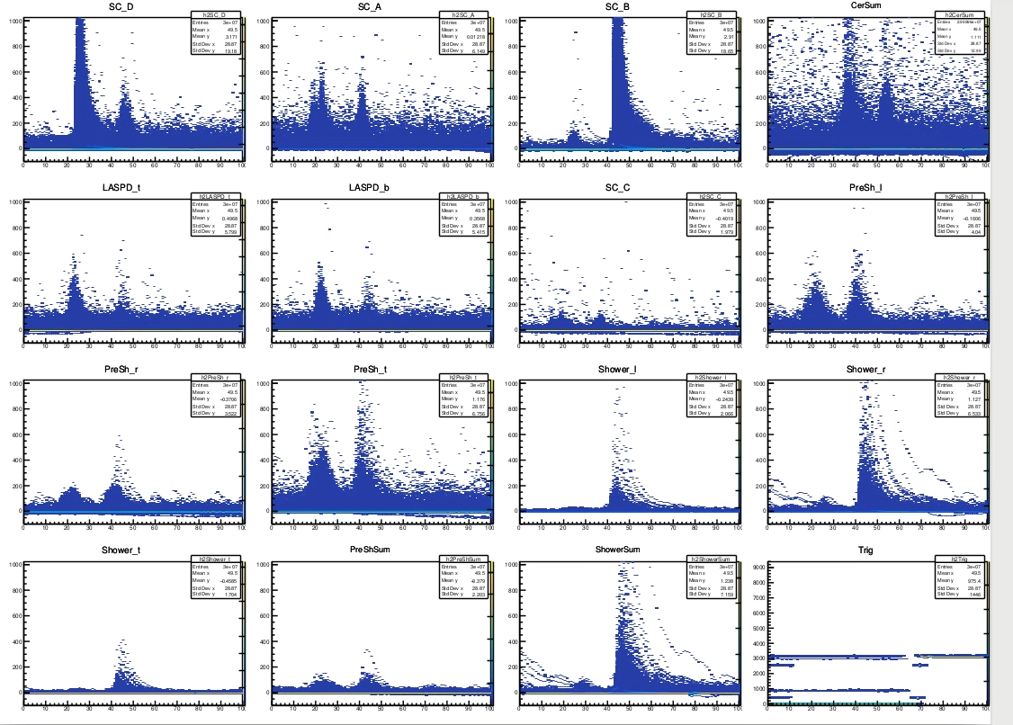
Tune beam on
Carbon Hole target
SC
PreShower
Shower

Slide 16
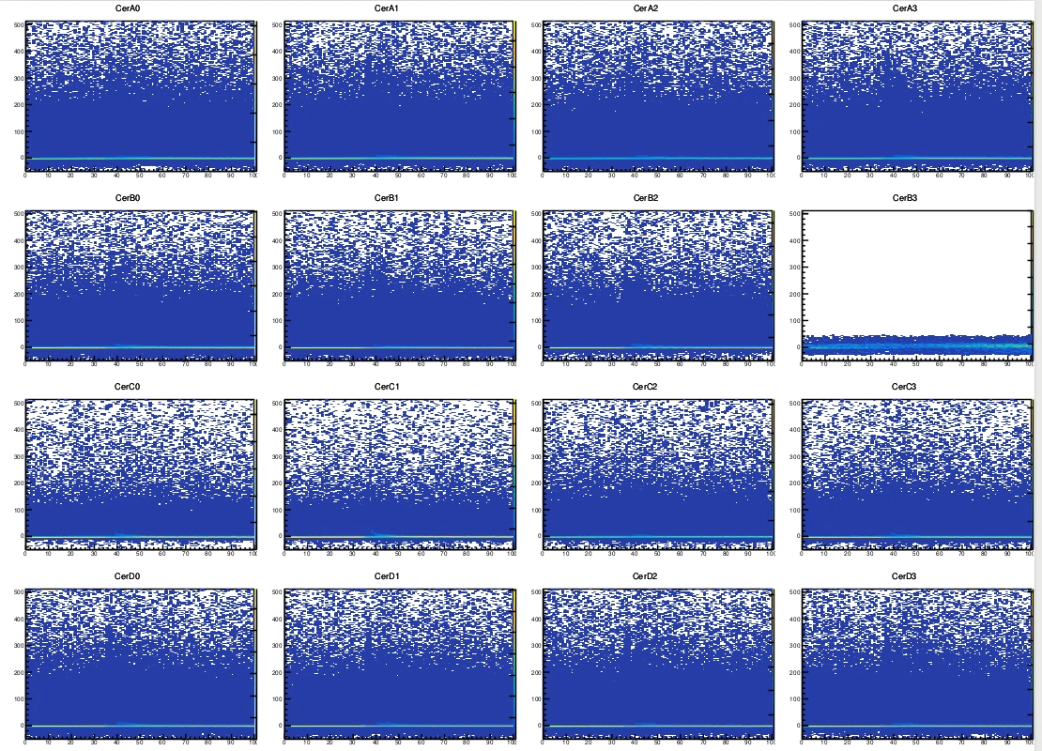
2uA CW beam on
Carbon hole.
Beam scraped the beam pipe

Slide 17
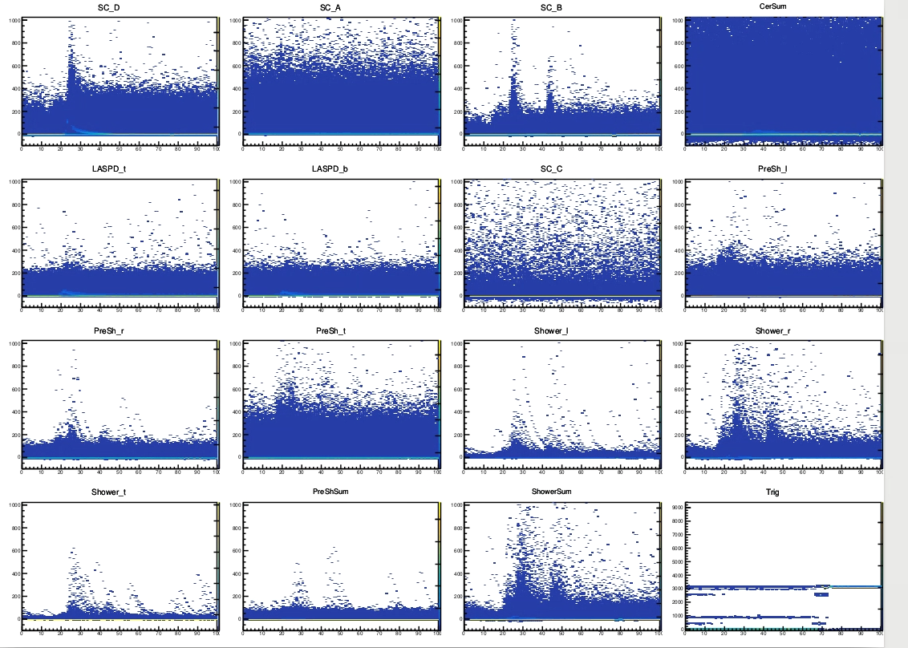
2uA CW beam on
Carbon hole.
Beam scraped the beam pipe

Slide 18
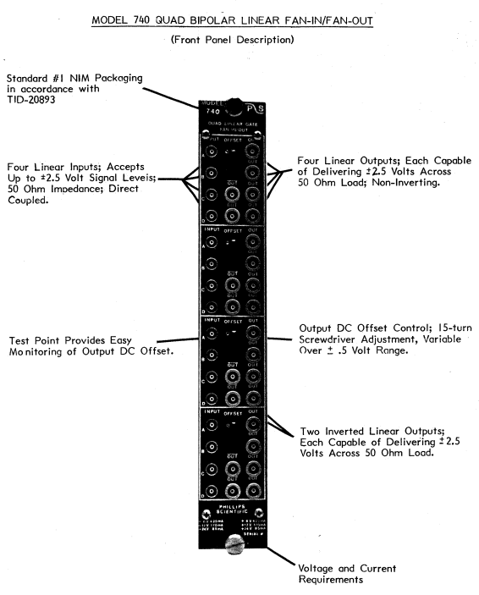
CAEN N625

