Slide 1
Trigger Design for The High-Rate Beam Test in Hall C
Jixie Zhang

Slide 2
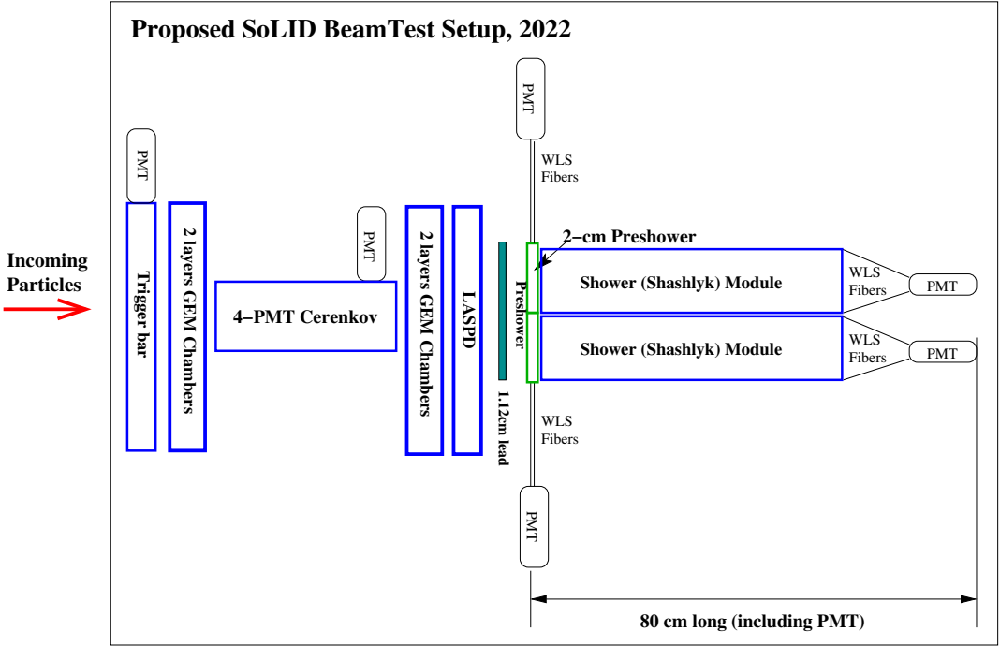
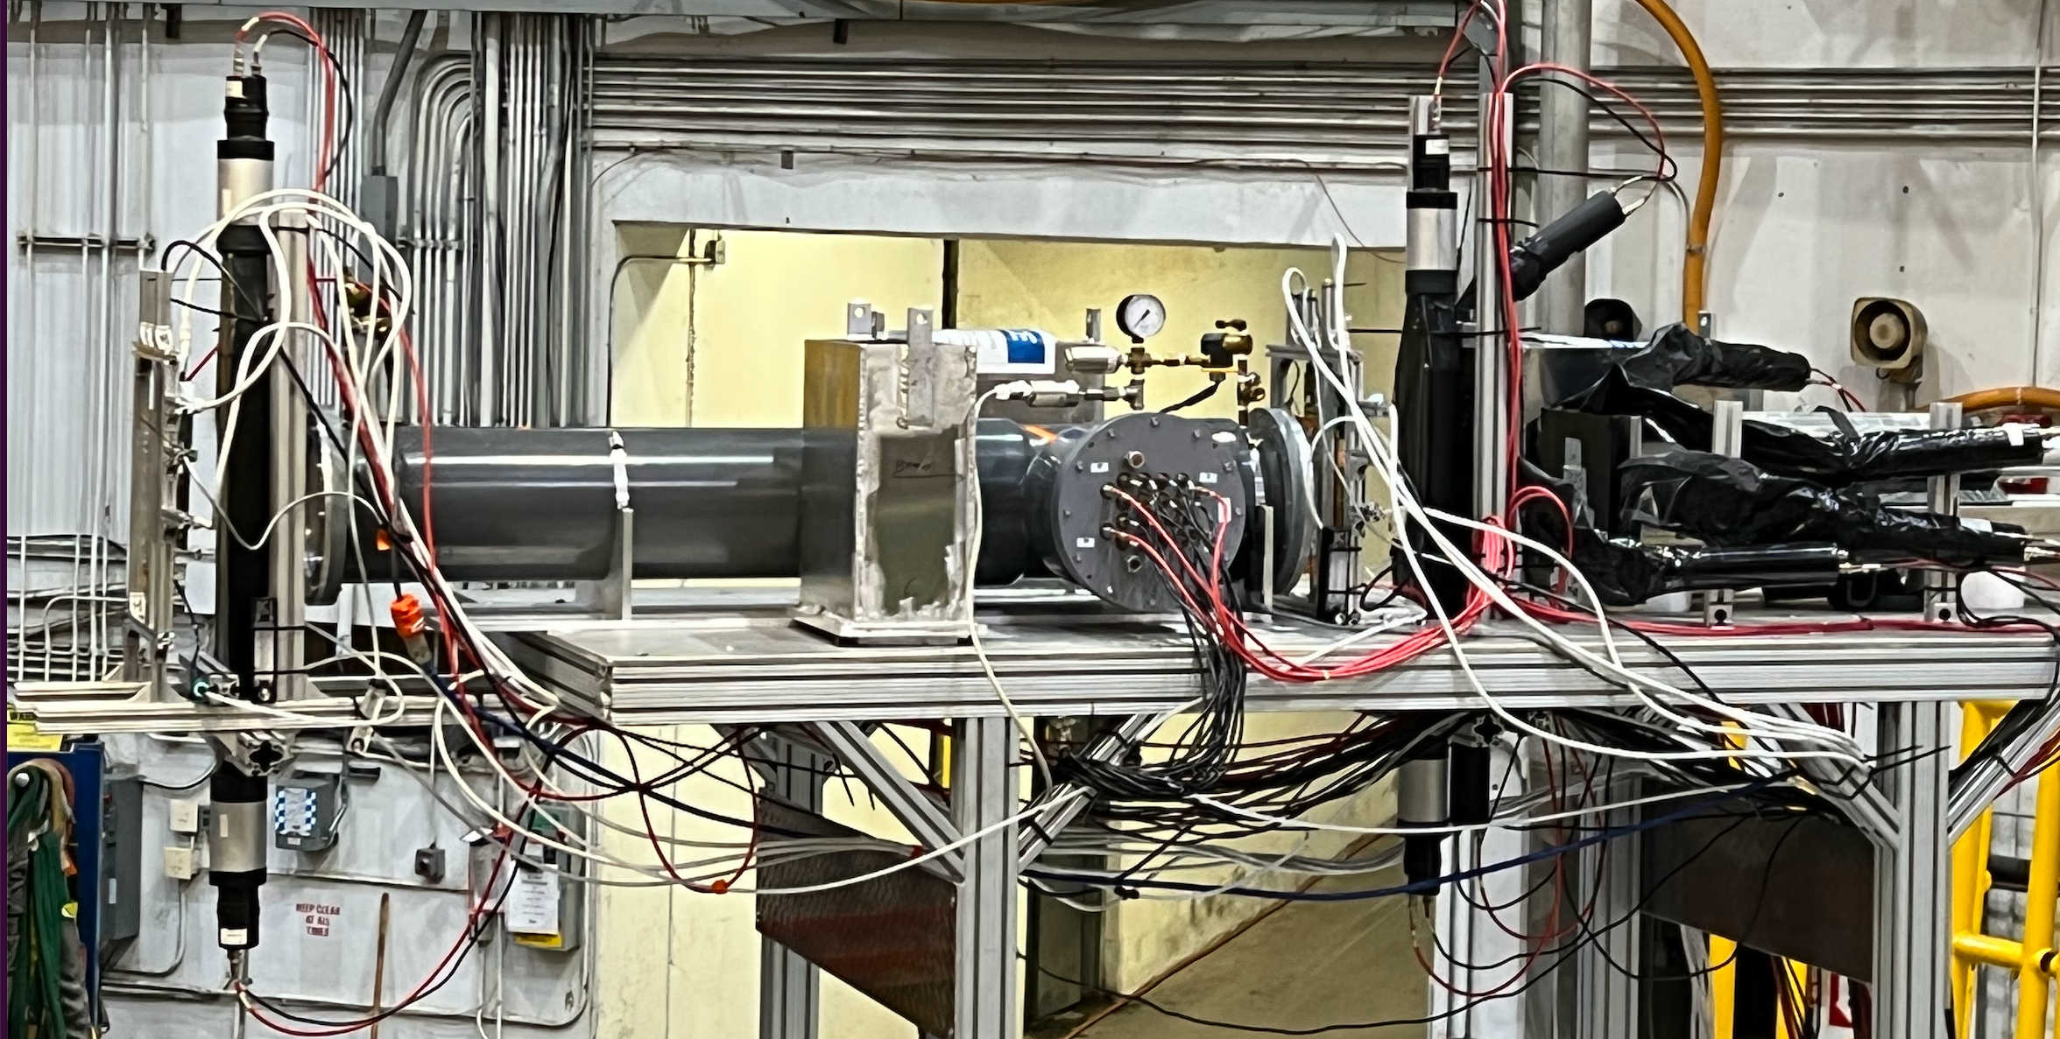

Slide 3
Low rate trigger setup (Hall C beam-left 82.2 deg)
sideview
frontview
frontview
top PMT
top PMT
and
and
Trigger Type 2 (bit 010)
Trigger Type 1 (bit 001)
and
and
Cherenkov
(length not to scale)
Preshower
Shower
top
top
GEM
GEM
SPDs
Preshower
Shower
left
right
left
right
sum of 3 shower blocks
table
bottom PMT
bottom PMT
SC0
SC1
Trigger Type 3 (bit 100)
All discriminator threshold is around 18.2 mV

Slide 4
High rate 7 deg detector layout (Hall C beam-right 7 deg)
sideview
frontview
frontview
top
PreShower
Shower
(not to scale)
Preshower
Shower
Cherenkov
(length not to scale)
top
LASPD
GEM
GEM
left
right
left
right
SC_A
SC_C
SC_D
SC_B
SC_B
sum of 3 shower blocks
table
List of Detectors (From upstream to downstream):
GEM_00, GEM01;
SC_A (5cm (x) x 7.5cm(y) x 1cm), Cherenkov;
GEM_10,GEM_11;
SC_C (trapezoid shape: 3.5cm wide top side (at end tip, in hall y direction) and 5.5cm wide bottom side (connected to light guide), 18cm height (in hall x direction), 2cm thick);
LASPD, SC_D (Kedi-6 preshower tile, 6.35cm side length hexagon, 2cm thick);
PreShower: Preshower_T(SDU#2), Preshower_left(SDU#1), Preshower_right(THU#1);
Shower: Shower_T(SDU#5), Shower_L(SDU#4), Shower_R(THU#4);
SC_B: (5cm(x) x 10cm(y) x 1cm)

Slide 5
High rate 18 deg detector layout (Hall C beam-right 18 deg)
sideview
frontview
frontview
top
PreShower
Shower
(not to scale)
Preshower
Shower
Cherenkov
(length not to scale)
top
LASPD
GEM
GEM
left
right
left
right
SC_A
SC_C
SC_D
SC_B
SC_B
sum of 3 shower blocks
table
List of Detectors (From upstream to downstream):
GEM_00, GEM01;
SC_A (5cm (x) x 7.5cm(y) x 1cm), Cherenkov;
GEM_10,GEM_11;
SC_C (trapezoid shape: 3.5cm wide top side (at end tip, in hall y direction) and 5.5cm wide bottom side (connected to light guide), 18cm height (in hall x direction), 2cm thick);
LASPD, SC_D (Kedi-6 preshower tile, 6.35cm side length hexagon, 2cm thick);
PreShower: Preshower_T(SDU#2), Preshower_left(SDU#1), Preshower_right(THU#1);
Shower: Shower_T(SDU#5), Shower_L(SDU#4), Shower_R(THU#4);
SC_B: (5cm(x) x 10cm(y) x 1cm)

Slide 6
High rate (current) detector layout (Hall C beam-right 18 deg)
sideview
frontview
frontview
Trigger Type 1 (bit 001)
Trigger Type 2 (bit 010)
and
and
top
PreShower
Shower
(not to scale)
Preshower
Shower
Cherenkov
(length not to scale)
top
LASPD
GEM
GEM
left
right
left
right
SC_A
SC_C
SC_D
SC_B
SC_B
sum of 3 shower blocks
table
List of Detectors (From upstream to downstream):
GEM_00, GEM01;
SC_A (5cm (x) x 7.5cm(y) x 1cm), Cherenkov;
GEM_10,GEM_11;
SC_C (trapezoid shape: 3.5cm wide top side (at end tip, in hall y direction) and 5.5cm wide bottom side (connected to light guide), 18cm height (in hall x direction), 2cm thick);
LASPD, SC_D (Kedi-6 preshower tile, 6.35cm side length hexagon, 2cm thick);
PreShower: Preshower_T(SDU#2), Preshower_left(SDU#1), Preshower_right(THU#1);
Shower: Shower_T(SDU#5), Shower_L(SDU#4), Shower_R(THU#4);
SC_B: (5cm(x) x 10cm(y) x 1cm)
and
and
Trigger Type 3
(bit 100)

Slide 7
High rate trigger type 1: primary electron trigger (sum_cer & sum_shower)
All inputs are after x10 amplifier
Cherenkov_sum
All 16 Cherenkov MaPMT channels (after x10 amplifier) go to one FADC board
cer_0,1,2,3
Sum/FIFO_0(0)
Sum
FIF0_1(3)
cer_4,5,6,7
Sum/FIFO_0(1)
cer_8,9,10,11
DS_0(1)
Sum/FIFO_0(2)
cer_12,13,14,15
DS_0(2)
Logic_0(1)
“and”
Sum/FIFO_0(3)
TI_0(1)
FADC_1 (10,11,12)
sh_l
FIFO_2(0)
Sum
FIFO_2(3)
sh_r
DS_0(3)
NOT USE
FIFO_2(1)
sh_t
DS_0(4)
FIFO_2(2)
DS_0(14)
Go to trigger type 4
Shower_sum
Separate each DSC channel for different threshold control to each trigger type

Slide 8
High rate trigger type 2: pion trigger (scintillators …)
FADC_1(2,0)
Logic_0(2)
“and”
(behind shower)
SC_B
FIFO_3(0)
TI_0(2)
DS_0(6)
SC_D
FIFO_3(1)
DS_0(7)
DS_0(8)
Go to trigger type 3
FADC_1 (7,8,9)
FADC_1 (13)
PreSh_0
Sum
FIFO_4(3)
FIFO_4(0)
PreSh_1
FIFO_4(1)
DS_0(9)
PreSh_2
FIFO_4(2)

Slide 9
High rate trigger type 3:
FADC_1(1)
Logic_0(3)
“and”
SC_A
SC_A,
DS_0(5)
TI_0(3)
FIFO_3(0)
SC_D,
DS_0(8)

Slide 10
High rate trigger type 4,6:
Shower_sum,
DS_0(14)
TI_0(4)
FADC Slot7,
2 out of 15
TI_0(6)
TS6 is about 240ns time later than trigger type 1-4. Tt can not replace Cherenkov sum before aligning trigger type 1-4 to it.

Slide 11
Back up

Slide 12
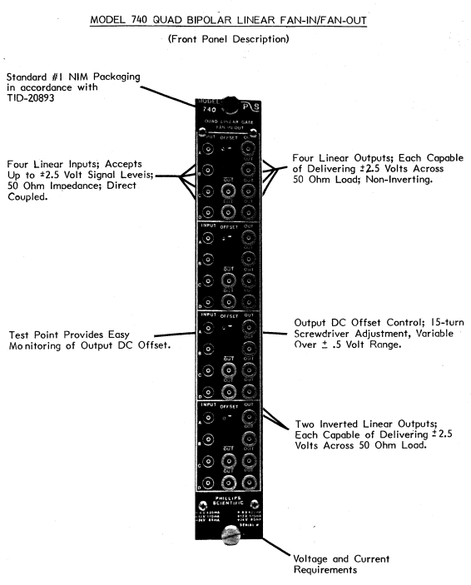
CAEN N625

