Slide 1
SHMS Defocused Hodoscope Calibration
Pion LT Analysis Meeting
Jacob Murphy

Slide 2
Run 11799 Calibration
Defocused run taken at start of experiment September 2021
TW and Velocity parameters used in replay of later runs
Compared to ‘Focused’ Runs, where parameters are found by calibrating that run
Quantitative measure of calibration effectiveness: Beta’s sigma
According to Dave M., beta’s sigma should be around 0.028
This value uses known separation of planes and paddle time resolution
Best value achieved in calibration fit (by Dave M.) was sigma of 0.0529
Current fitting method I implement is rough estimate
May need gaussian background added to fit

Slide 3
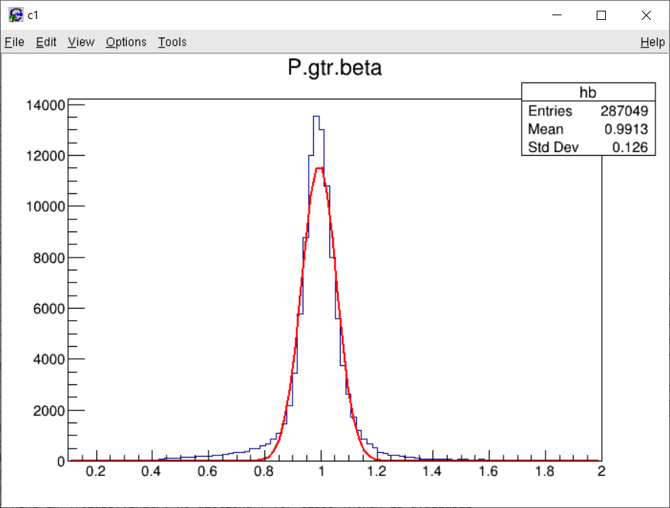
Defocused 14050 Focused
NO. NAME VALUE ERROR SIZE DERIVATIVE
1 Constant 1.18078e+04 5.59337e+01 -4.48507e-01 5.48039e-06
2 Mean 9.81781e-01 2.03772e-04 -1.82033e-07 -7.71369e-01
3 Sigma 6.39686e-02 2.25288e-04 2.91462e-06 3.53212e-02
NO. NAME VALUE ERROR SIZE DERIVATIVE
1 Constant 1.16479e+04 5.62577e+01 1.98552e+00 -2.03809e-06
2 Mean 9.93639e-01 2.02114e-04 1.05809e-05 1.41787e-01
3 Sigma 6.20702e-02 2.22347e-04 2.86950e-05 -9.92202e-02

Slide 4
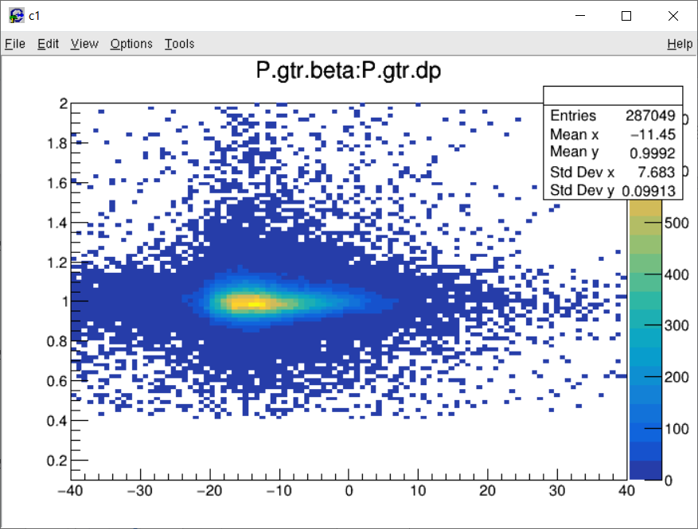
Defocused 14050 Focused

Slide 5
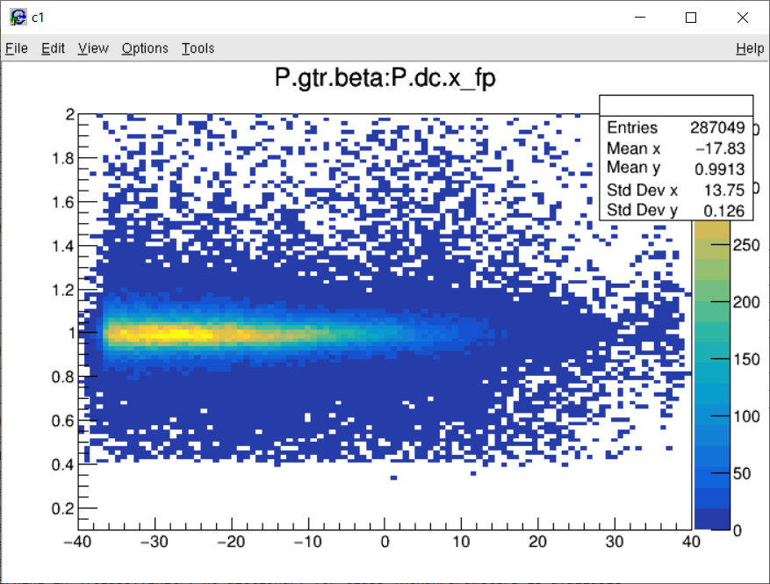
Defocused 14050 Focused

Slide 6
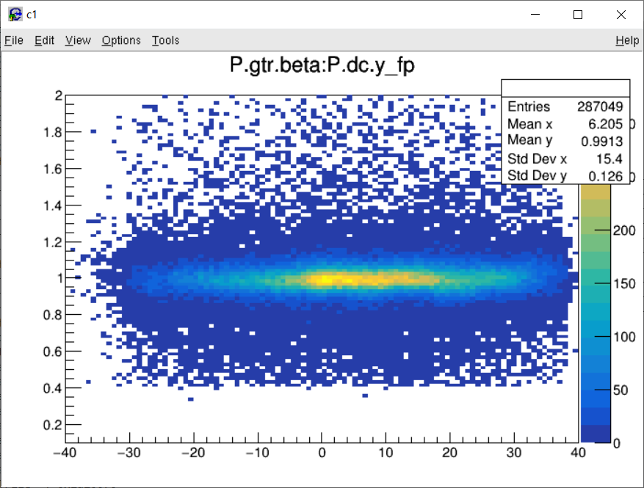
Defocused 14050 Focused

Slide 7
Extra Slides

Slide 8
Current Hodoscope Param Files
Run | Beam Energy | Kinematic | Date | HMS/SHMS? | Comment
11799 | 9.2 | Beam Checkout | 21/09/07 | SHMS | Defocused
12055 | 9.2 | Q2 1.6, W 3.08, Center | 21/09/15 | SHMS | Focused
13030 | 9.2 | Q2 8.5, W2 2.79 | 21/11/04 | HMS and SHMS | Late in 9.2
13080 | 6 | Q2 3.85, W 2.02 | 21/11/08 | HMS and SHMS
13212 | 9.9 | Q2 3.85, W 3.07, Center | 21/11/12 | SHMS
13400 | 9.9 | Q2 6.0, W 3.19, Center | 21/11/21 | HMS and SHMS | Late in 9.9
14500 | 8 | Q2 5, W 2.95, Left | 22/01/24 | HMS and SHMS | Late in 8

Slide 9
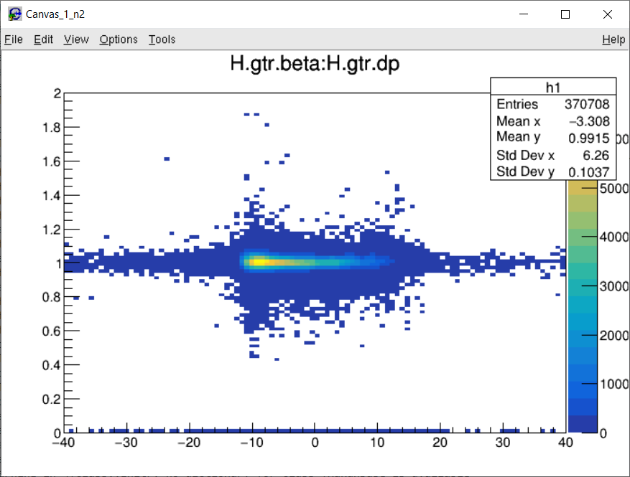
Run 13030 Beta vs Delta

Slide 10
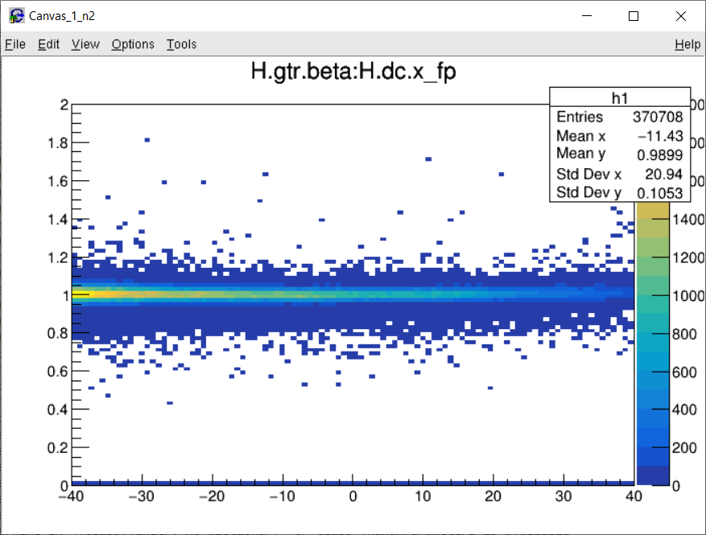
Run 13030 Beta vs Xfp

Slide 11
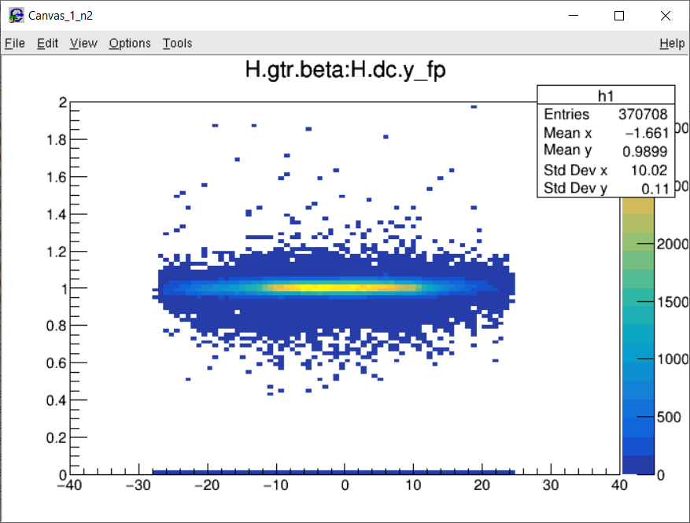
Run 13030 Beta vs Yfp

Slide 12
SHMS Hodoscope Calibrations
Calorimeter calibrations not in-place
Were not many calibrations during online running (maybe only initial, need to confirm)
Significant improvement in negative Delta/Xfp
Dave Mack and Carlos’ changes are apparent in these runs as well
Six completed calibrations
At least one per beam energy
13030, 13080, and 13400 (only new) are seen here

Slide 13
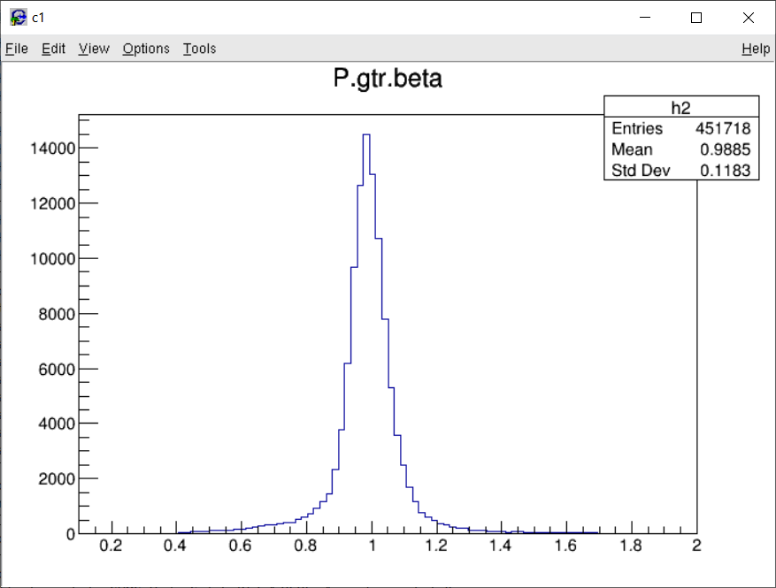
Run 13030 Beta

Slide 14
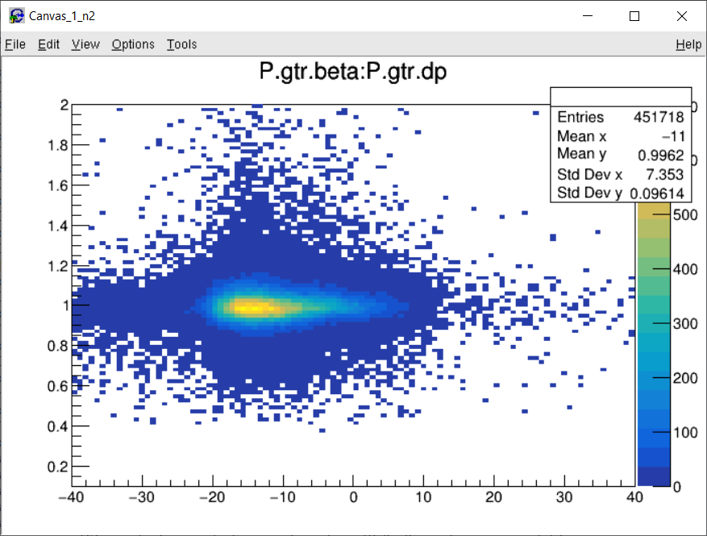
Run 13030 Beta vs Delta

Slide 15
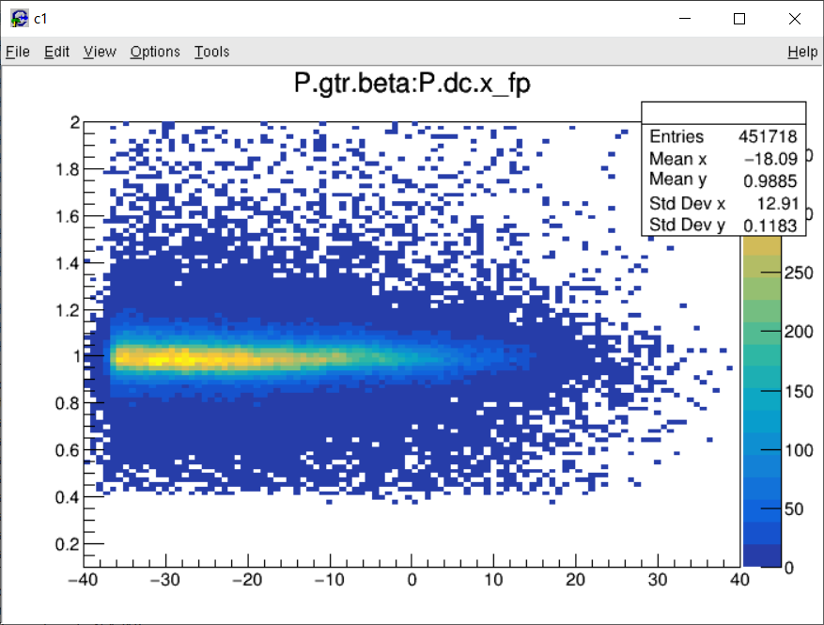
Run 13030 Beta vs X_fp

Slide 16
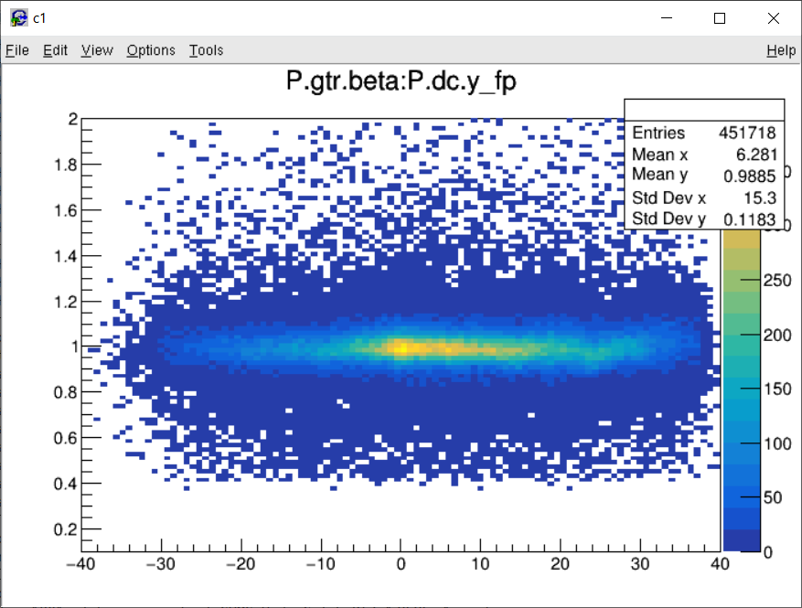
Run 13030 Beta vs Y_fp

Slide 17
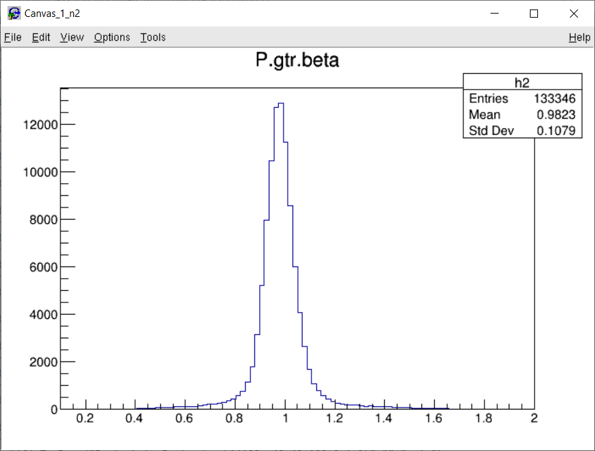
Run 13080 Beta

Slide 18
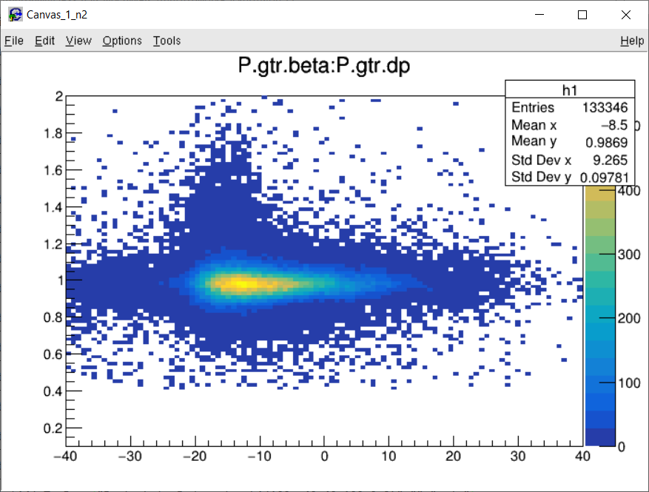
Run 13080 Beta vs Delta

Slide 19
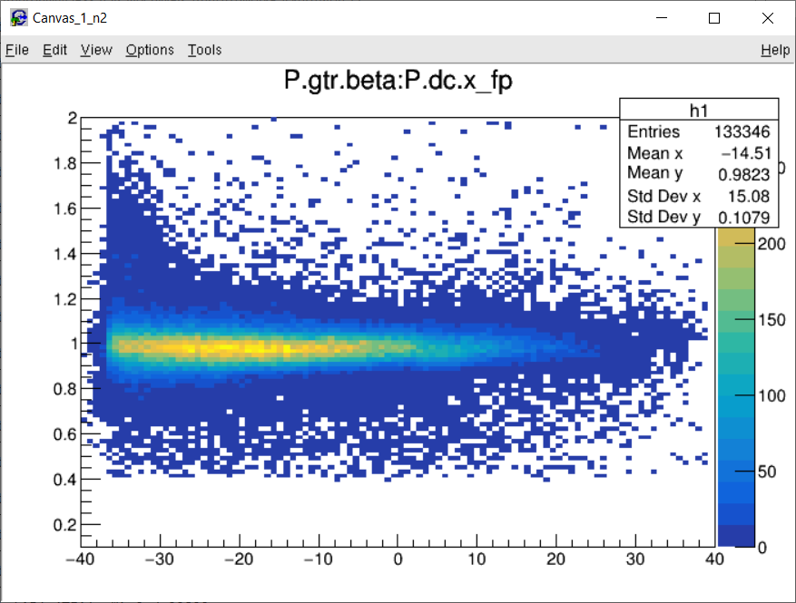
Run 13080 Beta vs X_fp

Slide 20
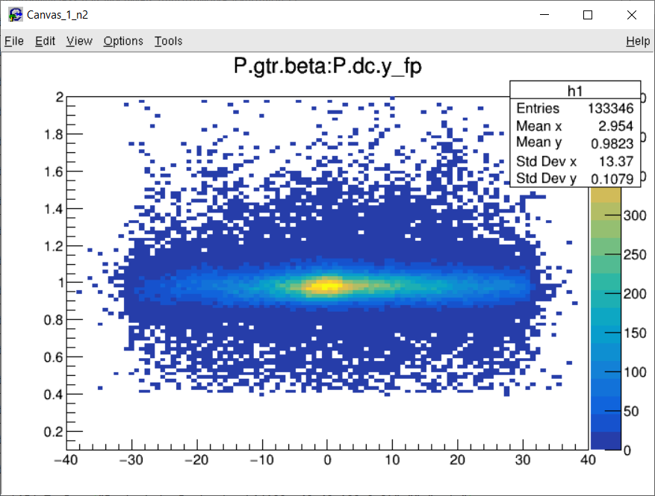
Run 13080 Beta vs Y_fp

Slide 21
Run 13400 Beta

Slide 22
Run 13400 Beta vs Delta

Slide 23
Run 13400 Beta vs X_fp

Slide 24
Run 13400 Beta vs Y_fp

