Slide 1
Hodoscope Calibration Update
Pion LT Analysis Meeting
Jacob Murphy

Slide 2
Hodoscope Analysis Batch Script
Now running with most recent hodoscope calibration scripts
Will push to farm this afternoon
Note only SHMS calibration has changed at present
Set to run from user’s directory rather than online analysis
Can be adjusted by switching out a commented line
Run periods are a work in-progress
Currently have custom database script for all runs after 11823
Database from online has ~6 different run periods for different HMS calorimeter calibrations
Junaid, Nathan, and myself will need to work out how often we need new param files

Slide 3
Current Hodoscope Param Files
Run | Beam Energy | Kinematic | Date | HMS/SHMS? | Comment
11799 | 9.2 | Beam Checkout | 21/09/07 | SHMS | Defocused, might be old
12055 | 9.2 | Q2 1.6, W 3.08, Center | 21/09/15 | SHMS | Focused
13030 | 9.2 | Q2 8.5, W2 2.79 | 21/11/04 | HMS and SHMS | Late in 9.2
13080 | 6 | Q2 3.85, W 2.02 | 21/11/08 | HMS and SHMS
13212 | 9.9 | Q2 3.85, W 3.07, Center | 21/11/12 | SHMS
13400 | 9.9 | Q2 6.0, W 3.19, Center | 21/11/21 | HMS and SHMS | Late in 9.9
14500 | 8 | Q2 5, W 2.95, Left | 22/01/24 | HMS and SHMS | Late in 8

Slide 4
HMS Hodoscope Calibrations
At present, do not point to correct calorimeter param file
This affects the calorimeter cuts in both the time-walk and velocity calibrations
Not expecting major improvements
Calibration during online running was solid
Four completed calibrations
One per beam energy
Only 9.2 (13030) plots seen here
Beta vs Xfp is odd, does not match live plots
Will investigate further

Slide 5
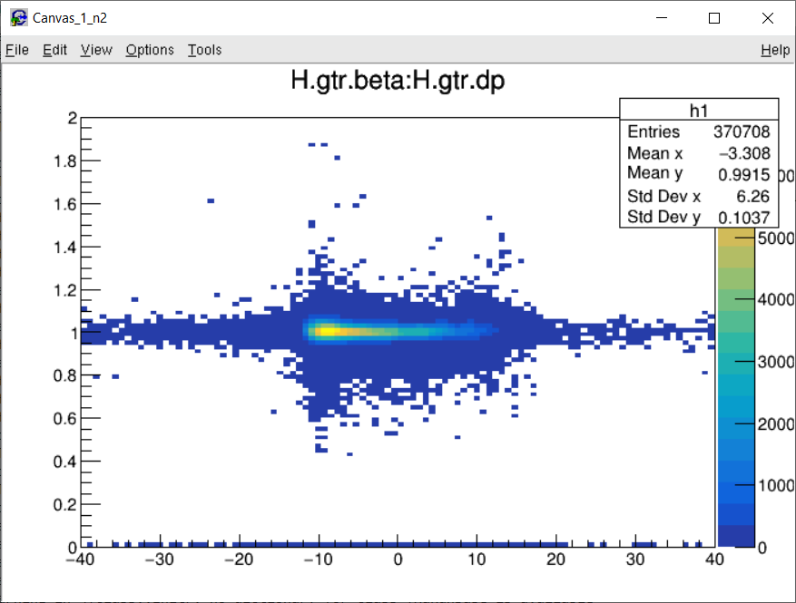
Run 13030 Beta vs Delta

Slide 6
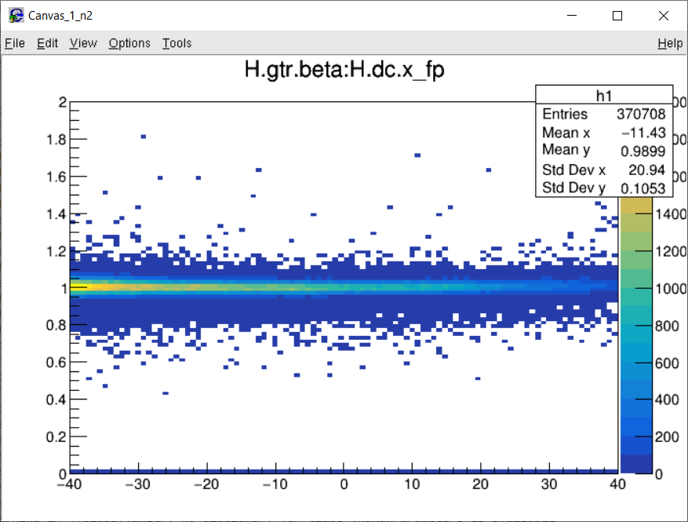
Run 13030 Beta vs Xfp

Slide 7
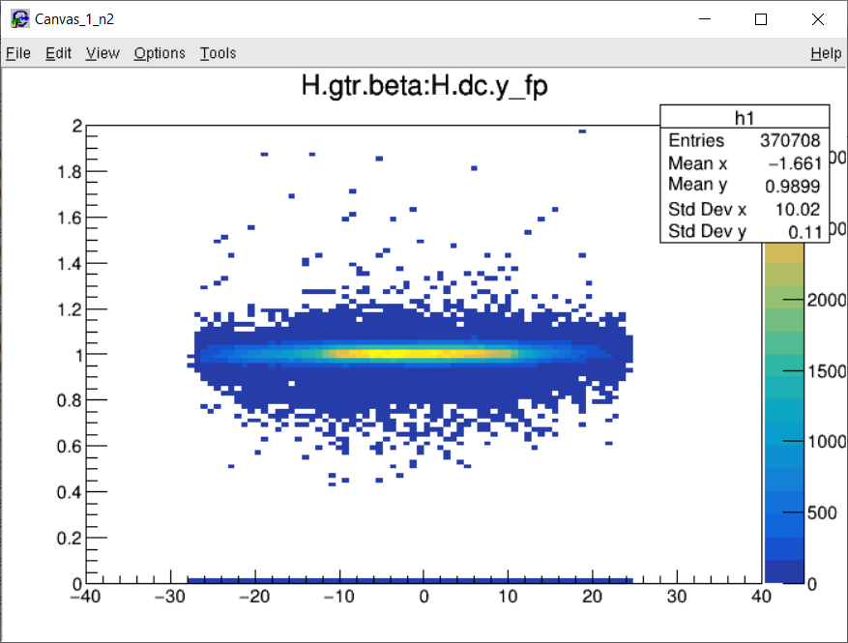
Run 13030 Beta vs Yfp

Slide 8
SHMS Hodoscope Calibrations
Calorimeter calibrations not in-place
Were not many calibrations during online running (maybe only initial, need to confirm)
Significant improvement in negative Delta/Xfp
Dave Mack and Carlos’ changes are apparent in these runs as well
Six completed calibrations
At least one per beam energy
13030, 13080, and 13400 (only new) are seen here

Slide 9
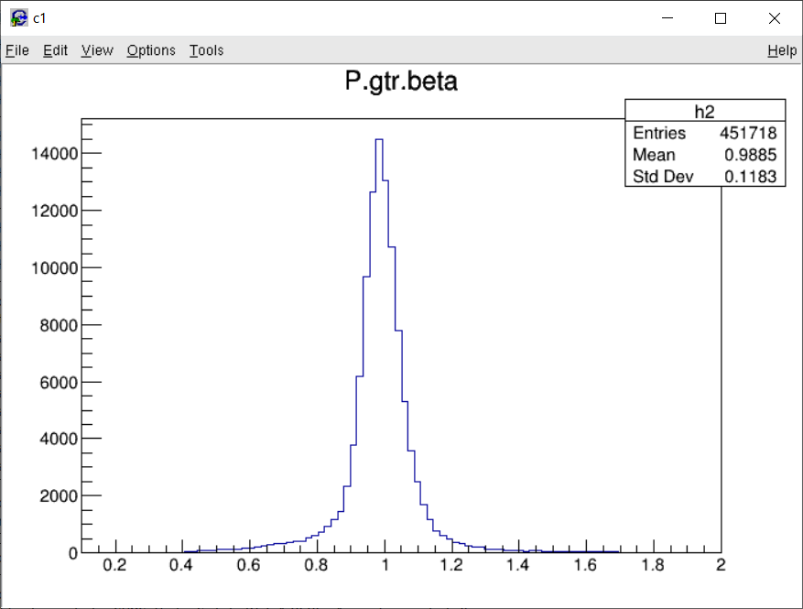
Run 13030 Beta

Slide 10
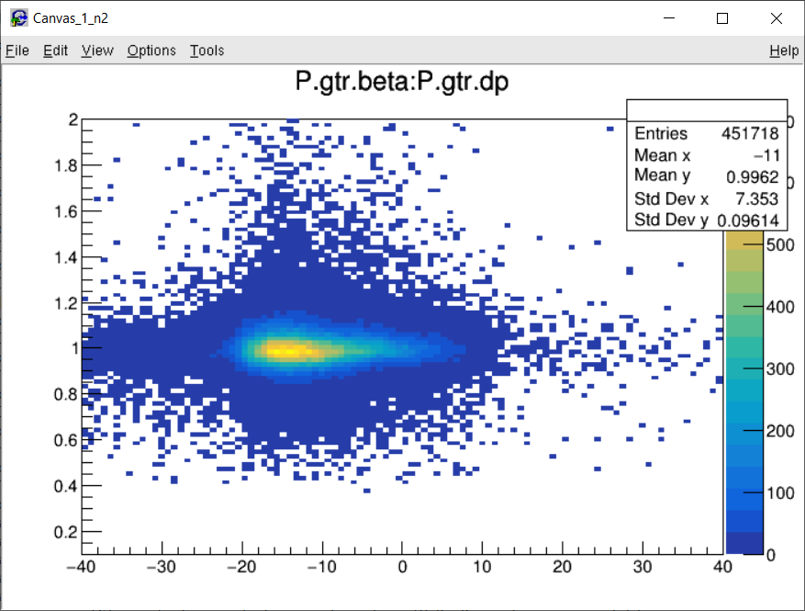
Run 13030 Beta vs Delta

Slide 11
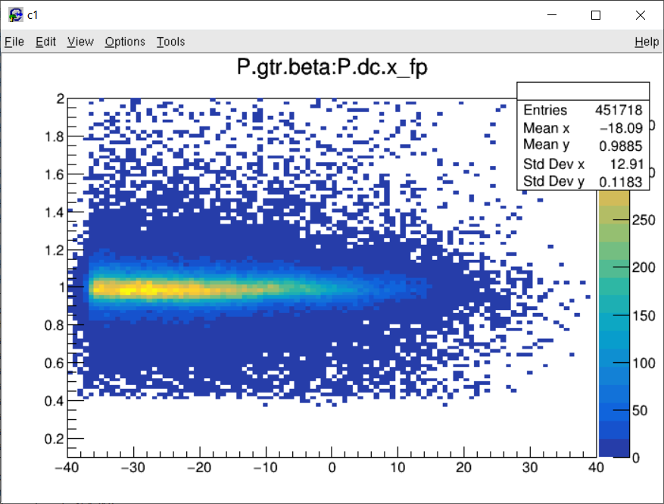
Run 13030 Beta vs X_fp

Slide 12
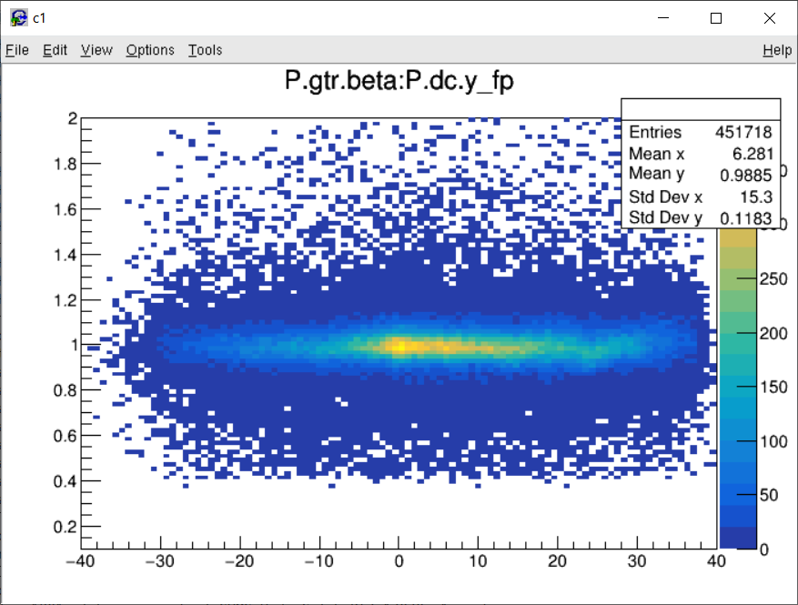
Run 13030 Beta vs Y_fp

Slide 13
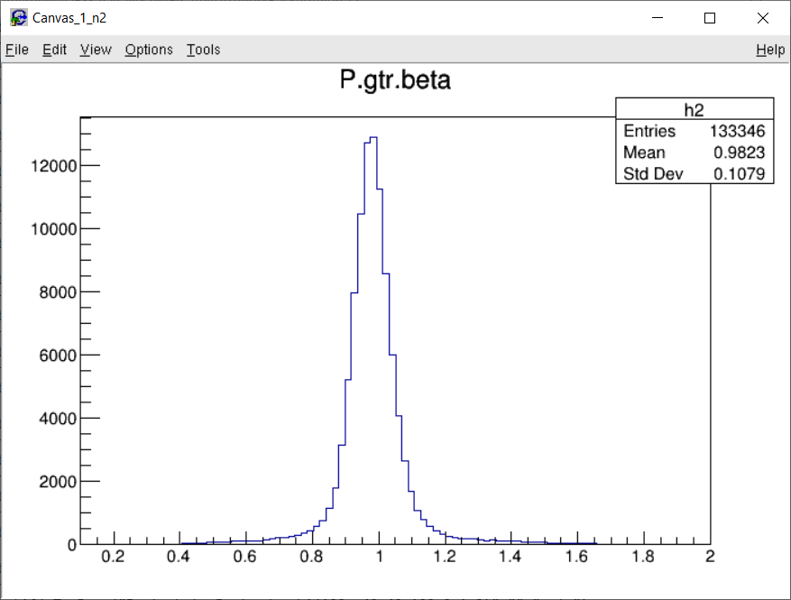
Run 13080 Beta

Slide 14
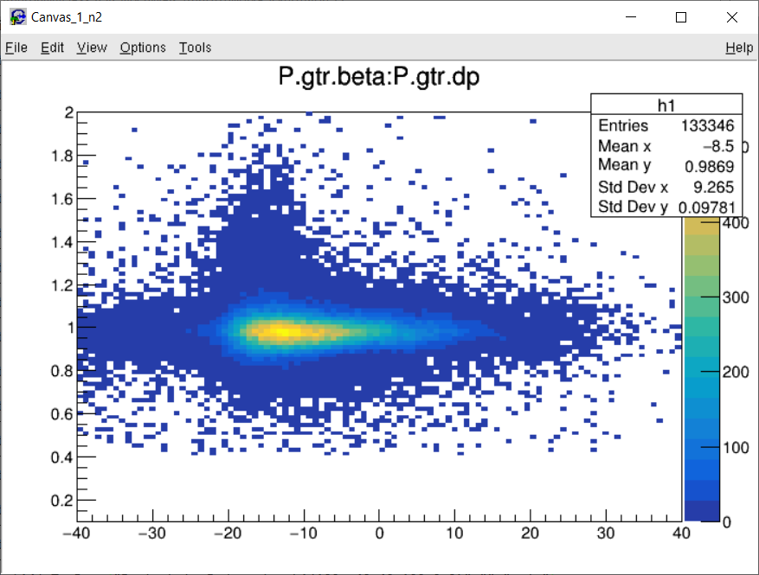
Run 13080 Beta vs Delta

Slide 15
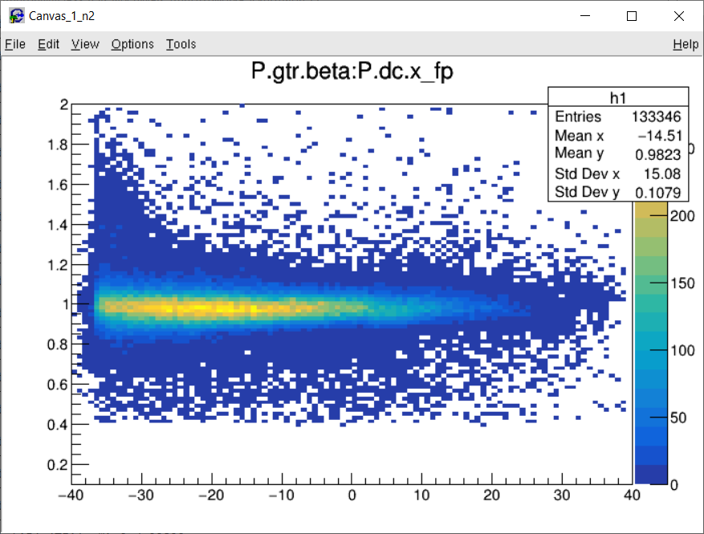
Run 13080 Beta vs X_fp

Slide 16
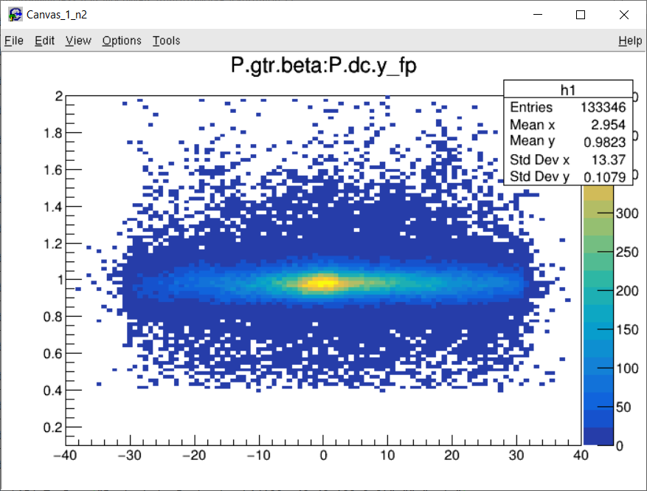
Run 13080 Beta vs Y_fp

Slide 17
Run 13400 Beta

Slide 18
Run 13400 Beta vs Delta

Slide 19
Run 13400 Beta vs X_fp

Slide 20
Run 13400 Beta vs Y_fp

