Slide 1
New SHMS Hodoscope Calibrations: Run 12055
04/19/2022

Slide 2
Calibration Changes
Hard-cut on paddle offsets adjusted by Dave Mack
MAJOR fix
New velocity constraints implemented by Carlos Yero
Time Walk tdc Threshold Parameter raised
High-end beta-tail improvement
Also can be implemented with HMS

Slide 3
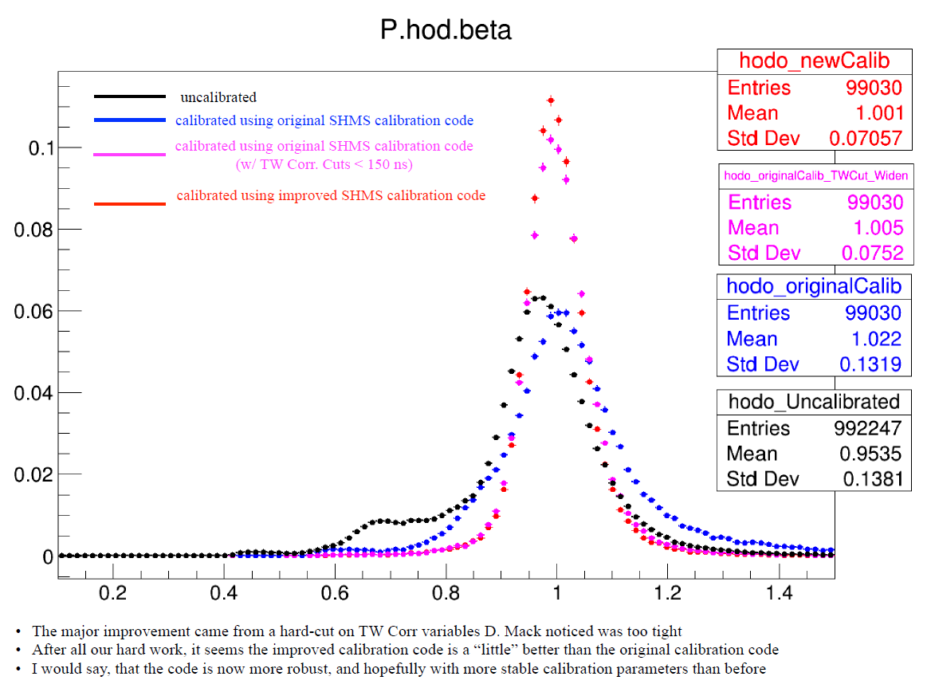
Carlos’ Summary Plot

Slide 4
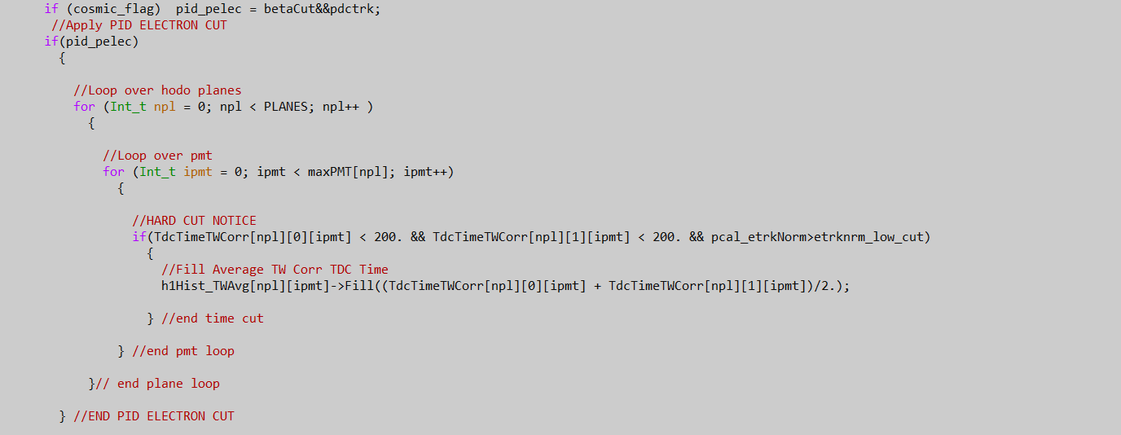
Paddle Offset Hard Cut Adjustment in in fitHodoCalib.C
Cut changed from 100 to 200

Slide 5
Dave’s Graphic on the Old Hard Cuts

Slide 6
Velocity Constraints in fitHodoCalib.C

Slide 7
Velocity Params Old

Slide 8
Velocity Params New

Slide 9
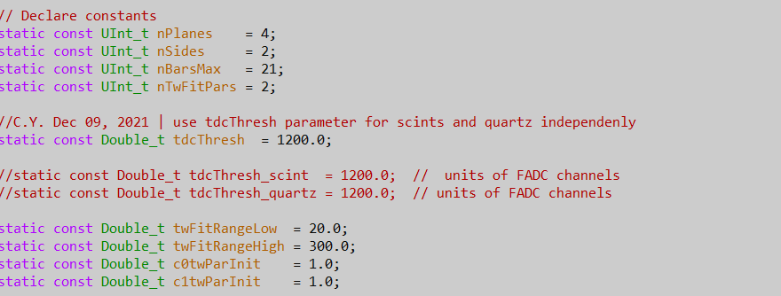
Raised TDC Threshold Fit Parameter in timewalkCalib.C
120->1200

Slide 10
Delta Old Calibration

Slide 11
Delta New Calibration

Slide 12
Xfp Old Calibration

Slide 13
Xfp New Calibration

Slide 14
Yfp Old Calibration

Slide 15
Yfp New Calibration

