Slide 1
Discussion of the Charges Pt. II
Elena Long
Tensor Conditionals Review
August 1st, 2022

Slide 2
Answer to Charge #2.2
What crosschecks or auxiliary measurements can be made to validate the results?
Extraction from $T_{20}$ @ gives $δP_{zz}≈10\%$(rel)
$Q^{2}=0.2 {GeV}^{2}/c^{2}$
Independent UNH extraction of $P_{zz}$ from NMR lineshape agrees w/ UVA method
Same method as C Zhang^{[1]}
$δP_{zz}=5.8−6.8\%$ (rel)
for very similar $Q^{2}$
^{[1]}C Zhang, et al, PRL 107 252501 (2011)

Slide 3
Answer to Charge #2.3
Will this uncertainty be sufficient to achieve meaningful physics results?
Yes!
Proposals (post-PAC condition):
$b_{1}:30\%±8\% (rel)$
$A_{zz} \& T_{20}:30\%±6\% (rel)$
Current target status:
ssRF: $\sim 30\%±7\% (rel)$

Slide 4
Answer to Charges #3.1 & #4.1
What assumptions are made regarding the vector polarization of the target? What is the current experimental situation?
Integrating over +/- vector pol. suppresses drift systematics
Also removes model dependence for diluting asymmetries
Flipping $P_{zz}$ multiple times per hour is possible
Further suppresses systematics

Slide 5
$P_{zz}$ Extraction from Elastic Scattering
Charge #2.2

Slide 6
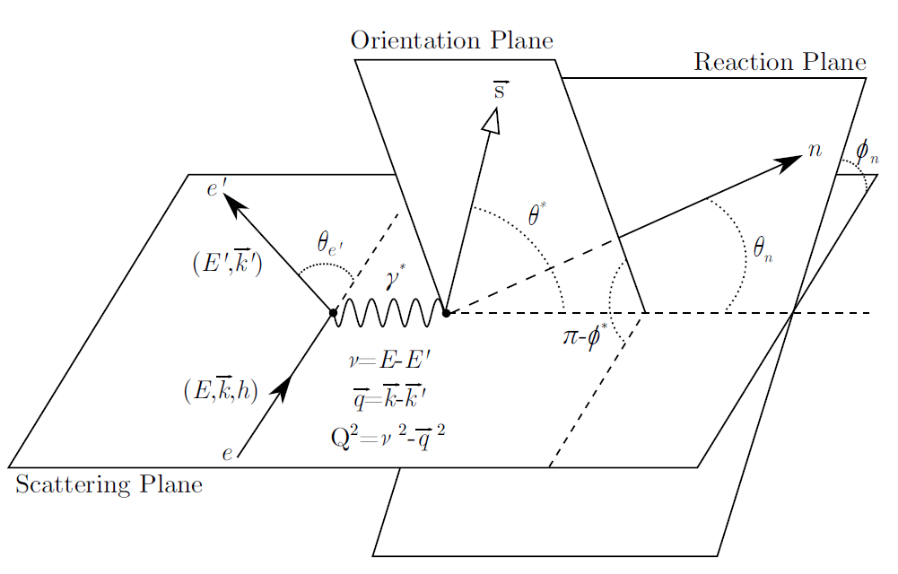
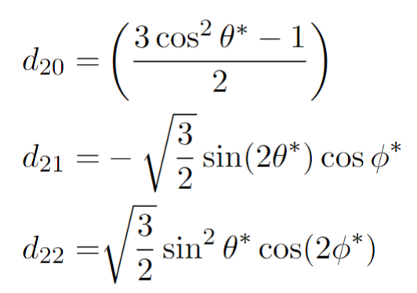
Crosschecks (#2.2): $P_{zz}$ from Scattering
The elastic cross-section can be used to extract the tensor polarization independently from NMR extraction
# Events w/ $P_{zz}>0$
Dilution factor
# Events w/ $P_{zz}=0$
At $Q^{2}=0.17 {(GeV/c)}^{2},$
$$θ^{∗}=78.8°±1.25°$$
$$φ^{∗}=0°±2.86°$$
Polarization oriented
along beamline
Previously measured observables
(Well-known at low $Q^{2}$)

Slide 7
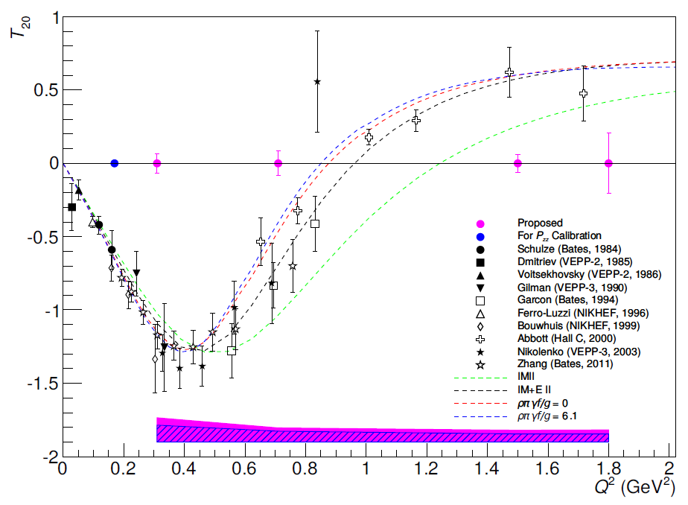
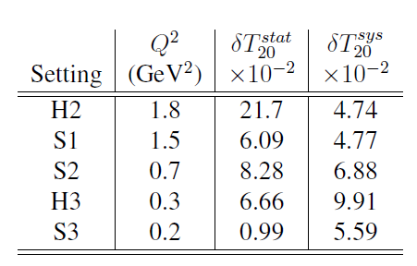
Crosschecks (#2.2): $P_{zz}$ from Scattering
$$N_{Q}=1.29×{10}^{7}$$
$$N_{0}=1.23×{10}^{7}$$
Assuming $P_{zz}=30\%$

Slide 8
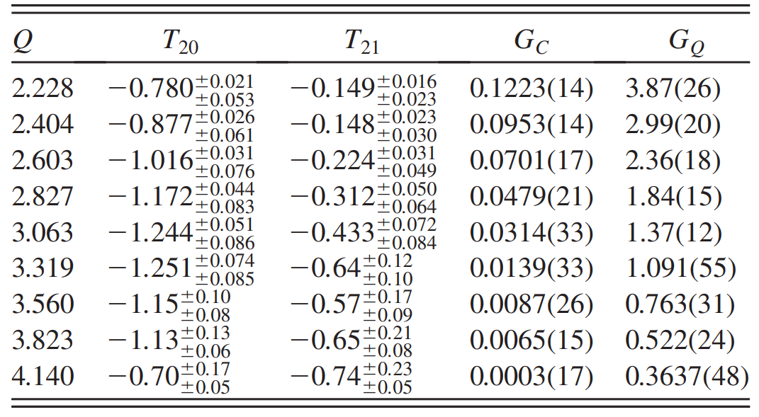
Crosschecks (#2.2): $P_{zz}$ from Scattering
At $Q^{2}=0.17 {GeV}^{2}$,
$Q=\frac{\sqrt{0.17 {GeV}^{2}}}{0.197 GeV∙fm}=2.09 {fm}^{−1}$
$T_{20}=−0.78±0.06$ (7.7%)
Can shrink to ~5% w/ parameterization as in Zhang, et al.
$Q^{2} ({GeV}^{2})$ (fm)
0.193
0.225
C Zhang, et al, PRL 107 252501 (2011)

Slide 9
Crosschecks (#2.2): $P_{zz}$ from Scattering
At $Q^{2}=0.17 {GeV}^{2}$,
$Q=\frac{\sqrt{0.17 {GeV}^{2}}}{0.197 GeV∙fm}=2.09 {fm}^{−1}$
$T_{21}=−0.15±0.03$ (20%)
Can shrink to ~5% w/ parameterization as in Zhang, et al.
$Q^{2} ({GeV}^{2})$ (fm)
0.193
0.225
C Zhang, et al, PRL 107 252501 (2011)

Slide 10
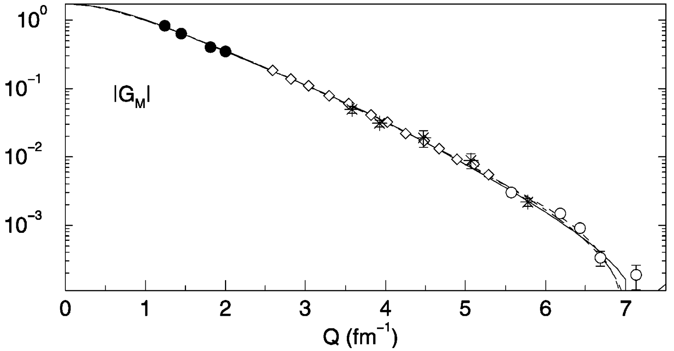
Crosschecks (#2.2): $P_{zz}$ from Scattering
$T_{22}$ strongly dependent on $G_{M}$, which is more cleanly extracted from $B$ form factor
At $Q^{2}=0.17 {GeV}^{2}$,
$Q=\frac{\sqrt{0.17 {GeV}^{2}}}{0.197 GeV∙fm}=2.09 {fm}^{−1}$
$T_{22}=−0.011±0.001$ (10%)
Can shrink to ~5% w/ parameterization as in Zhang, et al.
D Abbot, et al, Eur. Phys. J. A 7 421 (2000)

Slide 11
Crosschecks (#2.2): $P_{zz}$ from Scattering – Previous Data Only
Using values mentioned & $P_{zz}=30\%$, the relative $P_{zz}$uncertainty from elastic scattering is 12.68%
Similar rel. uncertainty in range $1\%<P_{zz}<100\%$
(Using $Q=P_{zz}$ for easier notation)
2.5%
1.05% 12.64%
10.13% 5.36% 0.45%
3.73% 2.82% 0.04%

Slide 12
Crosschecks (#2.2): $P_{zz}$ from Scattering – Parameterized
Using values mentioned & $P_{zz}=30\%$, the relative $P_{zz}$uncertainty from elastic scattering is 8.63%
Similar rel. uncertainty in range $1\%<P_{zz}<100\%$
(Using $Q=P_{zz}$ for easier notation)
2.5%
1.05% 8.57%
6.59% 1.34% 0.25%
3.73% 2.82% 0.04%

Slide 13
$P_{zz}$ from NMR Measurement Cross-Check
Charge #2.2

Slide 14
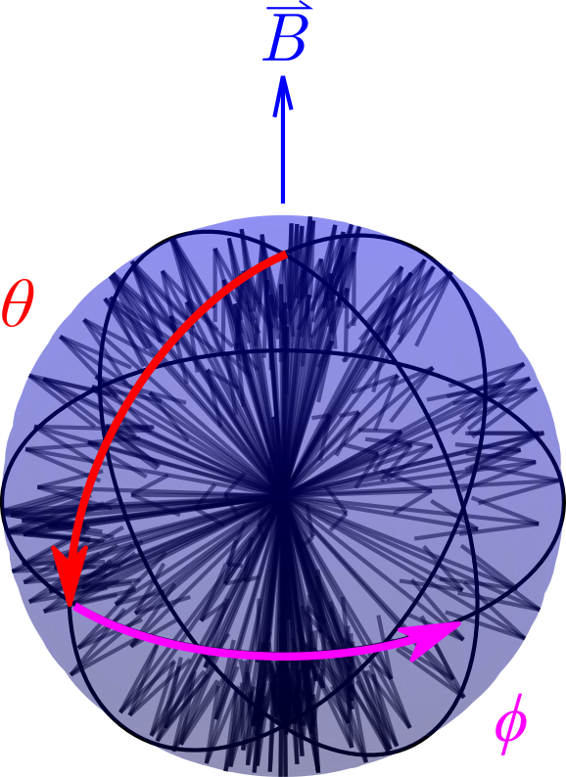
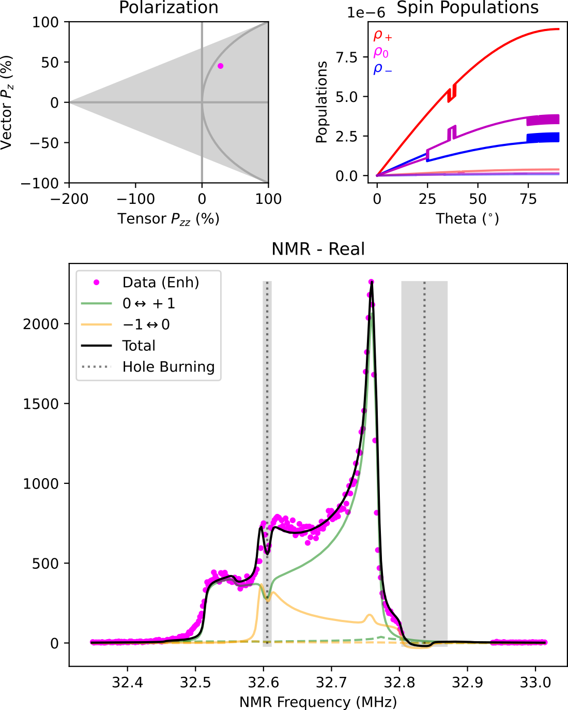
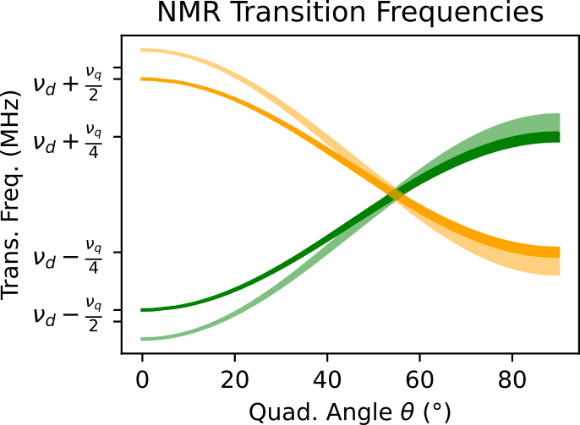
Crosschecks (#2.2): UNH NMR Cross-Check
M.H. Cohen, F. Reif, Solid State Phys. 5, 321 (1957)
UNH simulation based on modified Cohen & Reif
Calculates transition frequencies from energy levels
$E_{m}/h=−mν_{D}+\frac{1}{2}ν_{q}f_{0}^{H}\left(m^{2}−\frac{I(I+1)}{3}\right)$
$f_{0}^{H}=\frac{3}{2}\cos^{2}{θ}−\frac{1}{2}−\frac{1}{2}η\sin^{2}{θ}\cos{(2φ)}$
$I=1$ and $m=−1, 0, +1$
Assumes random powder pattern for $θ$ & counts spin flips across NMR frequency bins
Calculates ~125,000 spin flips into ~300 NMR bins
Spin flips determined by $P_{z}$ and $P_{zz}$, which can be independent in $θ \& φ$ bins to account for simple RF manipulation
Broadens each frequency bin into all others via real & imaginary Lorentzian
Allows phase angle extraction
Higher order spin diffusion not yet fully implemented
Simulation already agrees with UVA direct $P_{zz}$ measurement within experimental uncertainties, and we expect this agreement to further improve once spin diffusion is fully implemented
Preliminary

Slide 15
Physics Extraction
Charge #2.3

Slide 16
Physics Extraction (#2.3)
Proposal (Post-PAC) polarization uncertainty estimates:
$b_{1}:30\%±8\% (rel)$
$A_{zz} \& T_{20}:30\%±6\% (rel)$
Polarization uncertainty currently achieved:
ssRF-only: $\sim 30\%±7\% (rel)$
ssRF+AFP: $\sim 32\%±8.5\% (rel)$
ssRF+Rotation: $\sim 36\%±9.5\% (rel)$

Slide 17
$b_{1}$ Physics Extraction (#2.3) $$P_{zz}=30\% ±7\% (rel)$$
Effectively the same as PAC conditions
Drift mitigation will further reduce total uncertainty
(will be explained in a few slides)
Proposal
Update

Slide 18
$b_{1}$ Physics Extraction (#2.3) $$P_{zz}=36\% ±9.5\% (rel)$$
Proposal
Update

Slide 19
$A_{zz}$ Physics Extraction (#2.3) $$P_{zz}=30\% ±7\% (rel)$$
Proposal
Update

Slide 20
$A_{zz}$ Physics Extraction (#2.3) $$P_{zz}=36\% ±9.5\% (rel)$$
Proposal
Update

Slide 21
Measurement Helicity States
Charges #3.1 & 4.1

Slide 22
Helicity States (#3.1 & 4.1)
In the polarized deuteron cross section, there are four asymmetry terms
$h_{e}= \text{Electron} helicity$
$P=$ Vector polarization
$Q=$ Tensor polarization
Integrating electron helicity suppresses $A_{||}$ and $A_{T}^{ed}$
Switching between positive and negative vector polarizations and integrating suppresses $A_{V}^{d}$

Slide 23
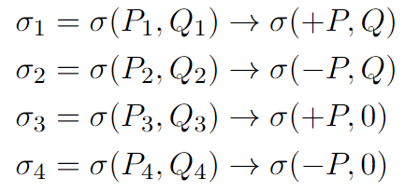
Helicity States (#3.1 & 4.1)
Advances in target development allow us to enhance or suppress the tensor polarization ($Q$) while maintaining either positive or negative vector polarization ($P$) multiple times per hour
We can measure
This further suppresses $A_{V}^{d}$ & highly suppresses drift effects on systematic uncertainty
Particularly important for $b_{1}$
$$σ_{Q}$$
$$A_{zz}=\frac{2}{fQ}\left(\frac{σ_{Q}−σ_{0}}{σ_{0}}\right)$$
$$σ_{0}$$
Proposal
Update
$$\frac{1}{\sqrt{N_{flips}}}→\sim \frac{1}{\sqrt{15}}→\sim \frac{1}{\sqrt{360}}$$
for $x=0.5$

Slide 24
Proposal/PAC $P_{zz}=30\% ±8\%$, $I=115 nA$
PAC40 condition values
$I=115 nA$
$P_{zz}=30\%±8\% (rel)$
Proposal

Slide 25
Update – Consistent $P_{zz}=30\% ±7\%$ $I=115 nA$
Figure of merit significantly improves from increased # of spin flip cycles
Update
Proposal
Update
$$\frac{1}{\sqrt{N_{flips}}}→\sim \frac{1}{\sqrt{15}}→\sim \frac{1}{\sqrt{360}}$$
for $x=0.5$

Slide 26
Update – Conservative $P_{zz}=26\% ±7\%$, $I=85 nA$
Reducing beam current to 85nA and $P_{zz}$ to 26% still gives slightly better figure of merit to PAC-approved total uncertainty
Update

Slide 27
Conclusions
Tensor Polarization Measurement Cross-Checks
2 independent methods of determining $P_{zz}$ from NMR data agree
Elastic $P_{zz}$ extraction from elastic data expected to have rel. uncertainty of $≲9\%$
Current tensor enhancement & measurement uncertainty very similar to proposed estimates
New development of tensor-state flipping ~few times/hour while maintaining +/- vector polarization greatly suppresses systematics well beyond estimates in original proposals

Slide 29
Backup

Slide 30
Measuring Polarization
For vector polarization,
$P_{z}=cc∙A_{NMR}=cc∙\left(I_{+}+I_{−}\right)$
For tensor polarization,
$P_{zz}=cc∙\left(I_{+}−I_{−}\right)$
Reducing $I_{−}$
Increases +$P_{zz}$
Line shape fits used to extract $I_{+}$ and $I_{−}$ area difference
D. Keller, et al., NIM A 981, 164504 (2020)
D. Keller, Eur. Phys. J. A 53, 155 (2017)

Slide 31
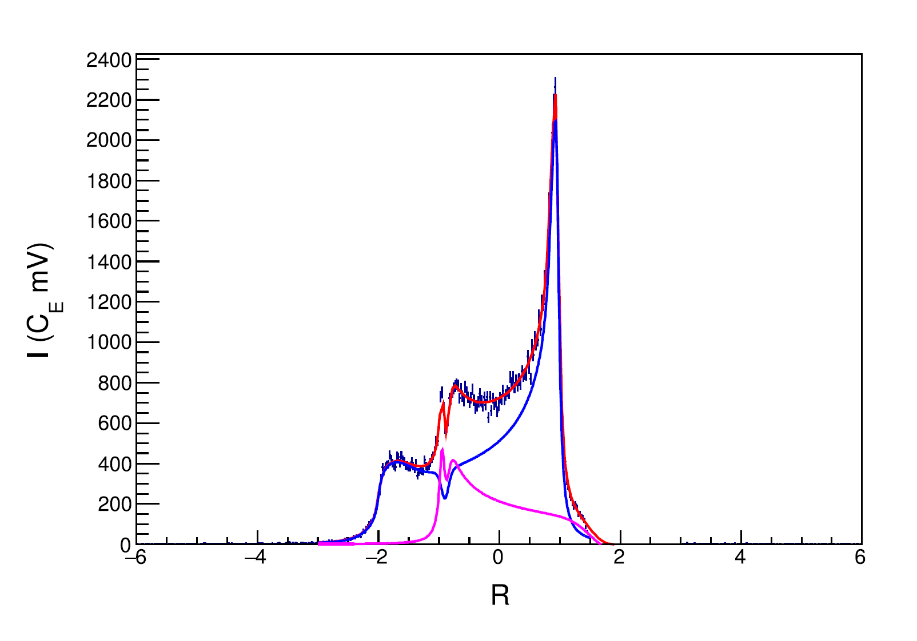
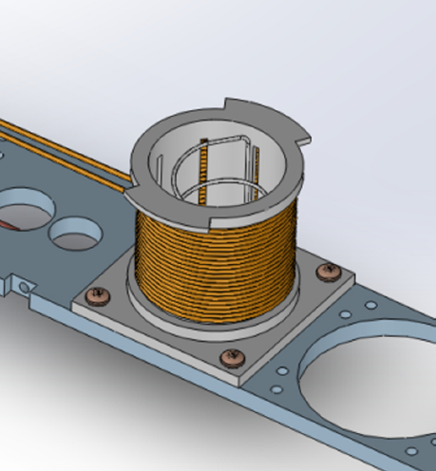
Semi-Selective RF Saturation (ssRF)
^{[1]} D. Keller, et al., NIM A 981, 164504 (2020)
^{[2]} D. Keller, Eur. Phys. J. A 53, 155 (2017)
^{[3]} A. Abragam, Principles of Nuclear Magnetism (1961)
Technique developed by D. Keller & UVA Polarized Target Lab^{[1,2]}
Additional RF coils drive spin-flips within NMR frequencies to minimize $I_{−}$ while having a minimal or enlargement factor on $I_{+}$
Frequencies are ‘mirrored’, but quadrupole angle $θ$ is not, so spin manipulation at one $θ$ shows up at two frequencies
Area reduction of $I_{−}(θ)$ causes a ½ area increase of $I_{+}(θ)$
To measure $P_{zz}$, a line shape derived from Abragam was used that allows for manipulated spin states with different polarizations at different frequencies (and thus different values of $θ$) ^{[2,3]}
UVA achieved $P_{zz}=28.8\%$ using ssRF^{[1]} on peak and shoulder of $I_{−}$
UVA $P_{zz}$ measurement agrees with independent UNH extraction within experimental uncertainty
$$P_{zz}=28.8\%±5.7\% {(rel)}^{[1]}$$
$$+\frac{1}{2}I(θ)$$
$$−I(θ)$$

Slide 32
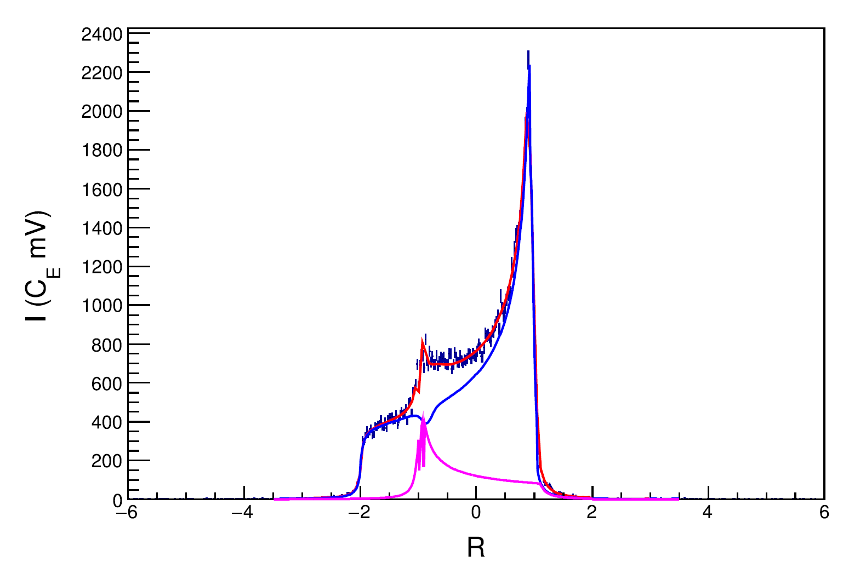
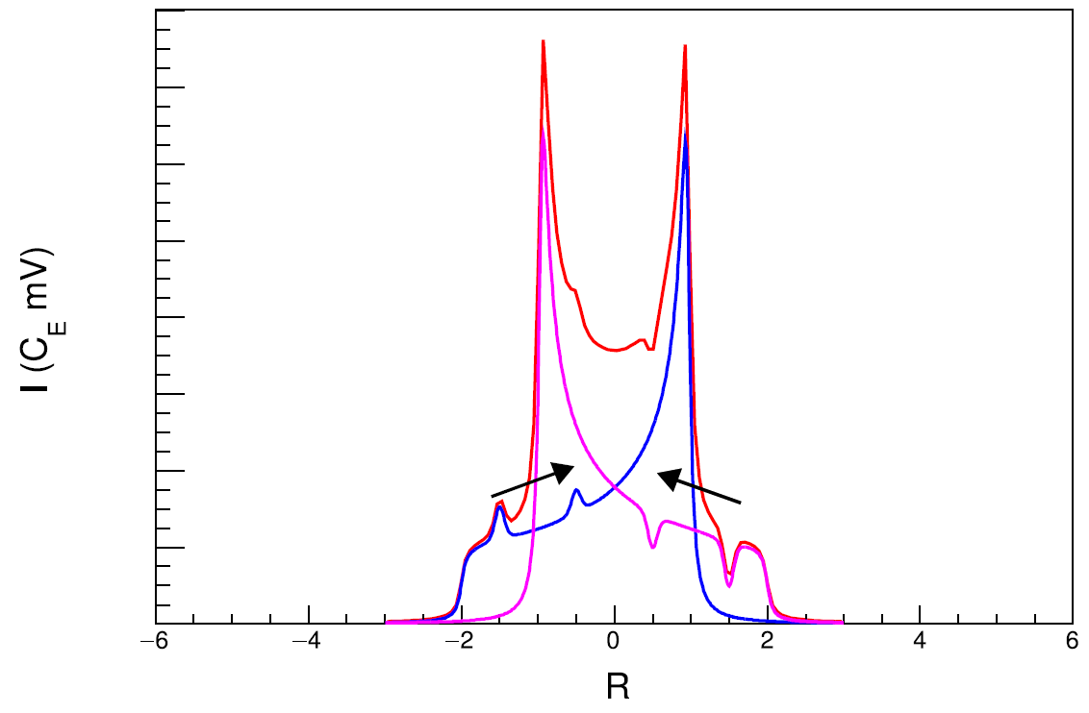
ssRF + Rotation
^{[1]} D. Keller, et al., NIM A 981, 164504 (2020)
^{[2]} D. Keller, Eur. Phys. J. A 53, 155 (2017)
Technique developed by D. Keller & UVA Polarized Target Lab^{[1,2]}
Rotating target material changes which nuclei are at which $θ$, and thus which NMR frequency
Rotating during ssRF can better transport spin manipulation, further increasing tensor polarization
Ideal rotation would be about $θ_{MAS}=54.7°$
UVA achieved $P_{zz}>36\%$ using double ssRF + rotation^{[1]}
$$P_{zz}=36.3\%±9.3\% {(rel)}^{[1]}$$
ssRF
Rot.
ssRF
Rot.

Slide 33
$b_{1}$ Physics Extraction (#2.3) $P_{zz}=25\% ±7\%$, $I=100 nA, t−120hr$
120 hours removed from two lowest kinematic settings
Update

Slide 34
$b_{1}$ Physics Extraction (#2.3) $P_{zz}=26\% ±2\% (rel)$ & Drifts Mitigated
Proposal
Update

Slide 35
$A_{zz}$ Physics Extraction (#2.3) $$P_{zz}=26\% ±2\% (rel)$$
Proposal
Update

Slide 36
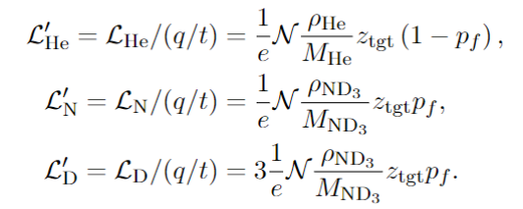
Helicity States – Definitions
Luminosities w/o charge & eff.
# Events Detected
Acceptance
Beam Charge
Efficiencies

Slide 37
Helicity States – 2 States
$$σ_{1}=σ(0,P_{1},Q_{1})→σ(0,P,Q)$$
$$σ_{2}=σ(0,P_{2},Q_{2})→σ(0,0,0)$$
$$≈\frac{2}{fQ}\left(\frac{σ_{Q}−σ_{0}}{σ_{0}}\right)$$

Slide 38
Helicity States – 4 States
$$σ_{Q}$$
$$σ_{0}$$

Slide 39
Helicity States – 4 States
$$σ_{Q}$$
$$σ_{0}$$
$$≈\frac{2}{fQ}\left(\frac{σ_{Q}−σ_{0}}{σ_{0}}\right)$$

Slide 40
Helicity States – 4 States
$$σ_{Q}$$
$$σ_{0}$$
With fast tensor pol. switching, $ε_{1}q_{1}=ε_{3}q_{3}$ & $ε_{2}q_{2}=ε_{4}q_{4}$
$$P_{1}=P_{3}=P$$
$$P_{2}=P_{4}=−P$$
$$=\frac{2}{fQ}\left(\frac{σ_{Q}−σ_{0}}{σ_{0}}\right)$$

Slide 41
Helicity States (#3.1 & 4.1)
In the case where integrated beam helicity is 0, this gives

Slide 42
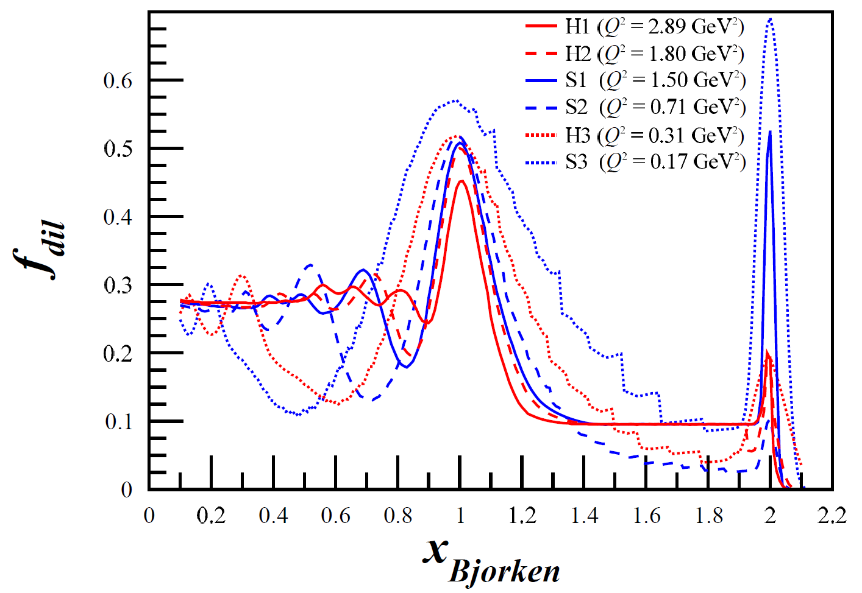
Helicity States (#3.1 & 4.1)
In the case where integrated beam helicity is 0, this gives
$$+P$$
$$−P$$
$$+P$$
$$−P$$
Suppressed by dilution factor, $|P|$, and by difference of $∆εq$
In worst case scenario $<0.7∙0.3∙0.004≈0.0008≈0.08\%$ relative to $A_{zz}$
$≈$ Transversity $∆εq$ used as $∆(∆εq)$
to be large over-estimate

Slide 43
Helicity States (#3.1 & 4.1)
More complicated if $h_{e}≠0$, but other terms still suppressed
Suppressed similar to $A_{V}^{d}$ w/ further $h_{e}$ suppression
Overestimate:
$$h_{e}≪1×{10}^{−4}$$
Suppressed by $h_{e}$
$\frac{f}{2}\left(Fraction\right)≈1/A_{zz}^{′}$, so term goes as
$$A_{zz}=\left(\frac{2}{f}\right)A_{zz}^{′}\left[1+\left(≈0\right)−2h_{e}\frac{A_{T}^{ed}}{A_{zz}^{′}}\right]$$
Likely not an issue as it’s expected that $A_{T}^{ed}≲A_{zz}$

Slide 44
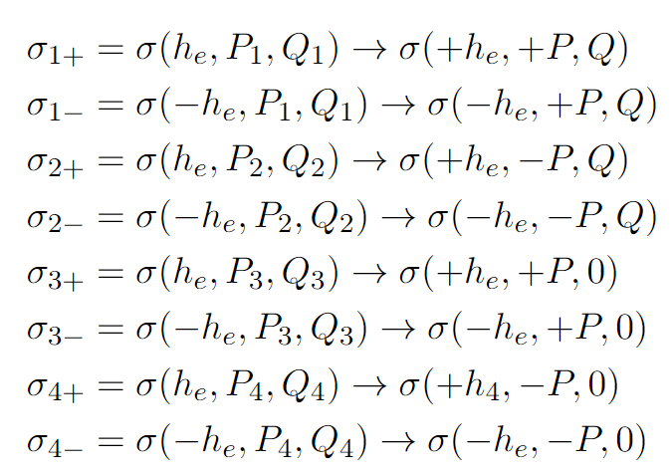
Helicity States (#3.1 & 4.1)
Though suppressed, by tagging beam helicity we can simultaneously measure all diluting asymmetries alongside $A_{zz}$ for no additional beamtime
Tagging +/- beam helicities for each of the 4 polarization states gives 8 total beam-target polarization states
Direct measurements eliminate model-dependent uncertainties from $A_{T}^{ed}$, $A_{V}^{d}$, & $A_{||}$

