Slide 1
Yield Current Dependence?
Compared yields for ps4 runs at KinC_x60_4 using scalers and events
Scalers: End-of-run ps4 scaler counts divided by charge
Events: Get entries from root file, remove EDTM events, apply prescale factor if needed, divide by charge
No physics cuts

Slide 2
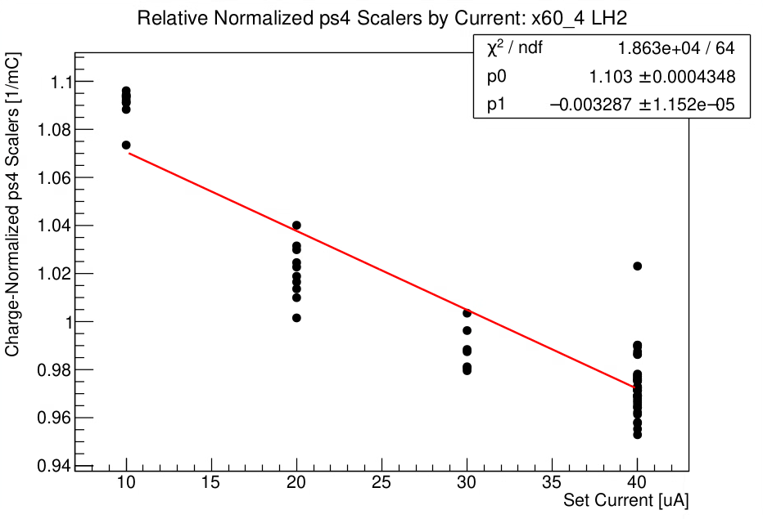
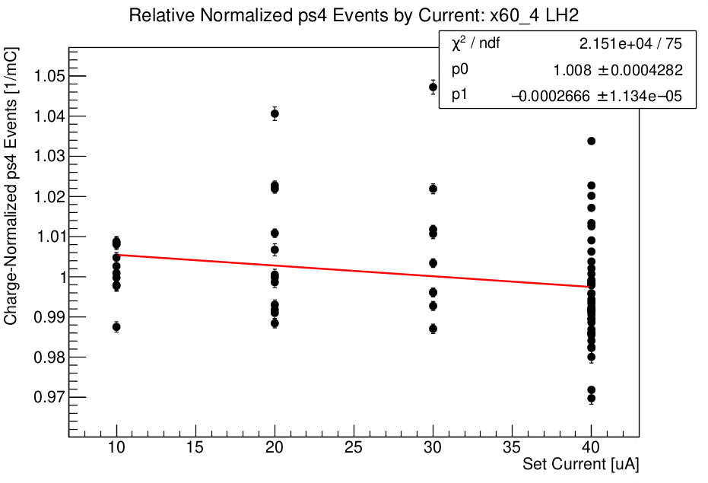
Yield vs Current – x60_4 LH2

Slide 3
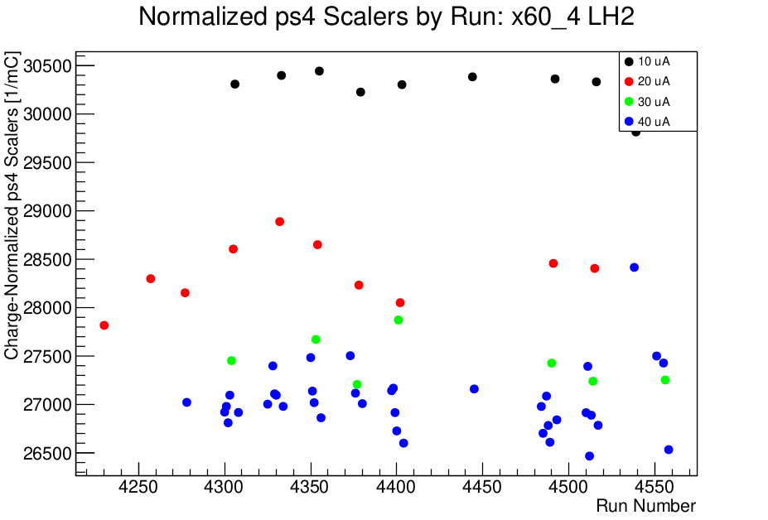
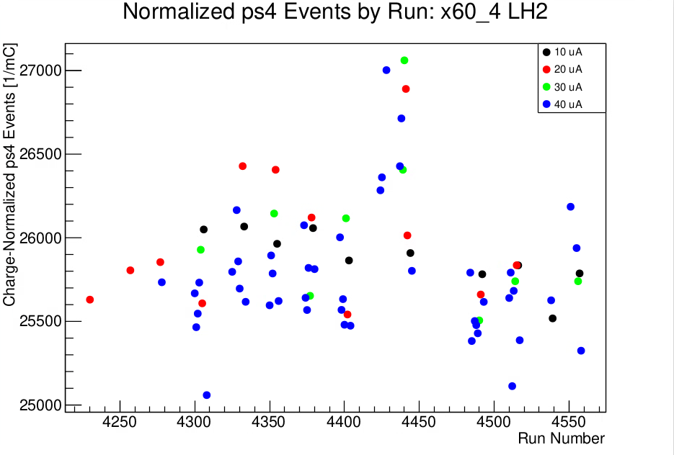
Yield vs Current – x60_4 LH2

Slide 4
DIS Yield
ps3 and ps4 runs since beginning of December
x60_2, x50_2, x50_3, x36_5, x60_3, and x60_4
HMS Cuts:
Cerenkov: npeSum > 0.7
Delta between +-8%
Calorimeter: etotnorm and etottracknorm > 0.6
Normalized by charge
Corrections for livetime and DC tracking efficiency

Slide 5
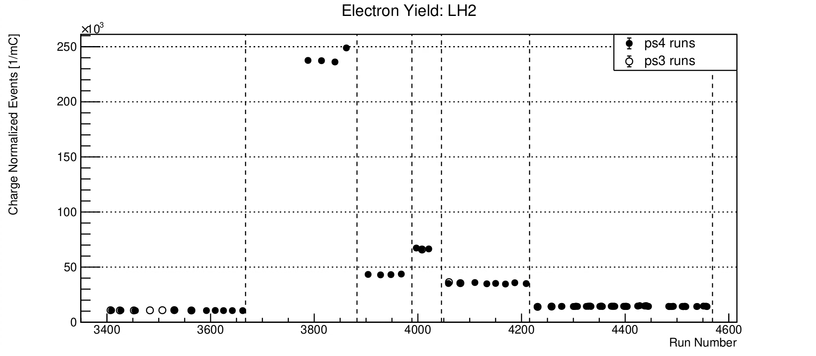
DIS Yield – LH2

Slide 6
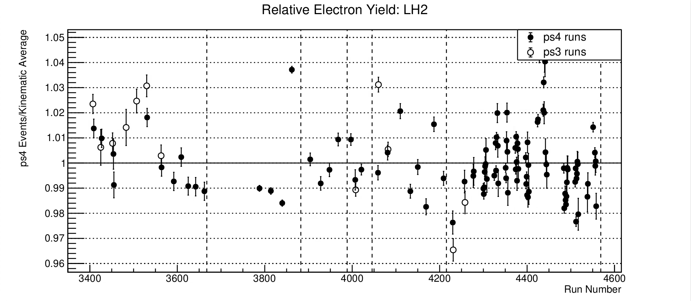
DIS Yield – LH2

Slide 7
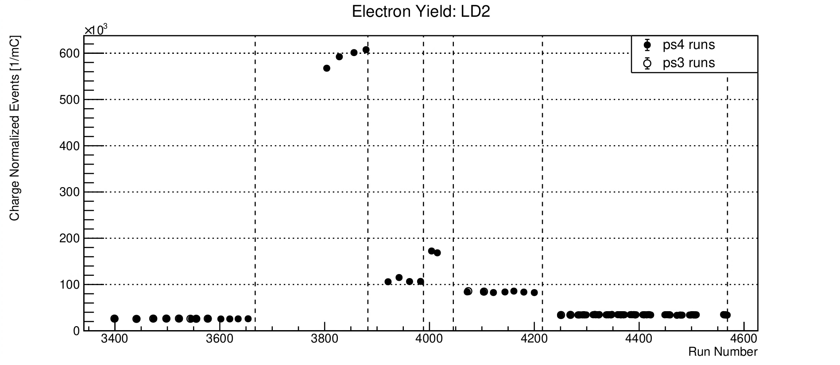
DIS Yield – LD2

Slide 8
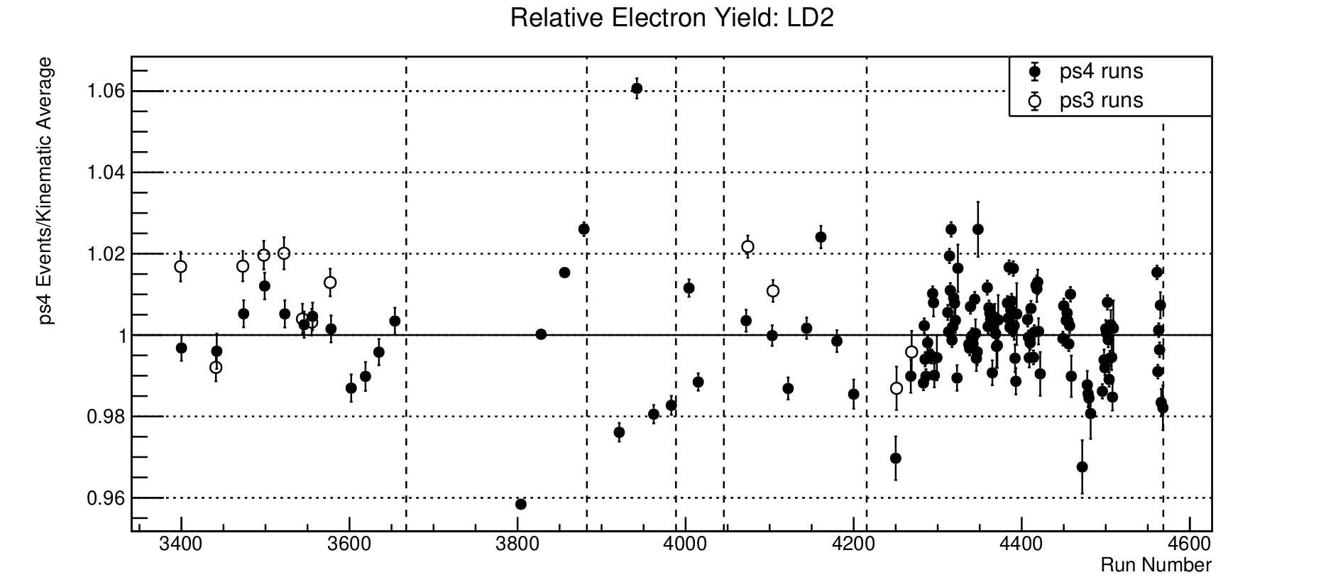
DIS Yield – LD2

