Slide 1
Logarithmic E Weighting of Clusters
Currently clusX, clusY, and clusZ are calculated as linear energy weighted averages of individual hits
Logarithmic energy weighting has been shown to provide more accurate energy resolution
$W_{0}$ is a parameter based on simulation data for the calorimeter

Slide 2
Logarithmic E Weighting of Clusters
Rewrote the functions in THcNPSCalorimeter.cxx to use log weighting
Set $W_{0}=4$ for now
Replayed run 3581, compared linear and log weighting of a few clusters
Checked log calculations manually

Slide 3
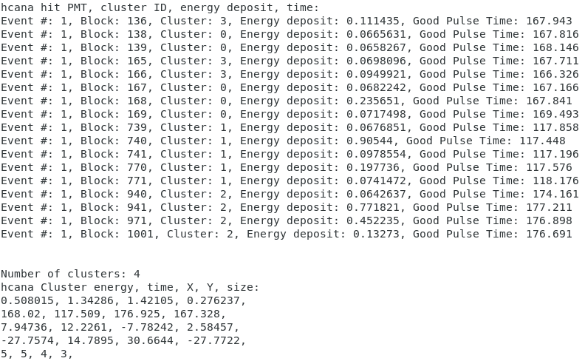

Slide 4
