Slide 1
KinC-x50-2 Optics
-6.667 GeV/c
Preliminary matrix elements from cuts on run 1544,
optimized matrix elements still in progress

Slide 2
KinC-x50-2 Optics Sieve Slit Data
Run | HMS P (GeV/c) | HMS Angle (deg) | Target | BPM Calib | Sweeper
1537 | -6.667 | 12.490 | Carbon 0.5% | Fall ‘23 | Off
1538 | -6.667 | 12.490 | Carbon 0.5% | Fall ‘23 | Off
1539 | -6.667 | 12.490 | Carbon +/- 8 cm | Fall ‘23 | Off
1540 | -6.667 | 12.490 | Carbon +/- 8 cm | Fall ‘23 | On
1541 | -6.667 | 12.490 | Carbon 0.5% | Fall ‘23 | On
1542 | -6.667 | 12.490 | Carbon 0.5% | Fall ‘23 | On
1543 | -6.667 | 12.490 | Carbon 0.5% | Fall ‘23 | On
1544 | -6.667 | 12.490 | Carbon 0.5% | Fall ‘23 | On
5156 | -6.667 | 15.195 | Carbon +/- 3 cm | Jan ’24 | On
5157 | -6.667 | 15.195 | Carbon +/- 3 cm | Jan ’24 | On
5158 | -6.667 | 15.195 | Carbon +/- 3 cm | Jan ’24 | On
5159 | -6.667 | 15.195 | Carbon +/- 3 cm | Jan ’24 | On
5160 | -6.667 | 15.195 | Carbon +/- 3 cm | Jan ’24 | On
5161 | -6.667 | 15.195 | Carbon +/- 8 cm | Jan ’24 | On
5162 | -6.667 | 15.195 | Carbon 0.5% | Jan ’24 | On
5163 | -6.667 | 15.195 | Carbon +/- 8 cm | Jan ’24 | On
5164 | -6.667 | 15.195 | Carbon +/- 8 cm | Jan ’24 | Off

Slide 3
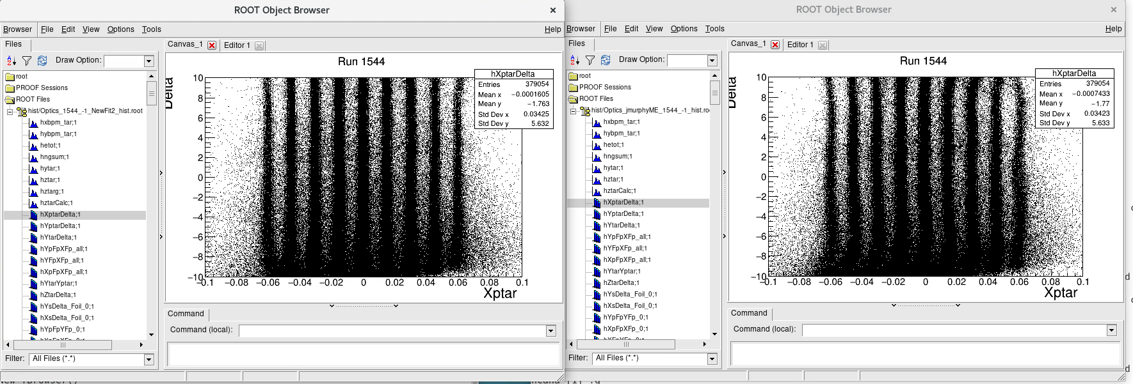
KinC-x50-2 Optics Sieve Slit Data Run 1544: -6.667 GeV/c Delta cuts at midpoints btwn -10, -8,-5,0,5,10
Xptar (angle) vs Delta
New Fit
-6.59 GeV/c matrix

Slide 4
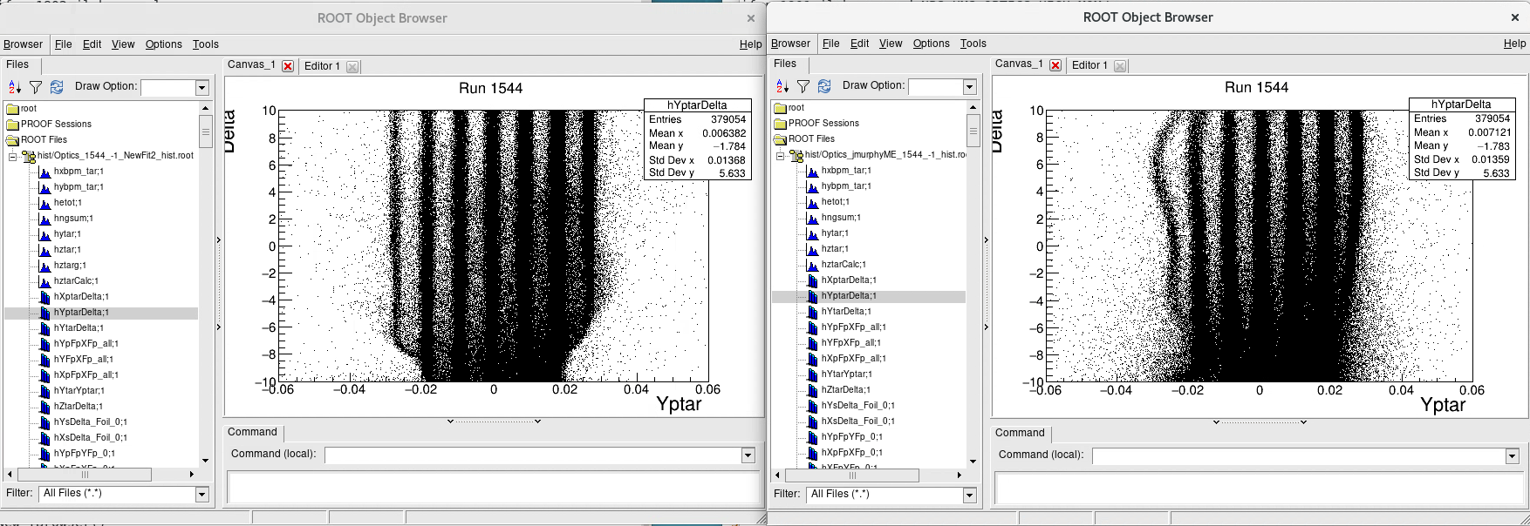
KinC-x50-2 Optics Sieve Slit Data Run 1544: -6.667 GeV/c Delta cuts at midpoints btwn -10, -8,-5,0,5,10
Yptar (angle) vs Delta
New Fit
-6.59 GeV/c matrix

Slide 5
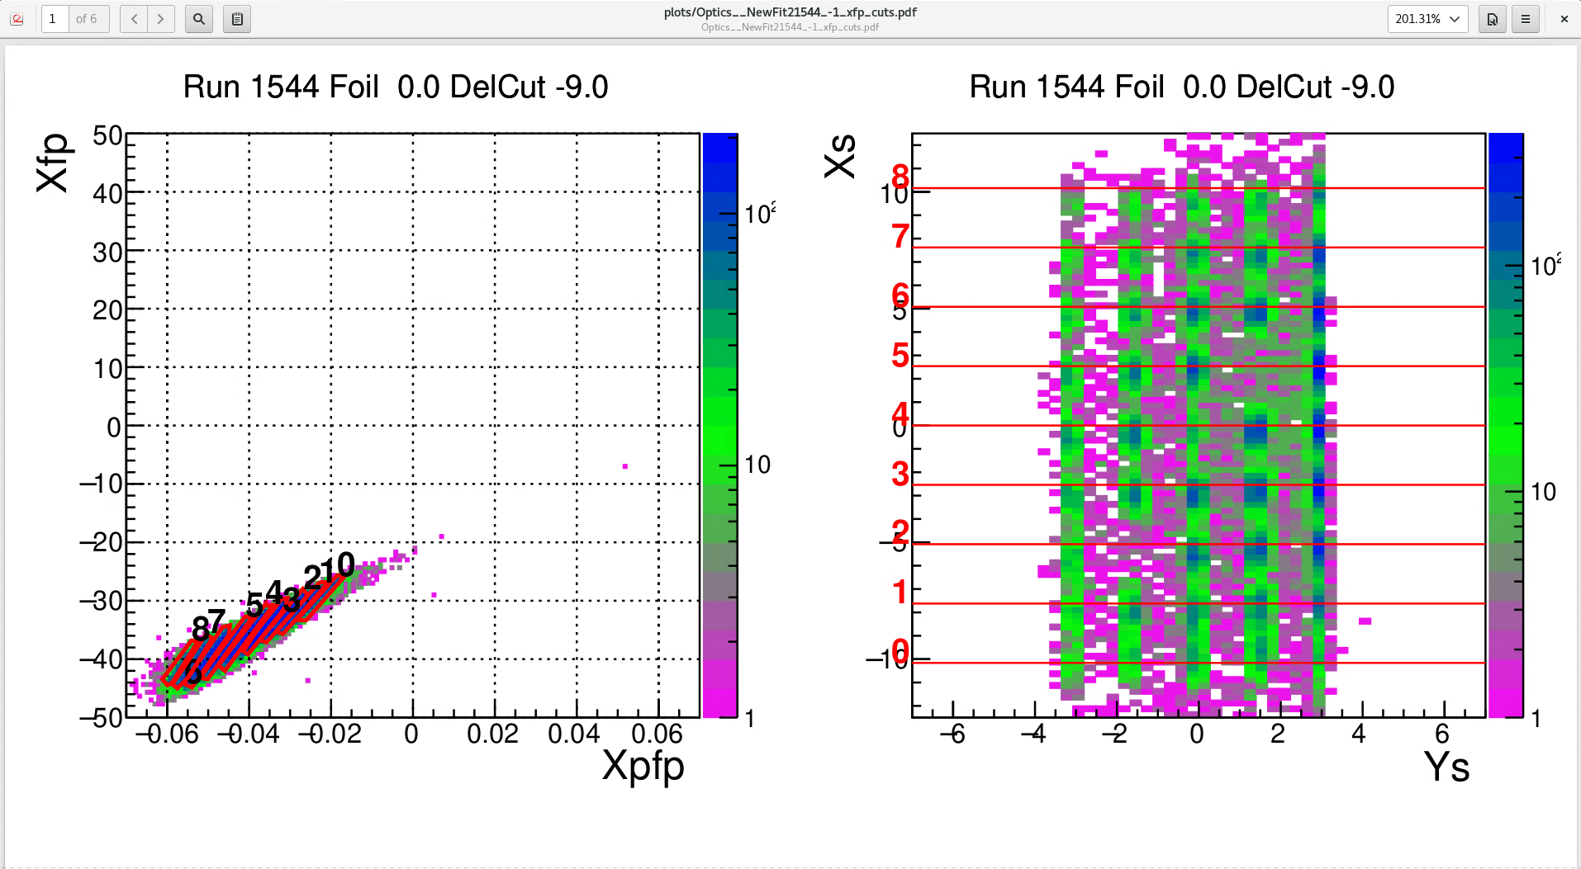
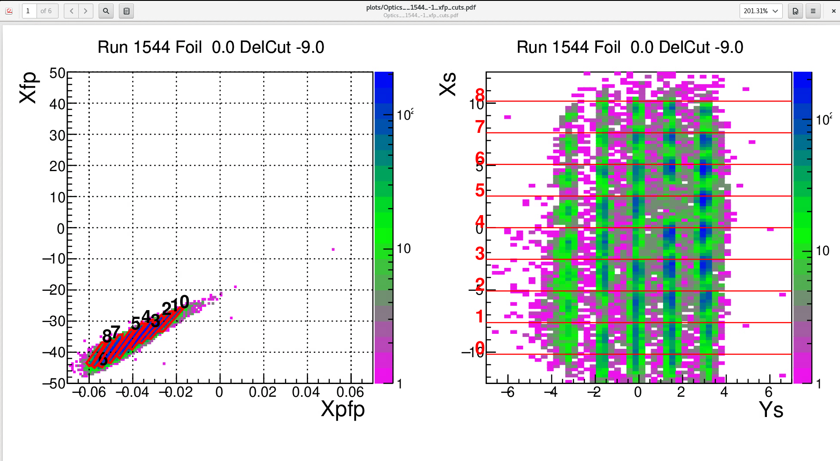
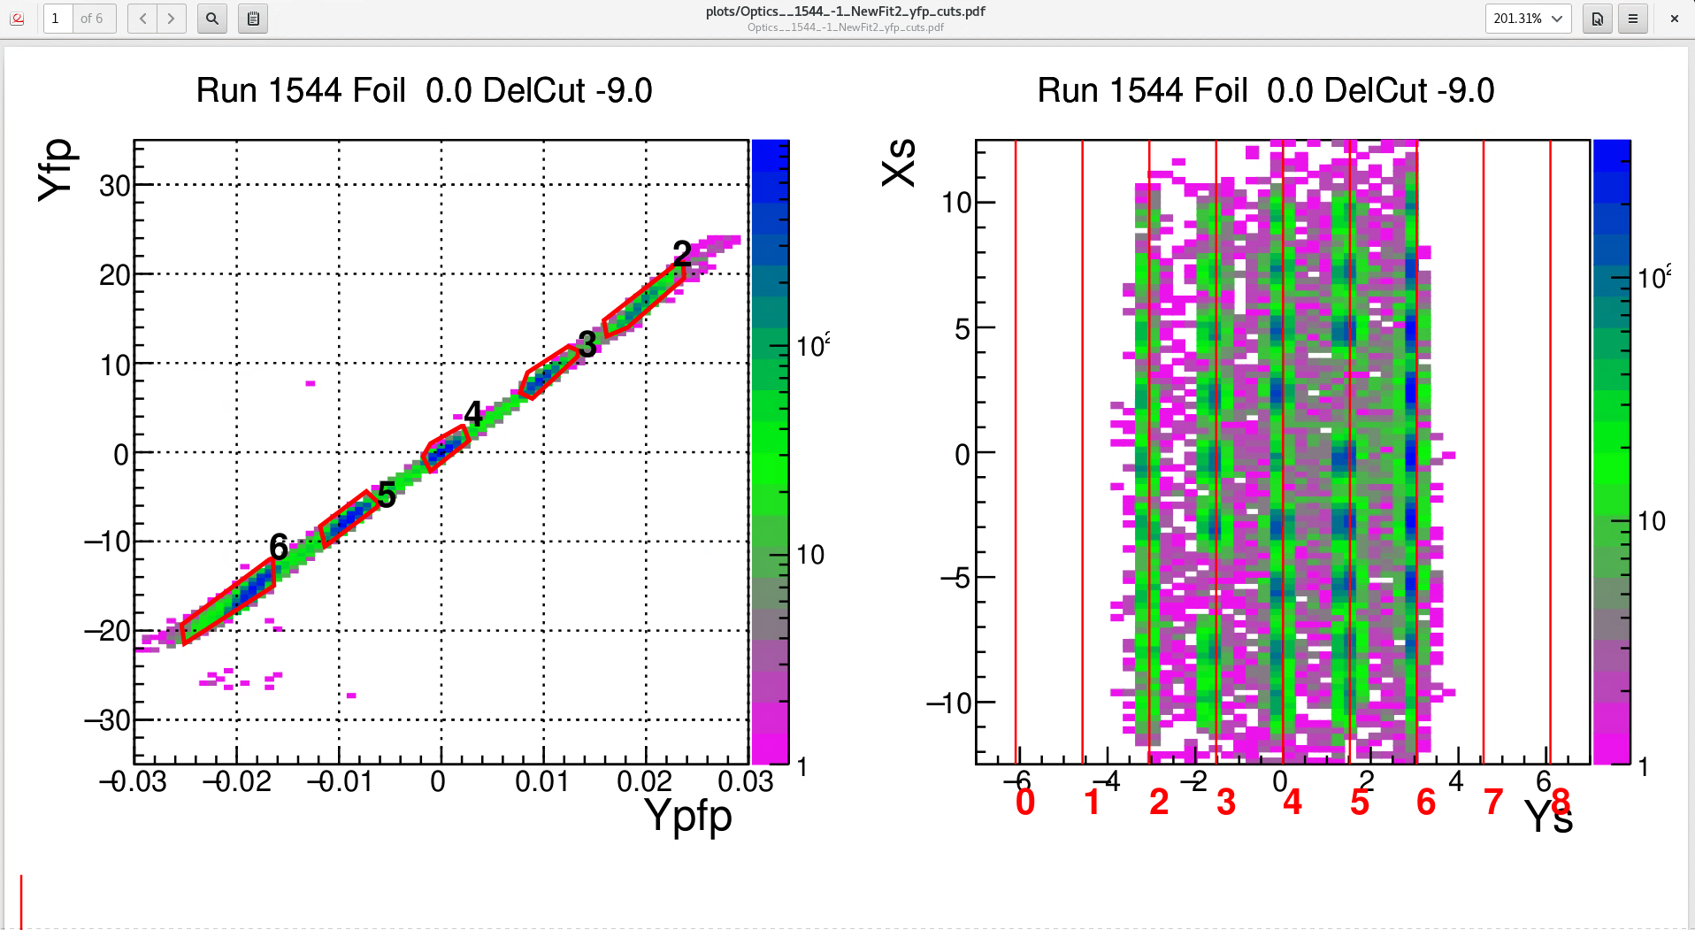
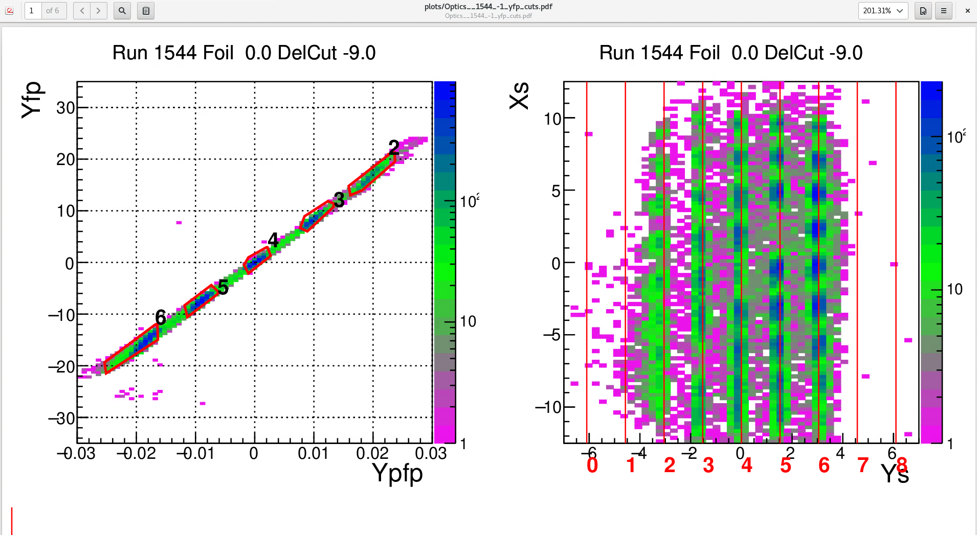
KinC-x50-2 Optics Sieve Slit Data Run 1544: -6.667 GeV/c
This “hard edge” along the 2nd and 6th ysieve holes might reflect the effects observed in yptar vs delta plot at delta < -6 %,
as we expect at high momentum
New Fit
-6.59 GeV/c matrix

Slide 6
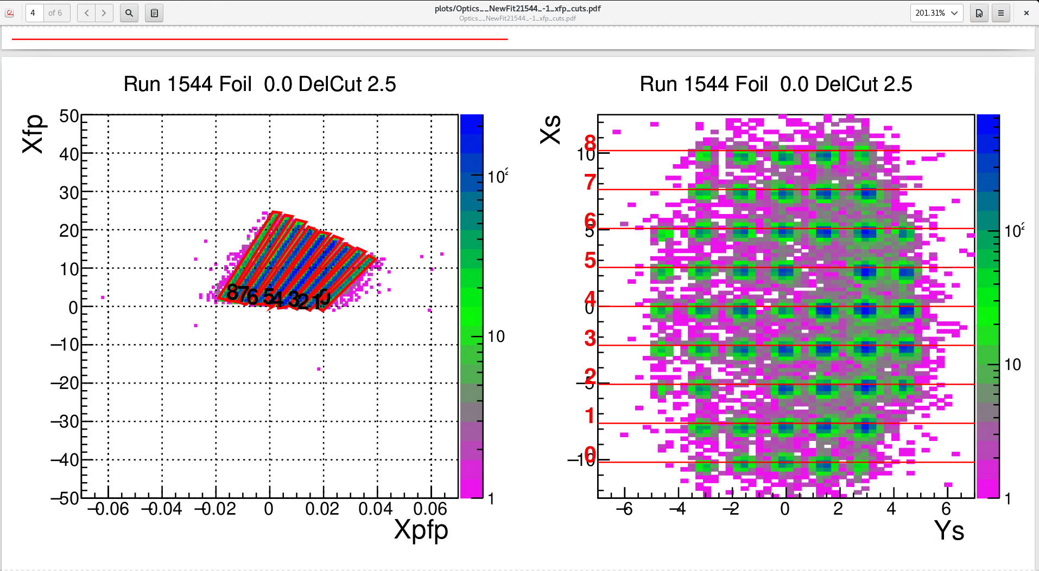
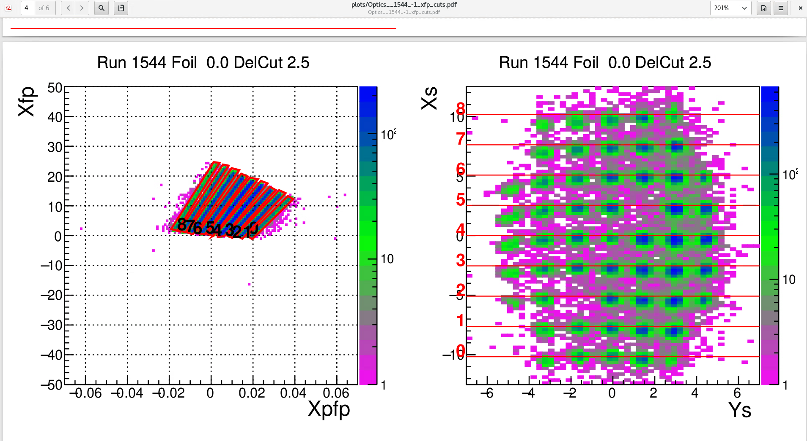
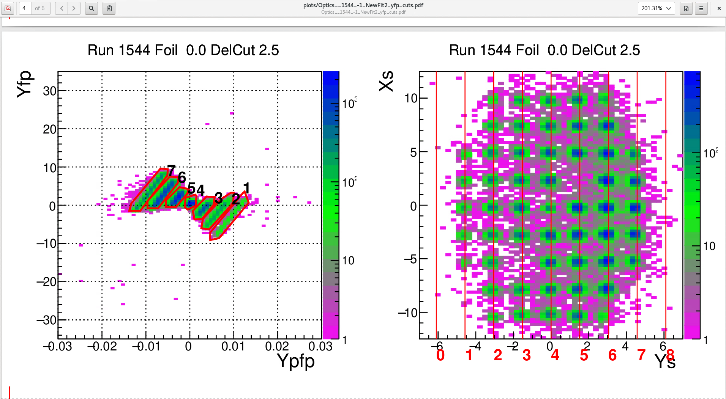
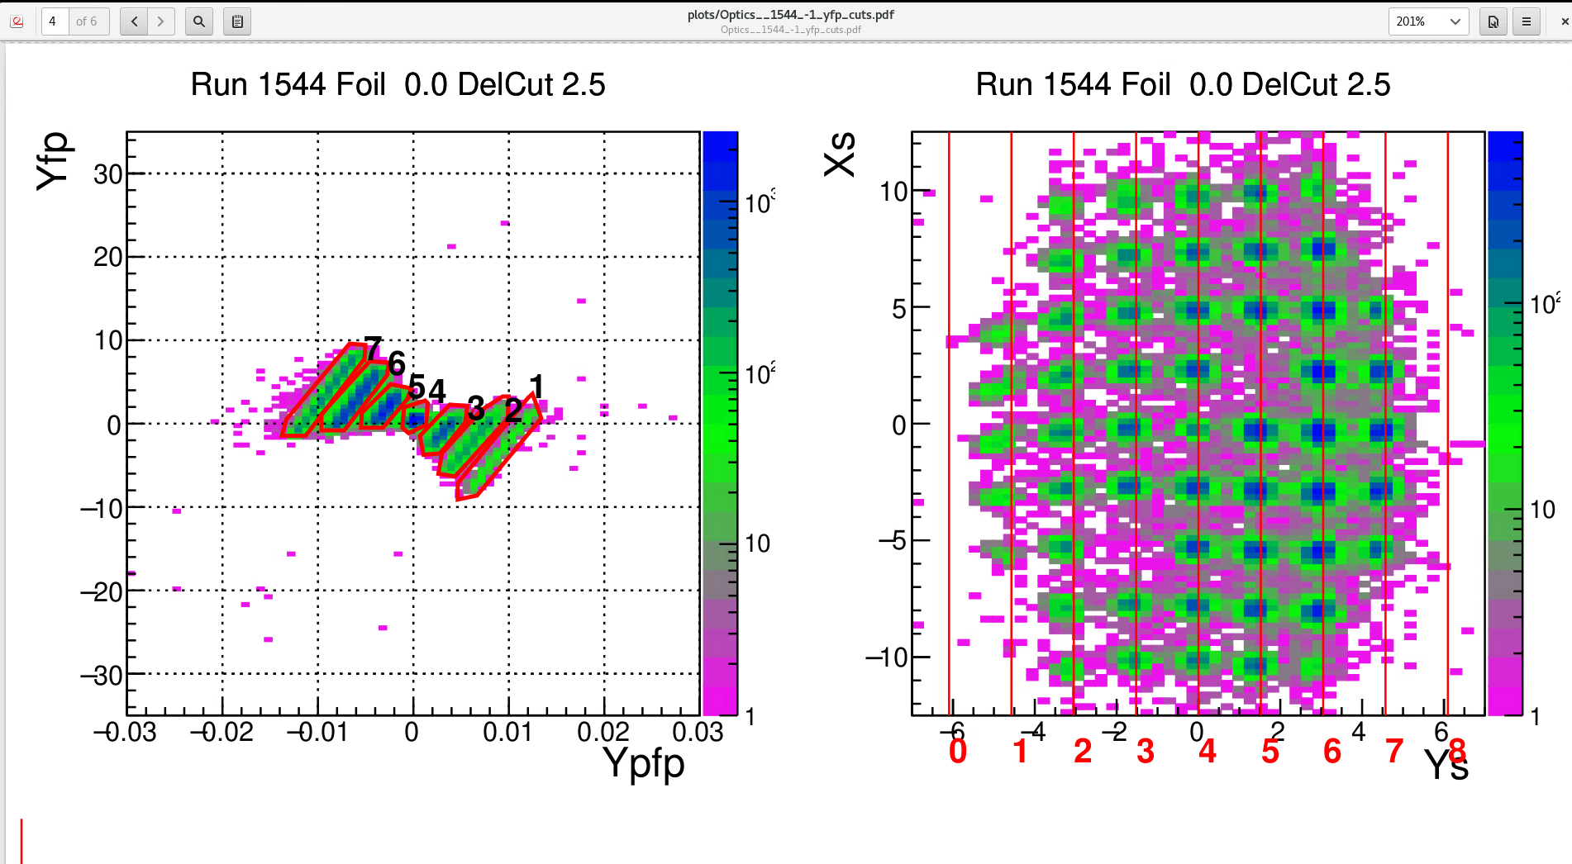
KinC-x50-2 Optics Sieve Slit Data Run 1544: -6.667 GeV/c
New Fit
-6.59 GeV/c matrix
We are hoping to improve the alignment along the red guidelines as well as remove the warping in the sieve holes.

