Slide 1
ML-PID Summer 2024
By Mohhamed Rafi

Slide 2
Introduction (Pencil Simulation Study)
SoLID detector responses include,
  Electromagnetic Calorimeter (ECal)
  Cherenkov Detector
  Scintillators
  Gas Electron Multipliers
The Pencil Beam simulates thin beams of e- (11), pi- (-211), and gamma photons (22), shot through the center of the detector set-up.

Slide 3
Detector Signal: ECal
ECal signals include PreShower, Shower modules.
PreShower are 2cm thick scintillators (followed by 2X_0 of lead).
Pre/Shower modules include a top, left, and right triangular pattern.
Primary response of an Ecal signal analysis is locating the Minimially-Ionzing Particle (MIP) peaks.

Slide 4
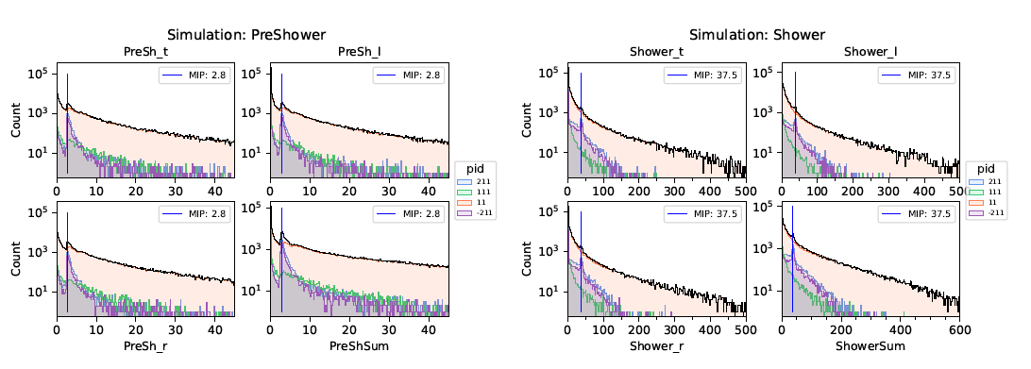
ECal Signals
ECal Analysis by Darren shows MIP peaks at 2.8 MeV in PreShower and 37.5 MeV in the Shower.

Slide 5
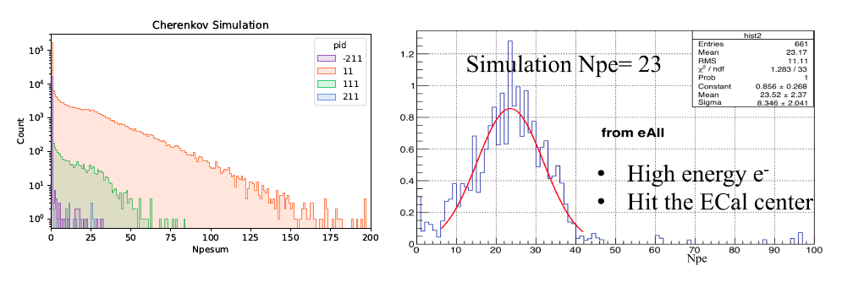
Cherenkov Detector Signals
When a charge particle passes through a Cherenkov Detector, they emit Cherenkov light. Photo-multiplier tubes would measure the number of photo-electrons (N_PE) from a charged particle.
pi^-,+ should be zero (excluding δ-electrons) in N_PE since we are using CO2, while pi^0 can decay into two gammas which can produce e^- e^+ pairs,

Slide 6
Scintillators Signals
MIP peaks can be seen in Scintillators (SC_{A,B,C}) and Large Angle Scintillating Pad Detector (LASPD)
SC_B is placed behind the ECal so pions create signals (high energy e leaking through the ECal).
LASPD is useful for gamma-rejection (?)
Multiple MIP peaks can be correlated to different decay chains that produce multiple particle final states.

Slide 7
Table of Pencil Simulation “Features”
Column (Variable Name) | What It Measures? |  | ECal Analysis | Cherenkov Analysis | Scintillator Analysis
vx,vy,vz | Particle Velocity
px,py,pz,p | Particle Momentum |  |  | Npesum
pid | True PID
PreShP | Pre Shower Momentum ?
PreShP_e | Pre Shower Momentum Energy?
PreShPx,PreShPy,PreShPz | Pre Shower Momentum
PreShTheta | ?
PreSh_Sum, PreSh_l, PreSh_r, PreSh_t | Pre Shower Energy Deposit |  | Hist
Shower_l,Shower_r,Shower_t,Shower_Sum | Shower Energy Deposit |  | Hist
SC_*_Endsum | Scintillators Energy Deposit |  |  |  | Hist
SPD_P,SPD_Eendsum | ?
LASPD_Endsum | LASPD Energy Deposit |  |  |  | Hist
Npesum | Number of Photoelectrons |  |  | Hist, NCh, P
Theta |  |  |  | Npesum
NCh | Number of Triggered Channels?
Notes |  |  | Pencil Sim showed MIP peaks 2.8, 37.5 MeV for Pre/Shower | Varying features in Npesum vs P space, Npe hist will show varying peaks depending on decay channel, Npe vs NCh is another space to look at. | Depending on decay channel or multiple particle final state, we can see multiple MIP peaks. Particles will correlate to the number of MIP peaks depending on the decay process

Slide 8
Replication of Pencil Beam - Cherenkov Study
I tried reproducing the pencil cher. results by
  Selecting p, Npesum, NCh columns for pi^-, e.
    Without any cuts to momentum.
  Training Darren’s model based on those columns.
  Looking at Loss/Accuracy vs Epoch, Confusion Matrix, and Location of Mislabeled particles in Npesum histogram.

Slide 9
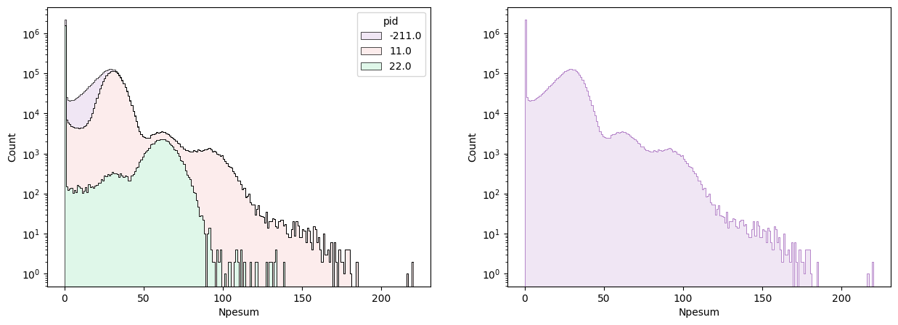
Dist. Of Pencil Data

Slide 10
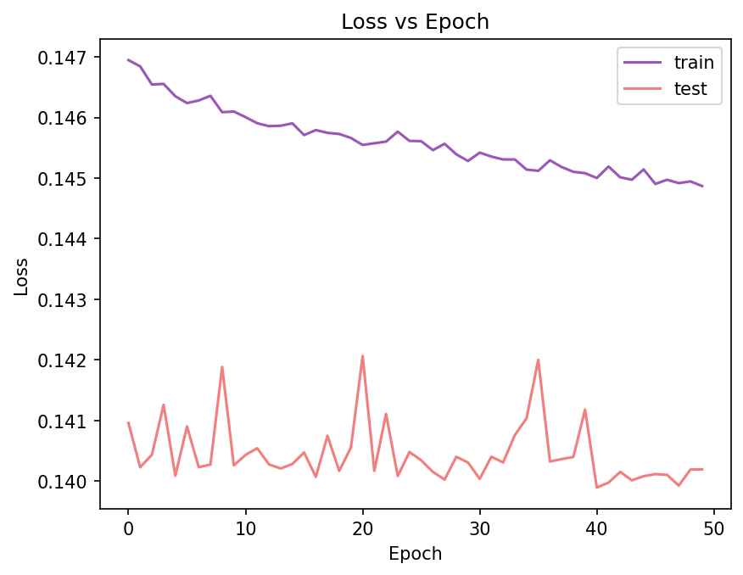
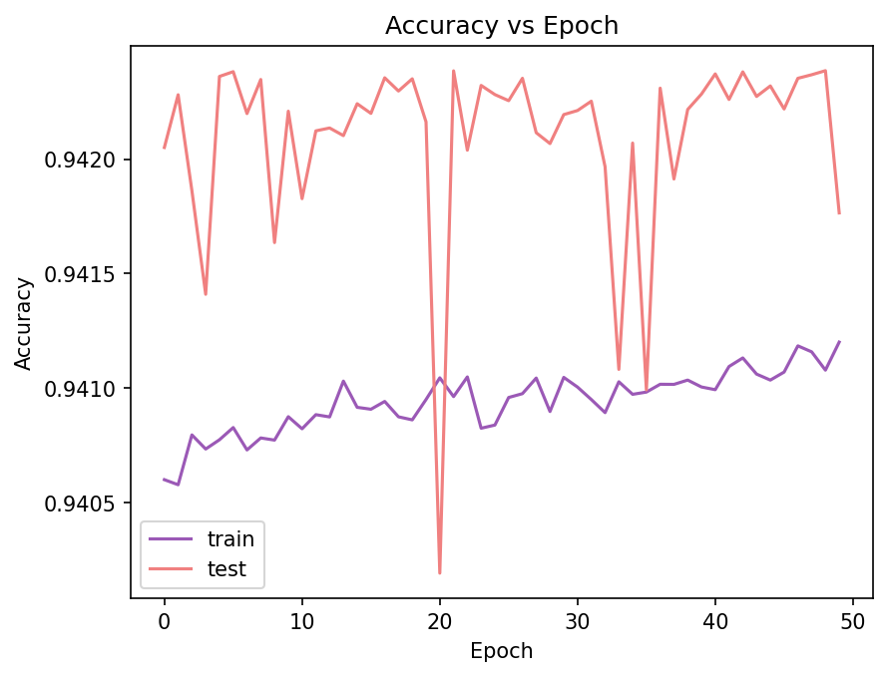
Model Metrics
Trained over 50 Epochs without any early stopping conditions to see accuracy/loss plateau. (When adding early stopping, we stop at the 7th epoch and recover some true probability)

Slide 11
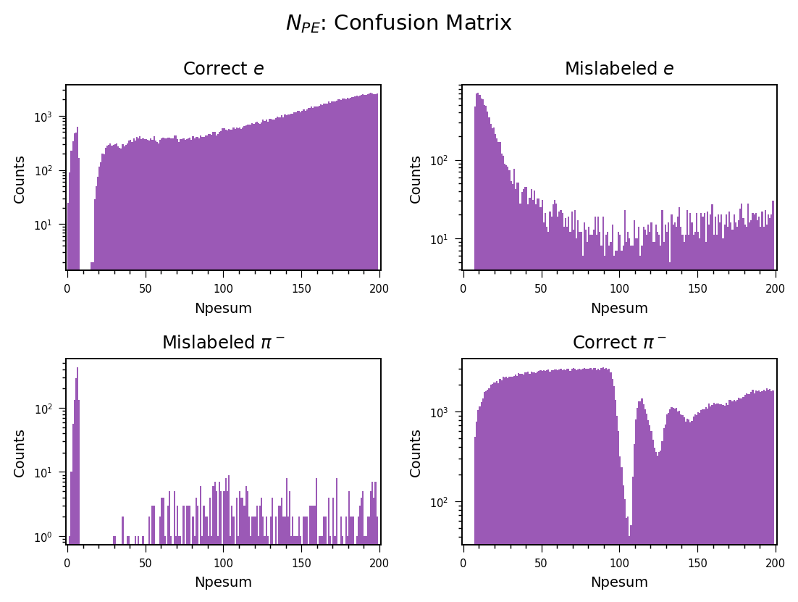
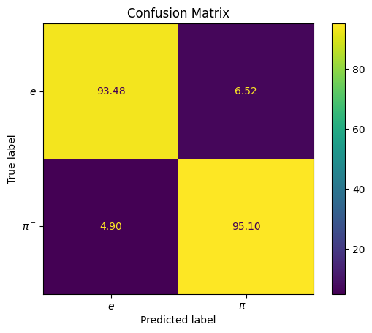
Confusion Matrix

Slide 12
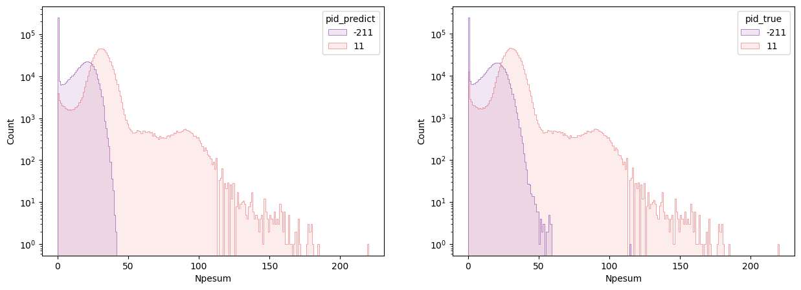
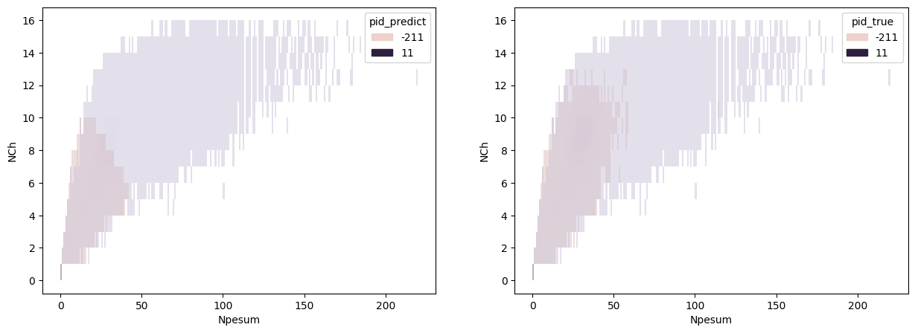
Comparing Predicted PIDs vs True PIDs

Slide 13
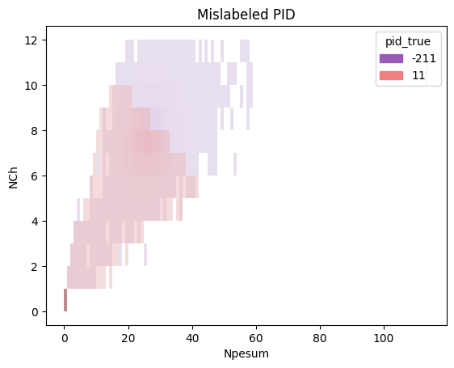
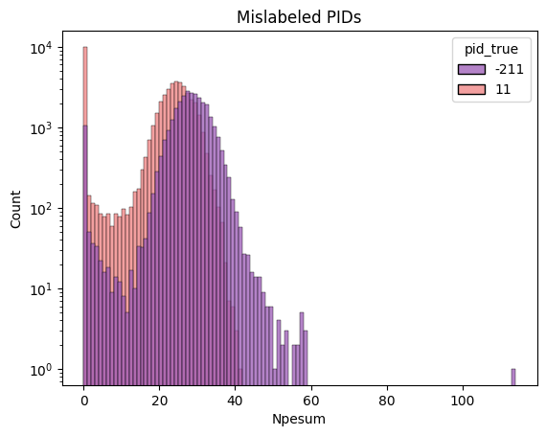
Location of Mislabeled PIDs

Slide 14
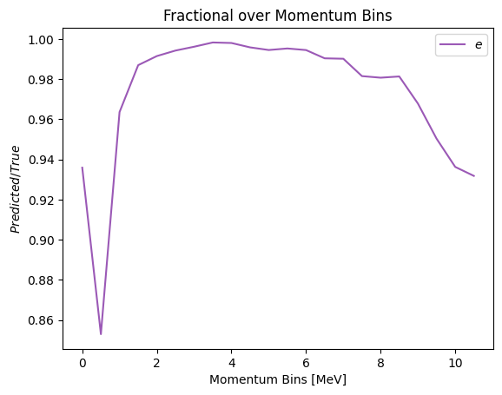
Electron/Pion Prediction Fraction

Slide 15
Summary (June 24)
Pencil Beam Analysis of Cherenkov ML (Done-ish)
  I need to figure out to plot nu_e vs nu_pi^- (relevant metric).
  Do a combined classification with the ECal by including relevant ECal Columns (Basically recreate the Baseline):
    Cher columns are: Npesum, NCh, p
    ECal columns are: PreShSum,PreSh_*,ShowerSum,Shower_*
Baseline model on Full Simulation (Potential Next Step?)

Slide 16
Ecal Replication Study
Used Relevant Ecal columns from Darren’s Report.
Processing was done on momentum bins of 0.5 GeV each.
  Gamma’s were excluded.
No changes made to the model from the previous iteration.
Note: Backwards propagation is done by TensorFlow.

Slide 17
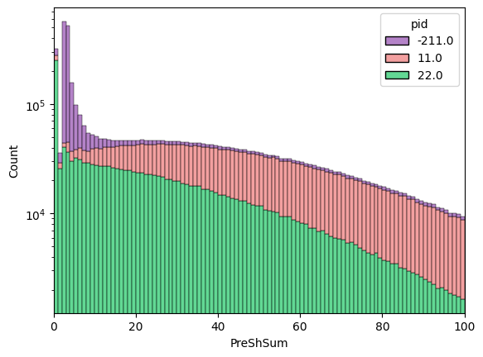
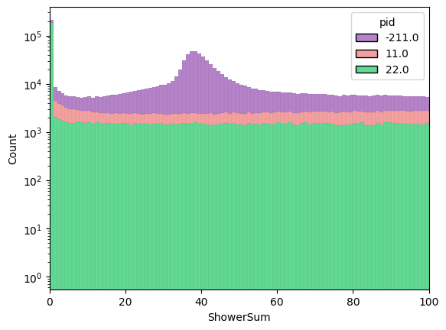
M.I.P Peaks for Negative Pions

Slide 18
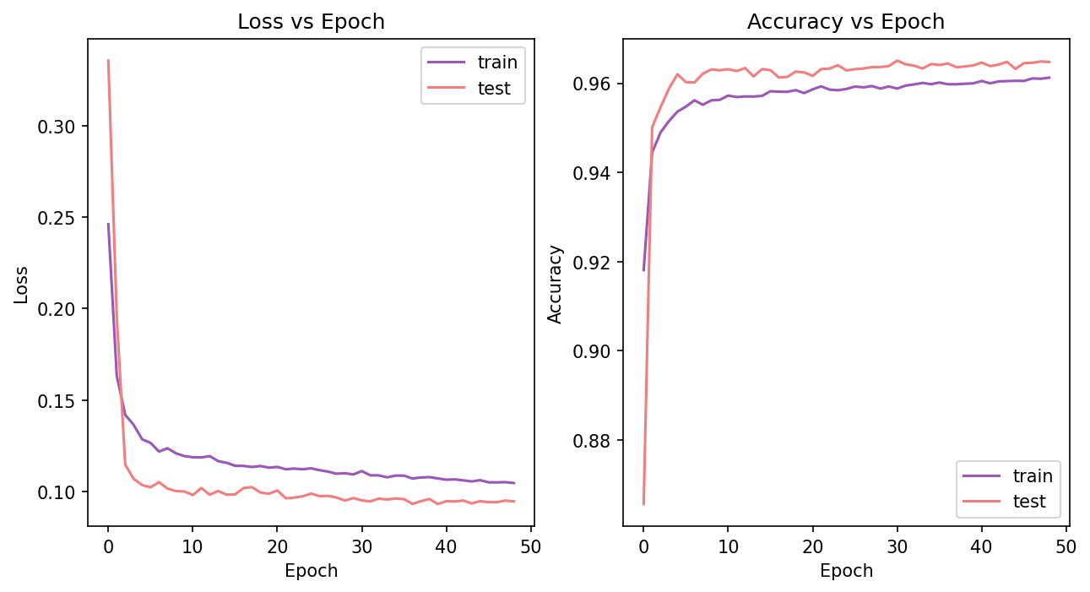
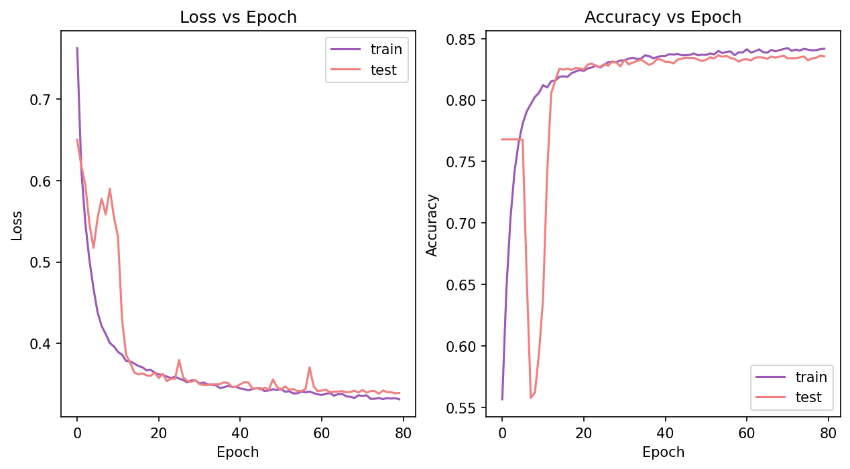
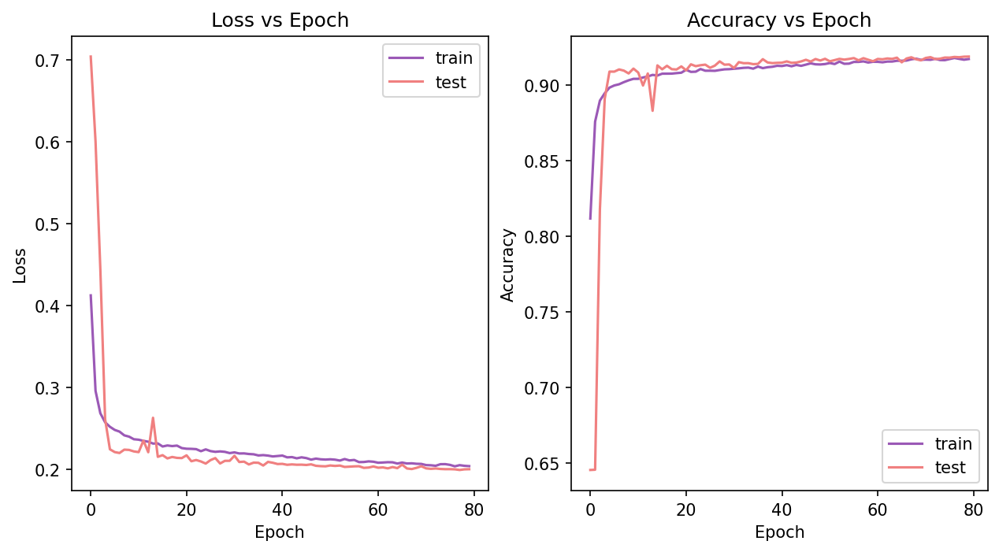
Loss/Accuracy Plots For Momentum Bins

Slide 19
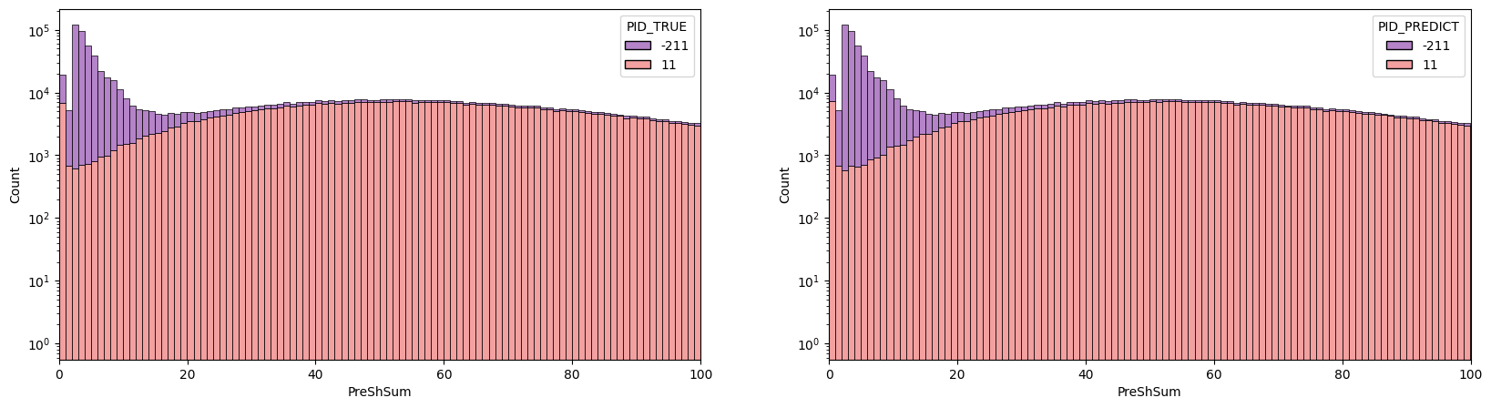
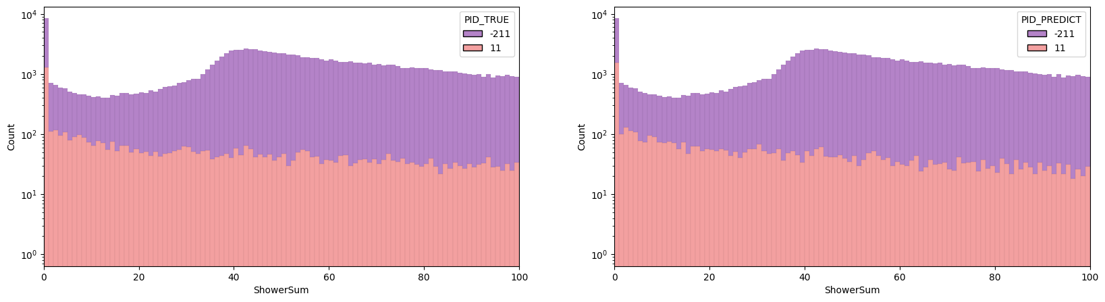
Results

Slide 20
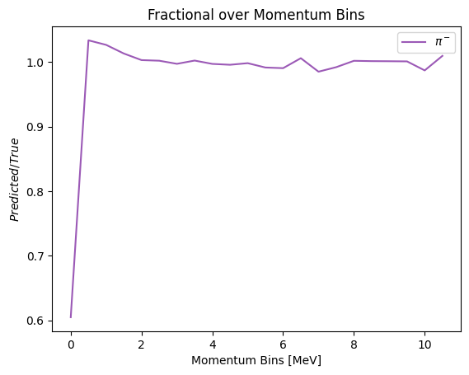
Prediction Fraction

Slide 21
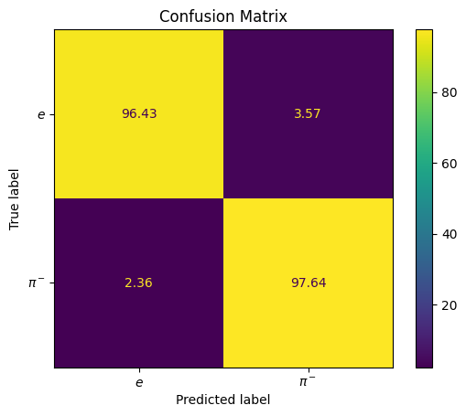
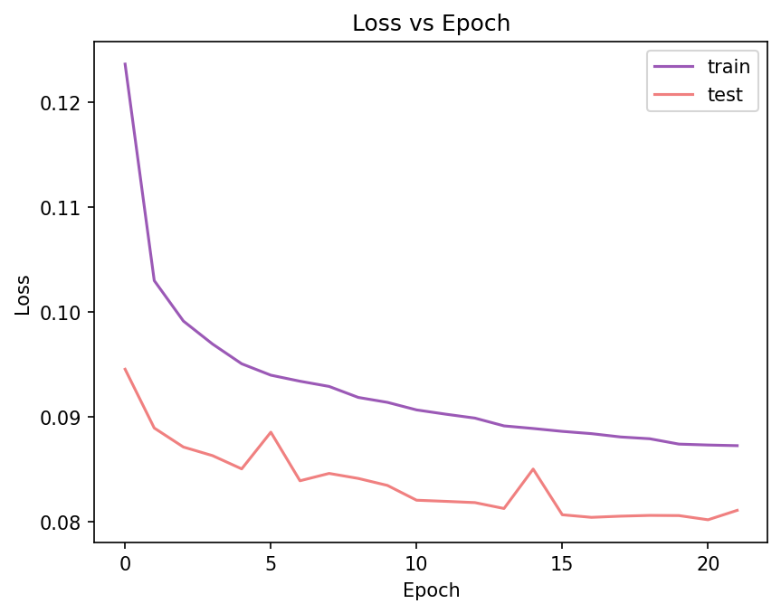
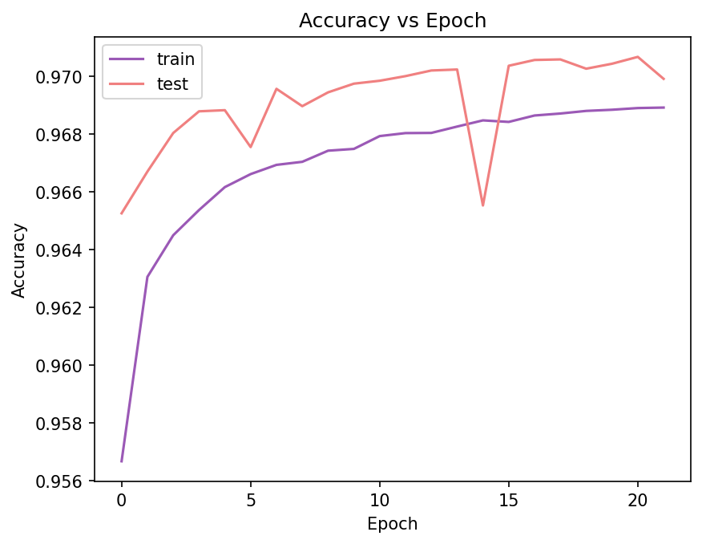
July 8th Update
“Full” Model trained on Pencil Beam data based on Ecal/Cherenkov columns

Slide 22
RECAP August 6
ML-Model Designed to applied for Beam Test Data
  Model Designed on Full simulated events.
  Beam Test ADC conversation values applied.
  First look at Beam Test Data with PID applied.

Slide 23
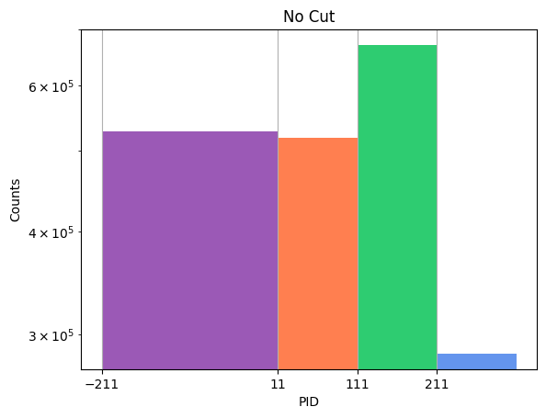
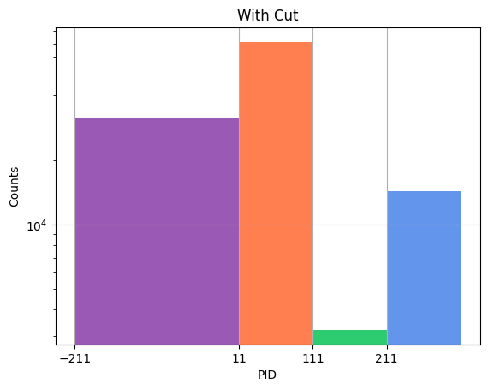
Full Simulation Data Set
The simulated event provide had to pass a cut:
  SC_A > MIP/2, SC_D > MIP/2, ShowerSum > 0.5 & p > 1
    The SC & ShowerSum cut selects requires energy to be deposited throughout the setup. The p > 1 gets rid of potential neutral pion that the ML model confuses as electron events.
    This reduced the number of training events significantly.

Slide 24
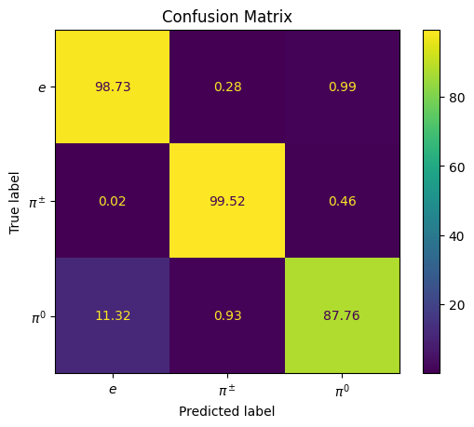
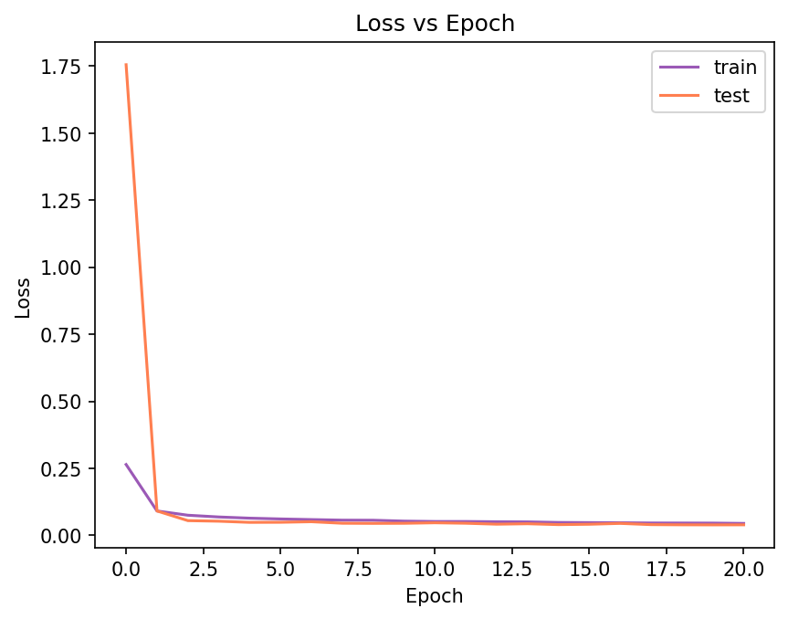
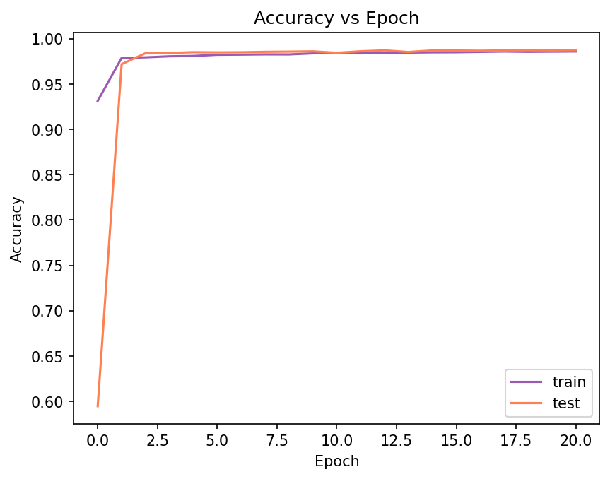
Model Information
To deal with reduced event count, ML model parameters were reduced as well.
Further optimization is need to improve hyper-parameters of the model.
Model does well at identifying electrons and charged pions but confuses natural pions with electrons.
  This potentially could be fixed with more neutral pion events.

Slide 25
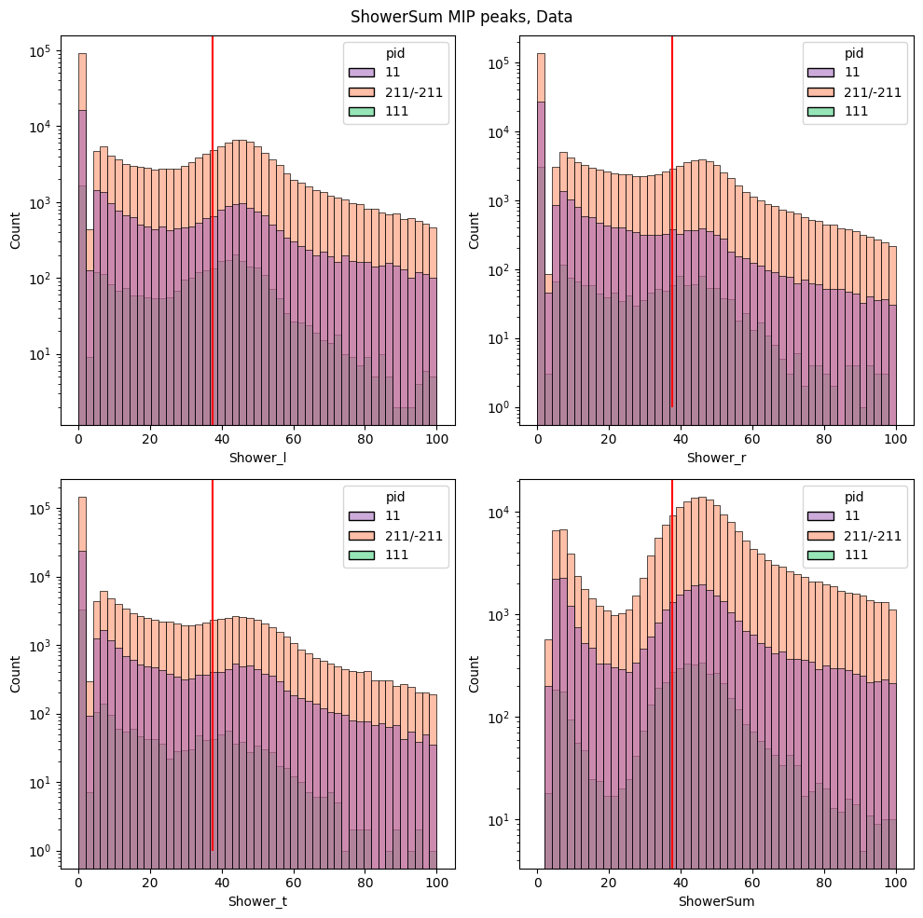
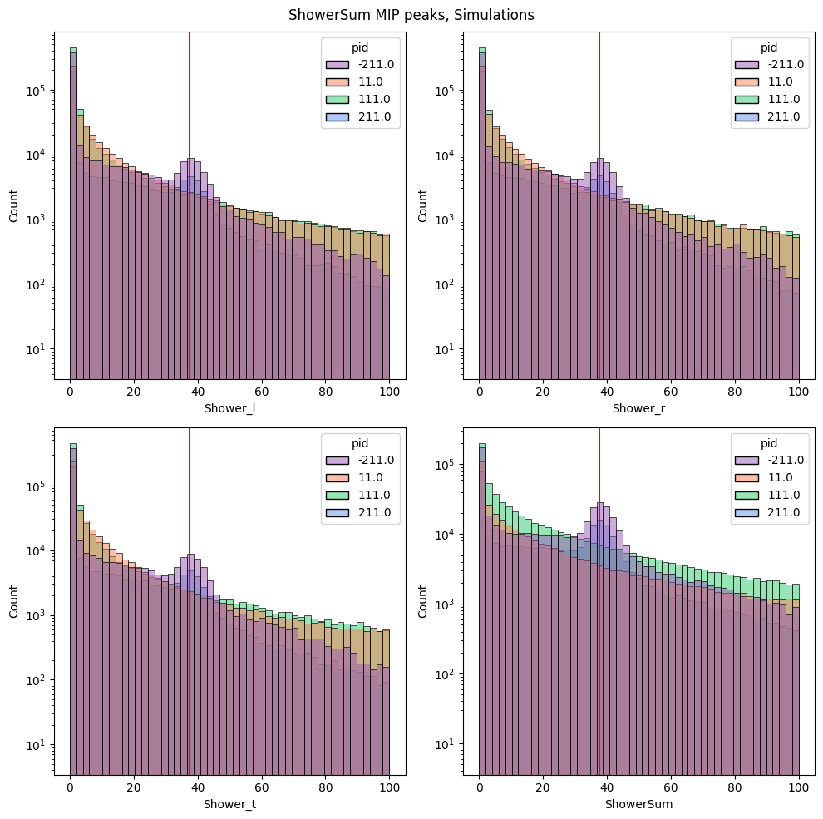
Beam Test, 4779 @ 10 uA
ADC conversation values applied to beam test.

Slide 26
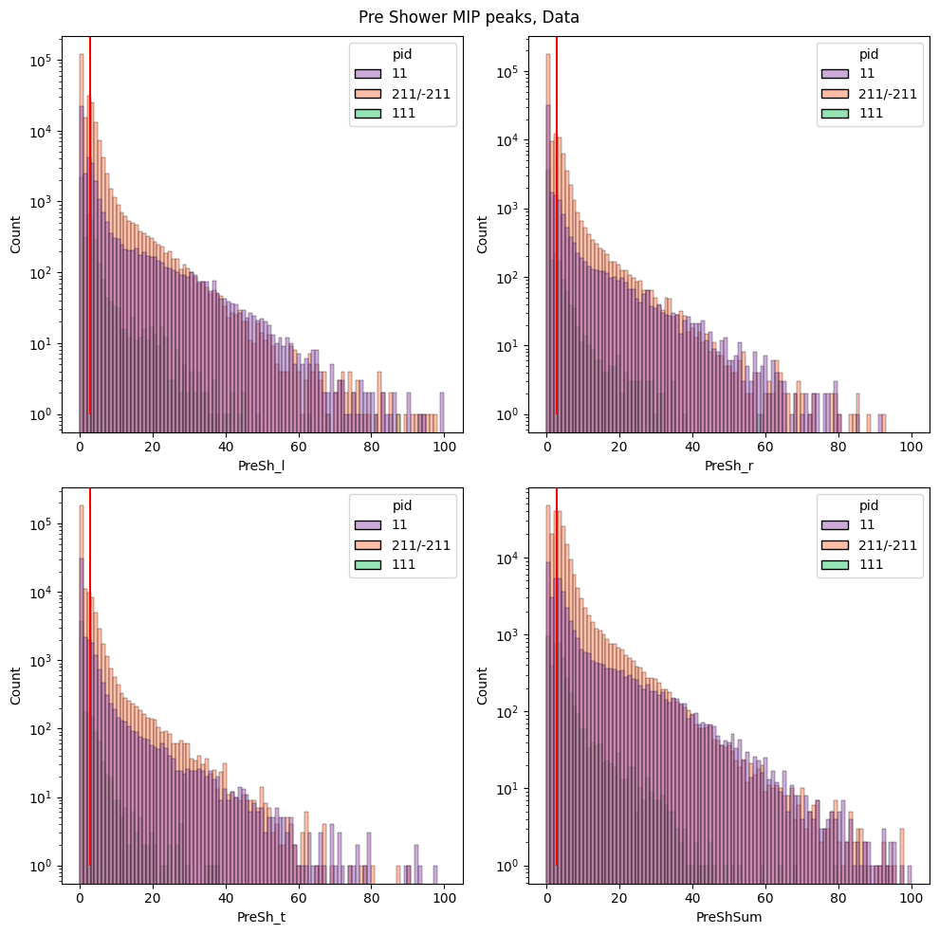
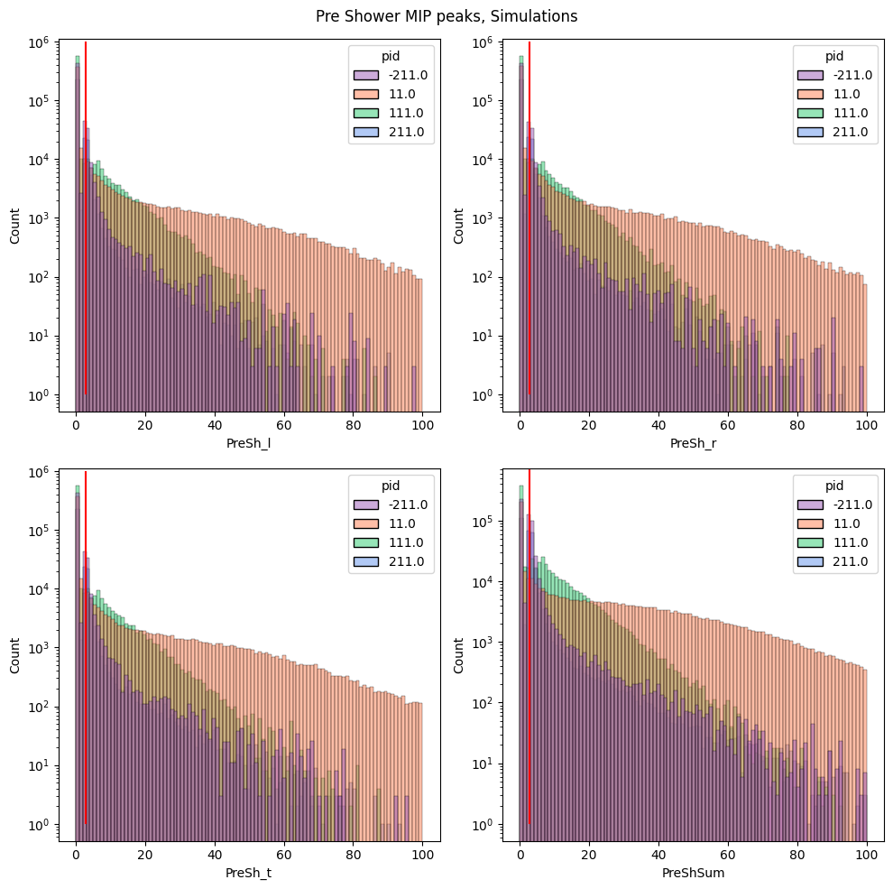
Beam Test, 4779 @ 10 uA

Slide 27
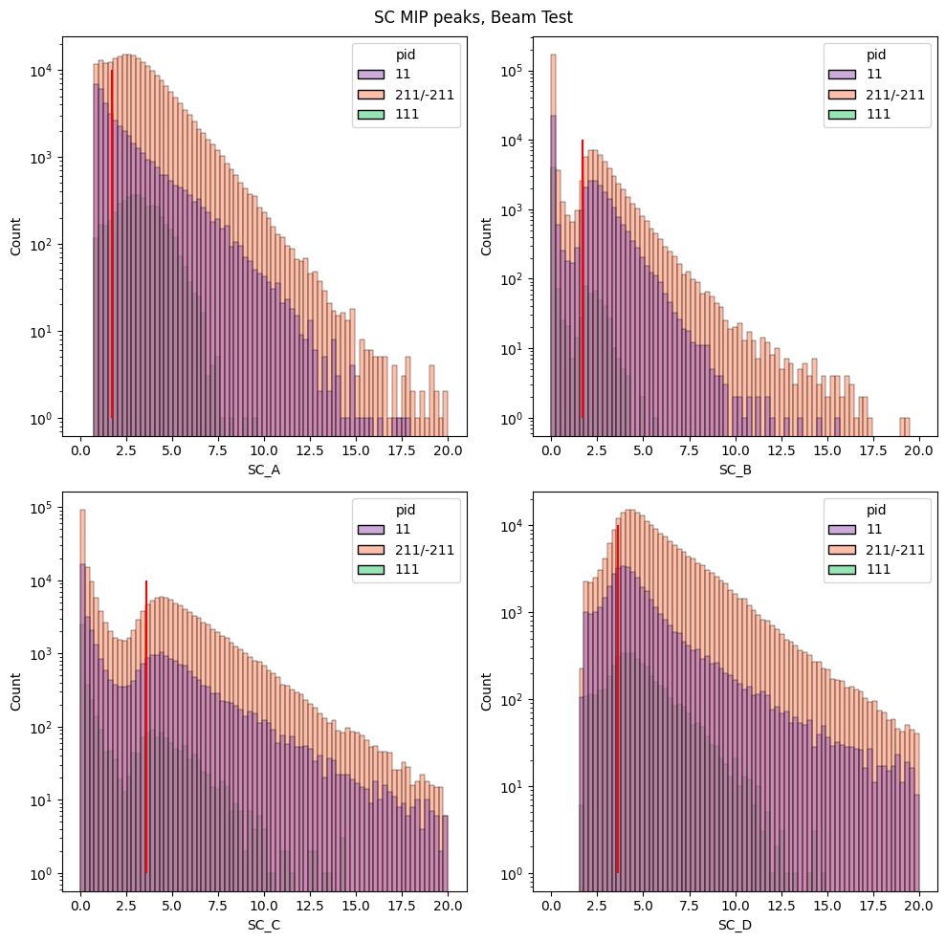
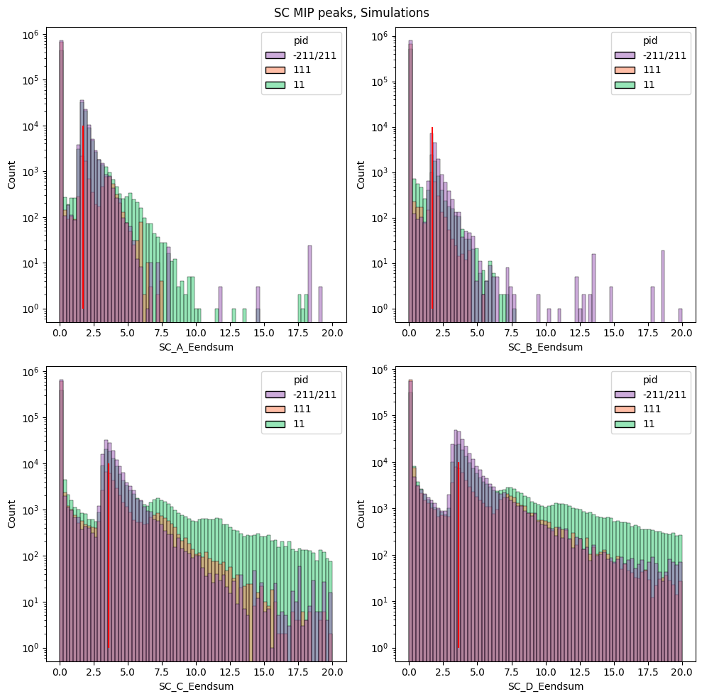
Beam Test, 4779 @ 10 uA

Slide 28
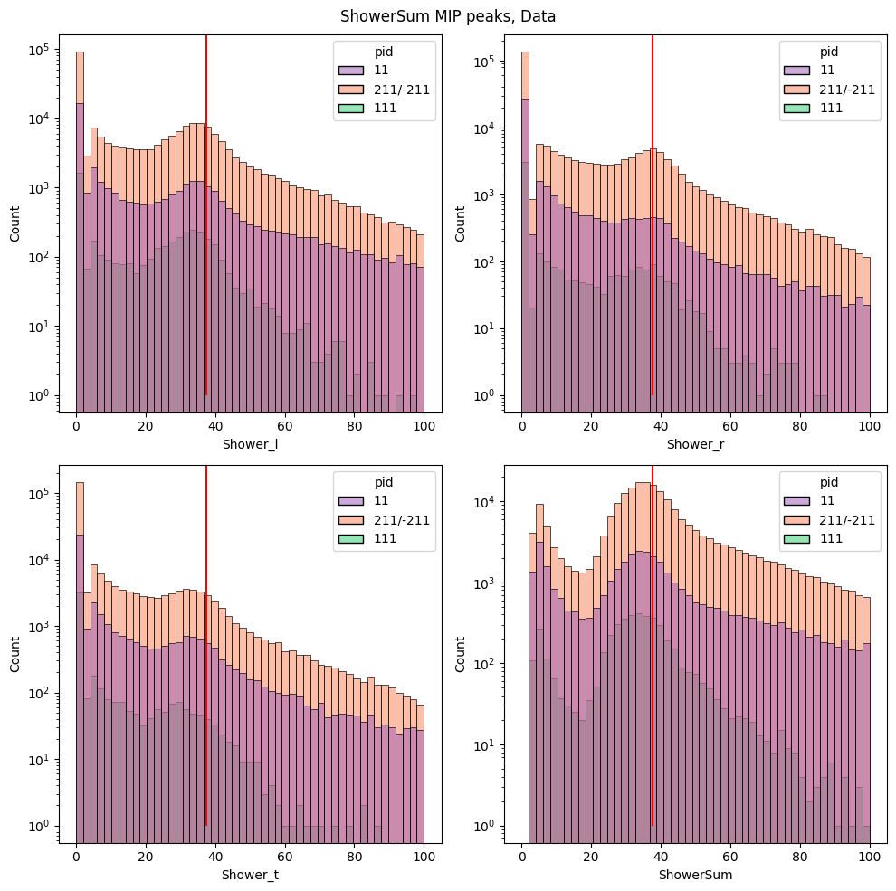
Shower MIP peak

Slide 29
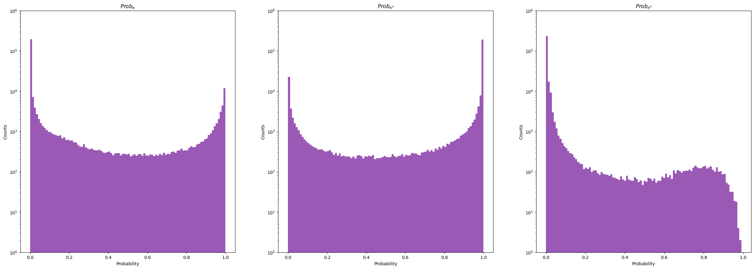
Probability Dist.

Slide 30
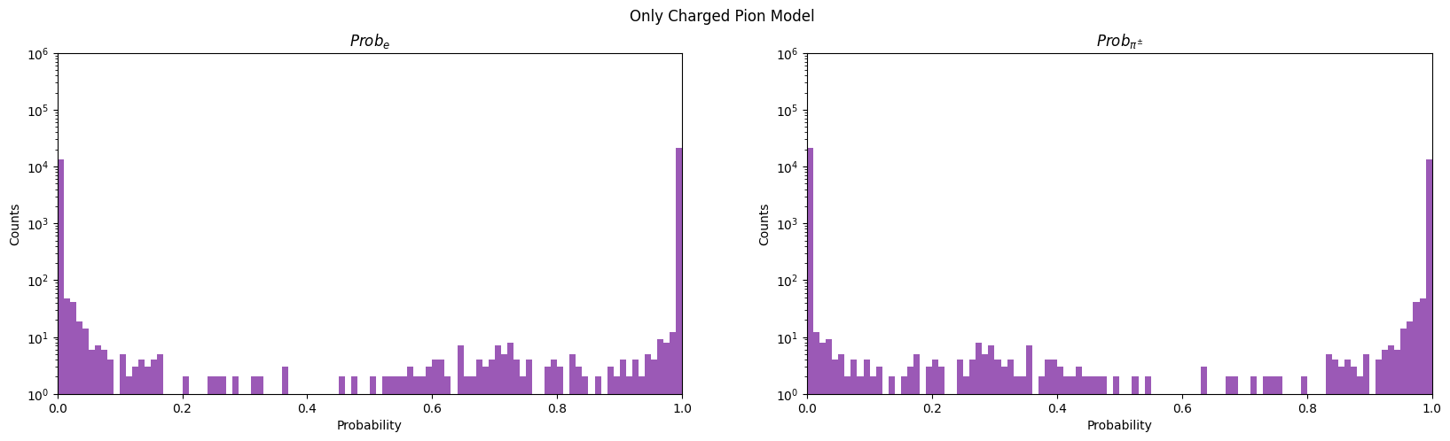
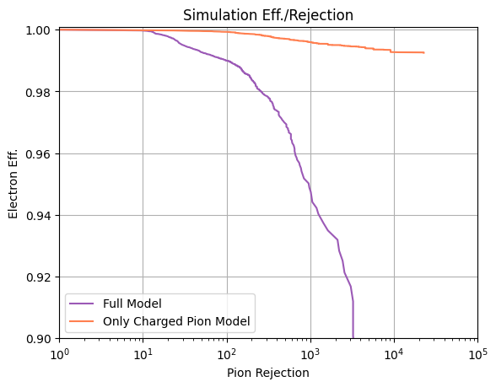
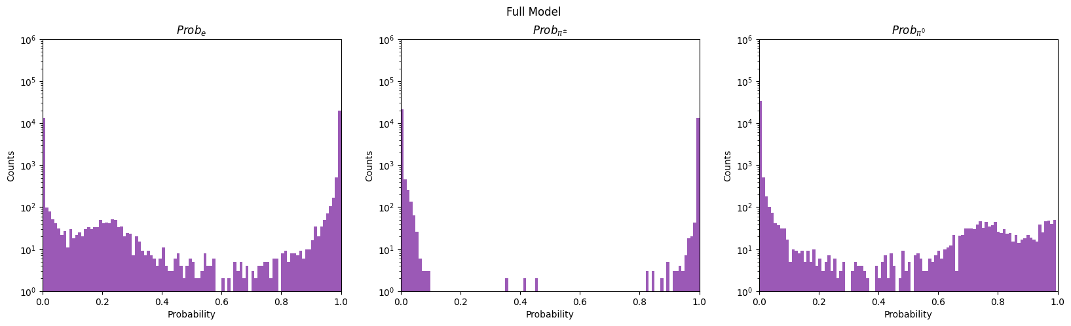
ROC plots

Slide 31
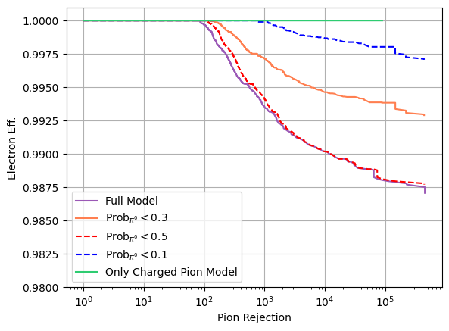
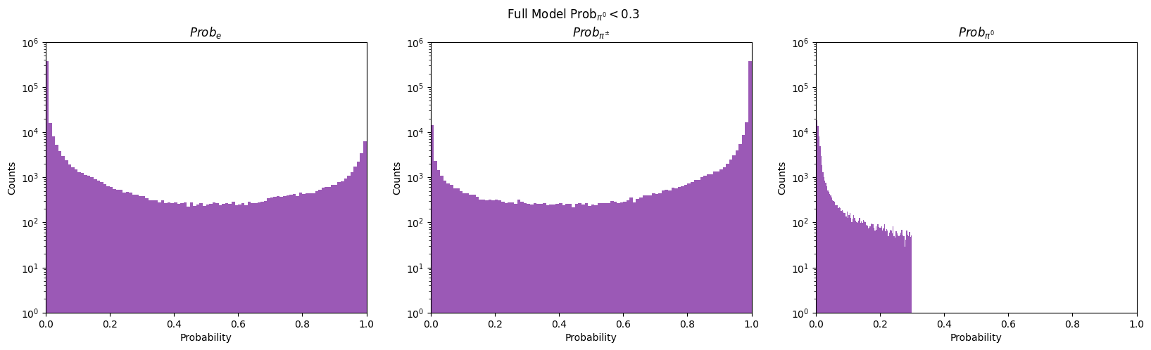
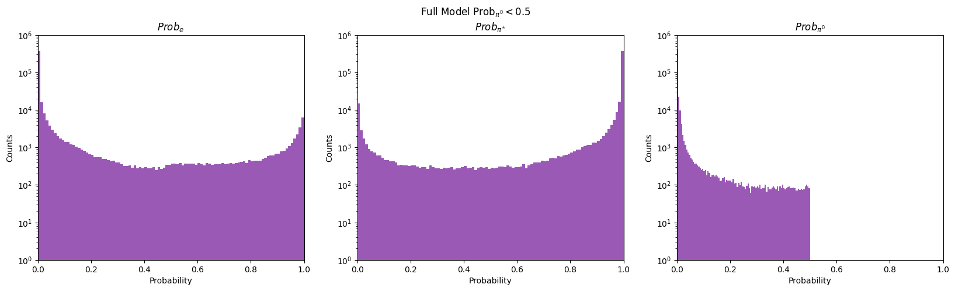
ROC Beam Test (Incorrect Usage of ROC)
BEAM Test doesn’t have true labels so ROC plots can’t be created

Slide 32
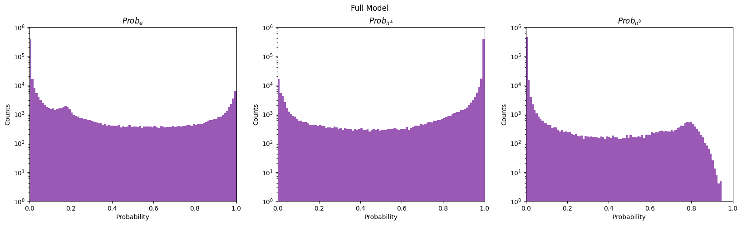

Slide 33
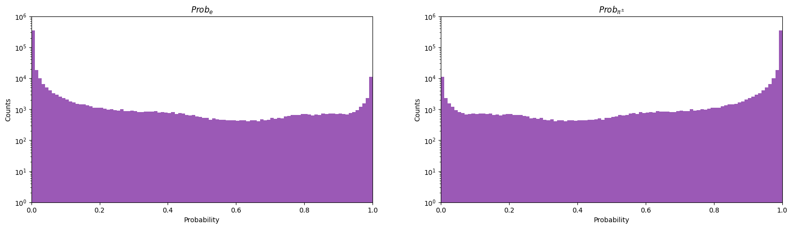

Slide 34
Updates to Models
We have 6 total models:
  A ”mixed” model that considers e/pi0 vs pm/pp
  A “full” model that considers e vs pi0 vs pm/pp
  A “only charged” model that considers e vs pm/pp
The models are trained on the TS3 cut definition of SC_A & SC_D both being 1/2 of their respective MIP peak and ShowerSum > 0.5
  An additional set of models we composed with a momentum (not possible in beam test) of p > 1 MeV.

Slide 35
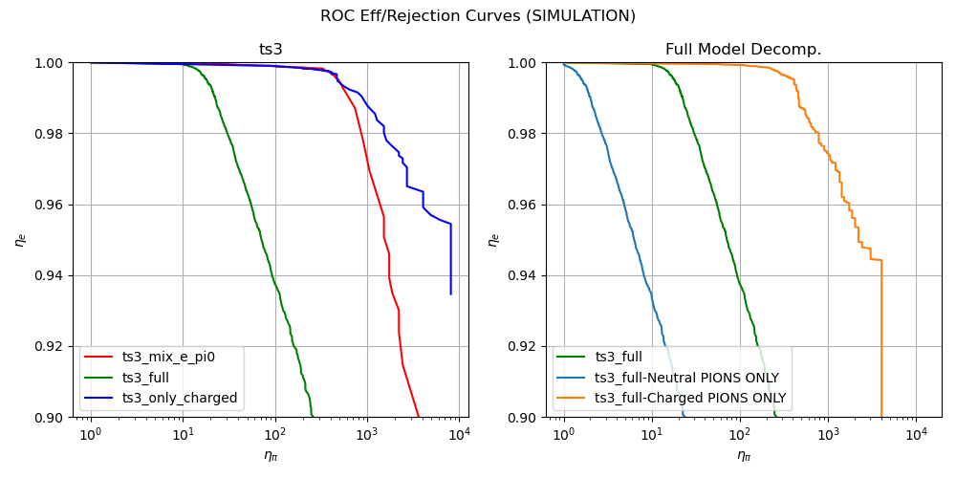
ROC Plots of Simulation (ts3 cut only)

Slide 36
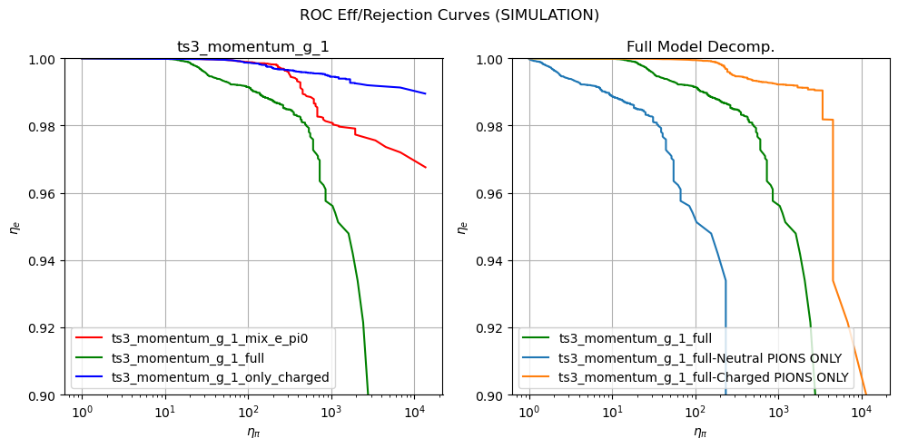
ROC Plots of Simulation (ts3 & p > 1)

