Slide 1
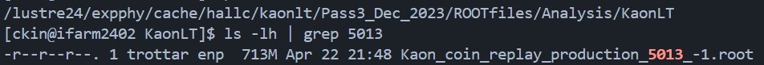
KaonLT Replay
Rerun replay the all 10 settings in Q^2=3.0, W=3.14 and Q^2=2.1,W=2.95
Used repository :
  Hallc_replay_ly : https://github.com/JeffersonLab/hallc_replay_lt/tree/LTSep_Analysis_2022
  UTIL_KAONLT : https://github.com/JeffersonLab/UTIL_KAONLT/tree/LTSep_Analysis_2024
Issues:
  File size > what Richard provides (847M vs 713M),
  But Missing mass is identical (probably just root version diff)

Slide 2
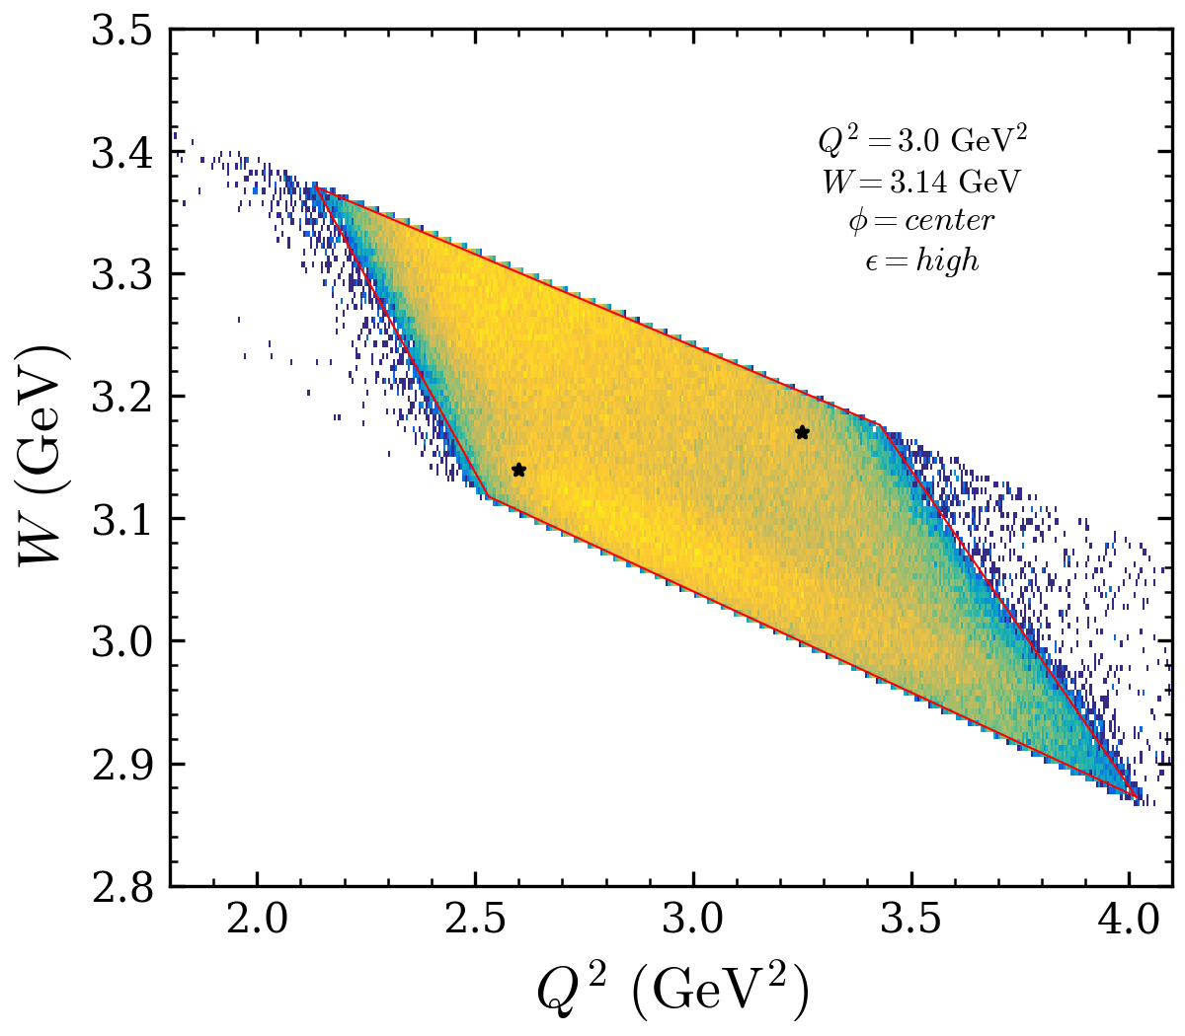
Diamond cut
Threshold = 3 counts
Pick two control points well within the diamond
Pointed are selected by the first and last non-zero bin
Fit all 4 sides
smear the histogram first for the noise ?

Slide 3
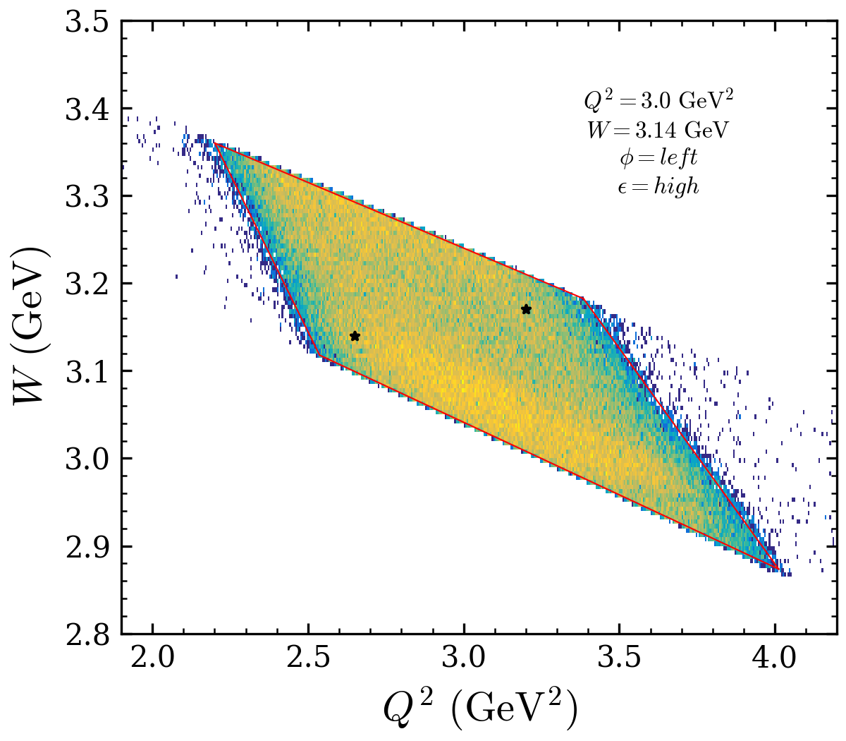
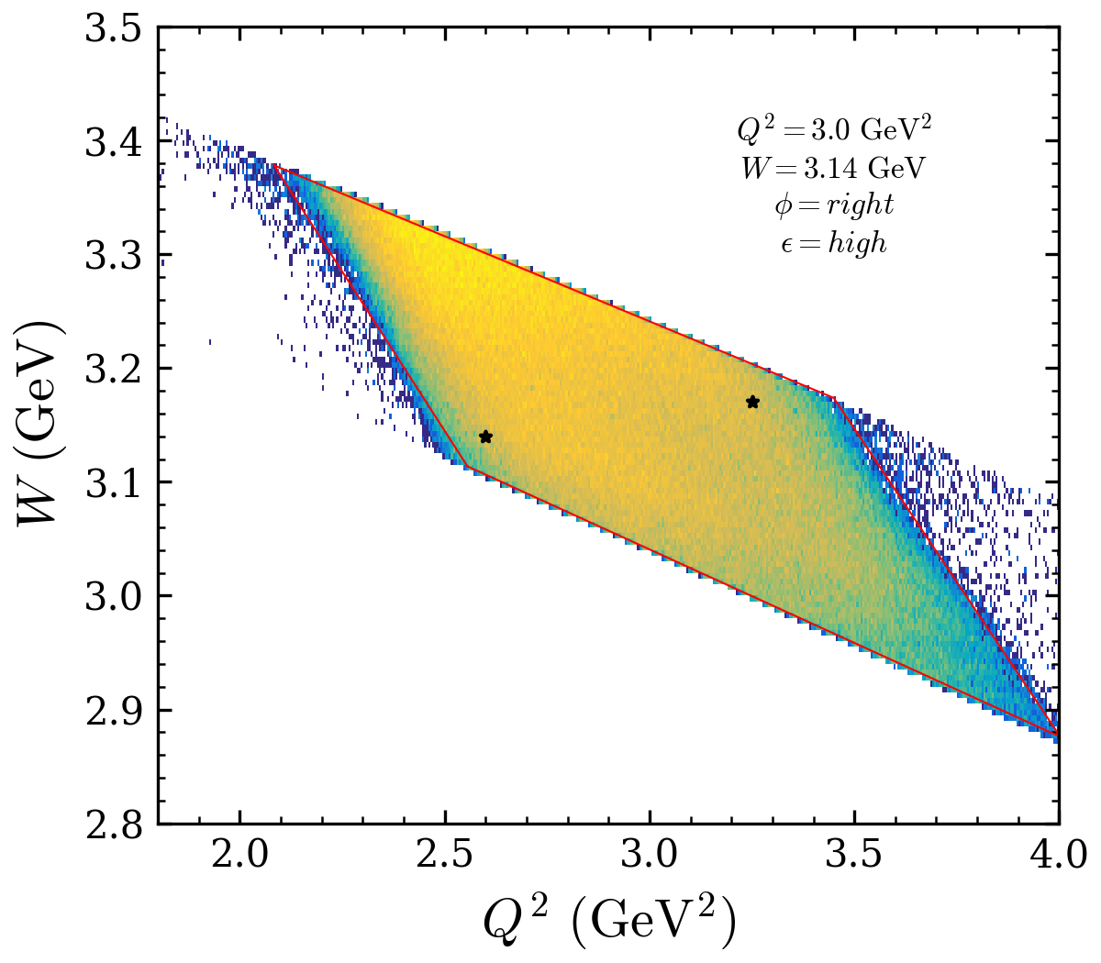
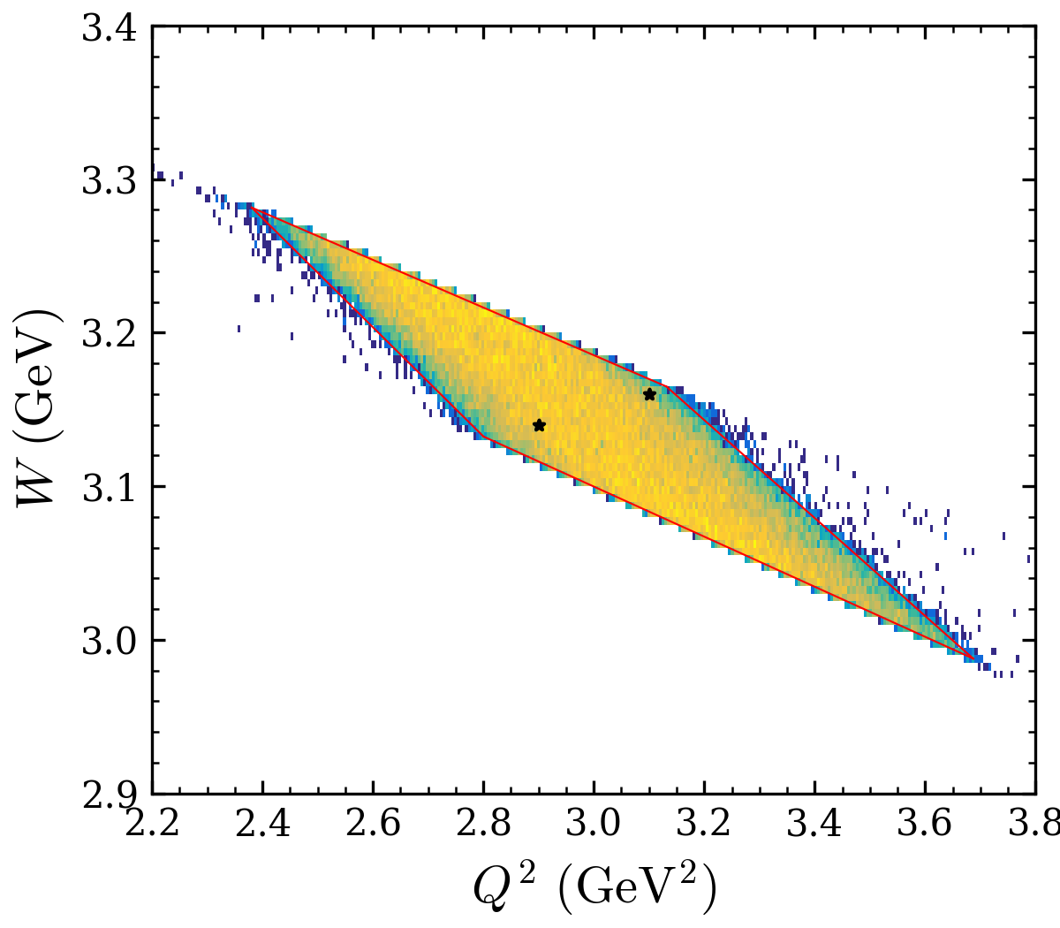
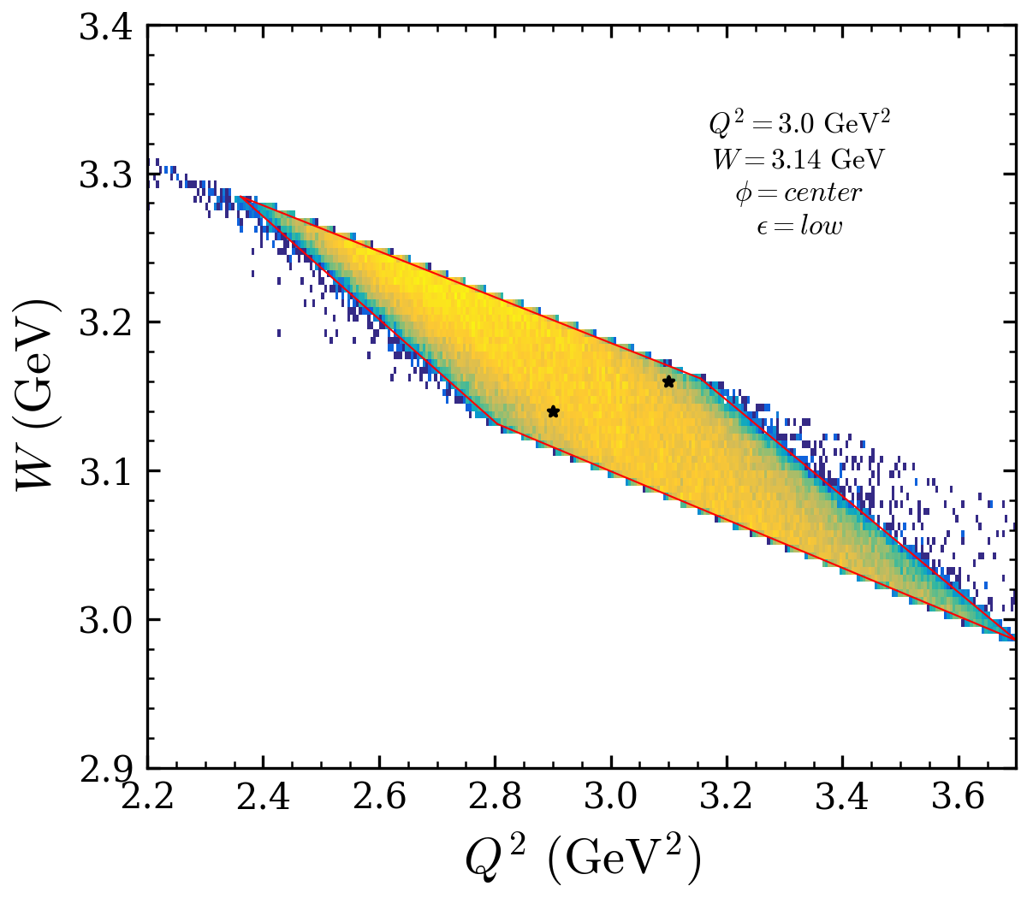

Diamond cut
$$Q^{2}=3.0, W=3.14$$

Slide 4
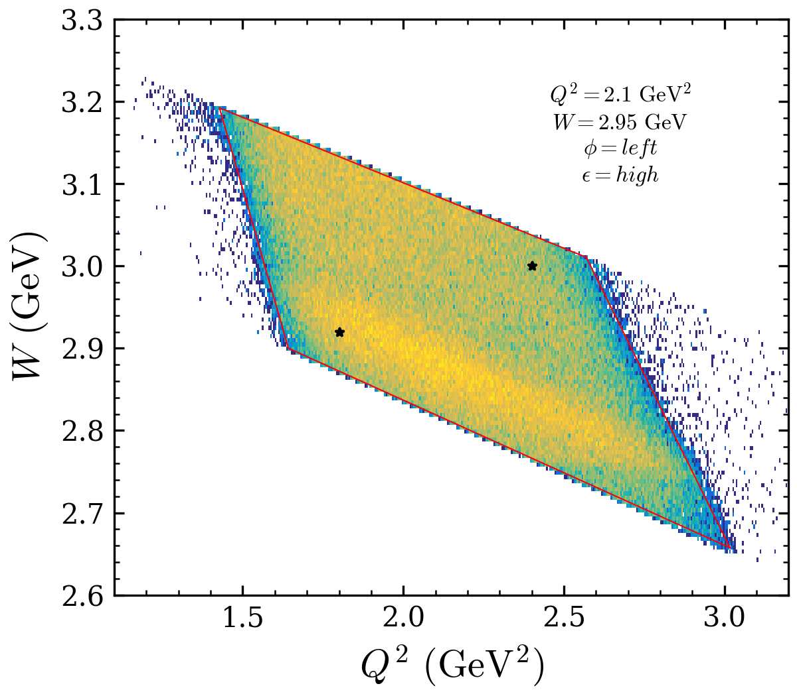
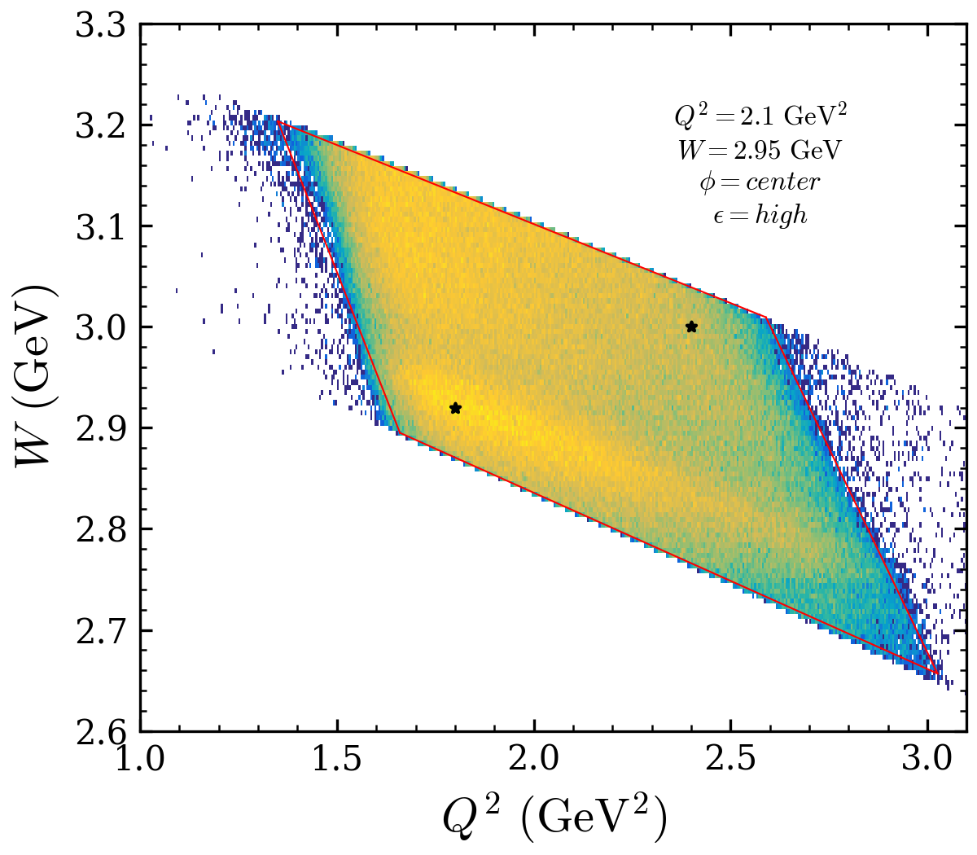
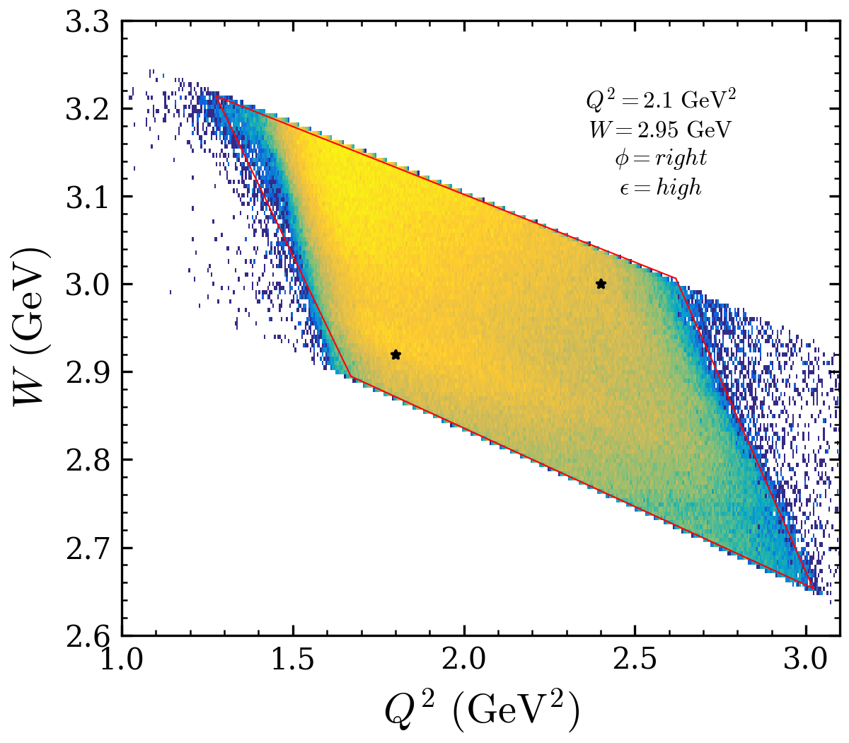
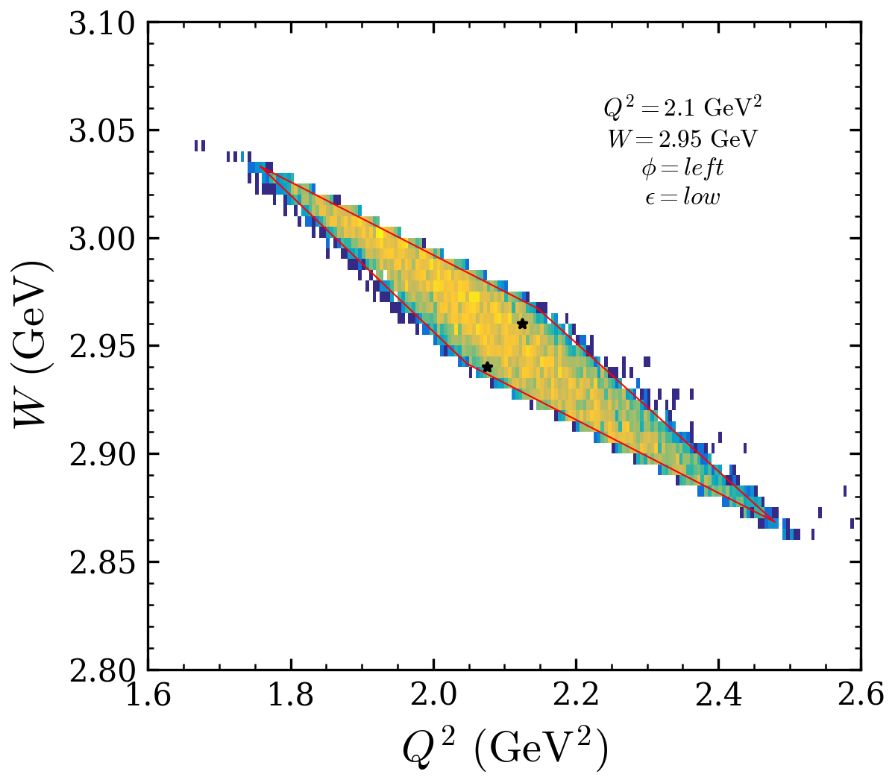
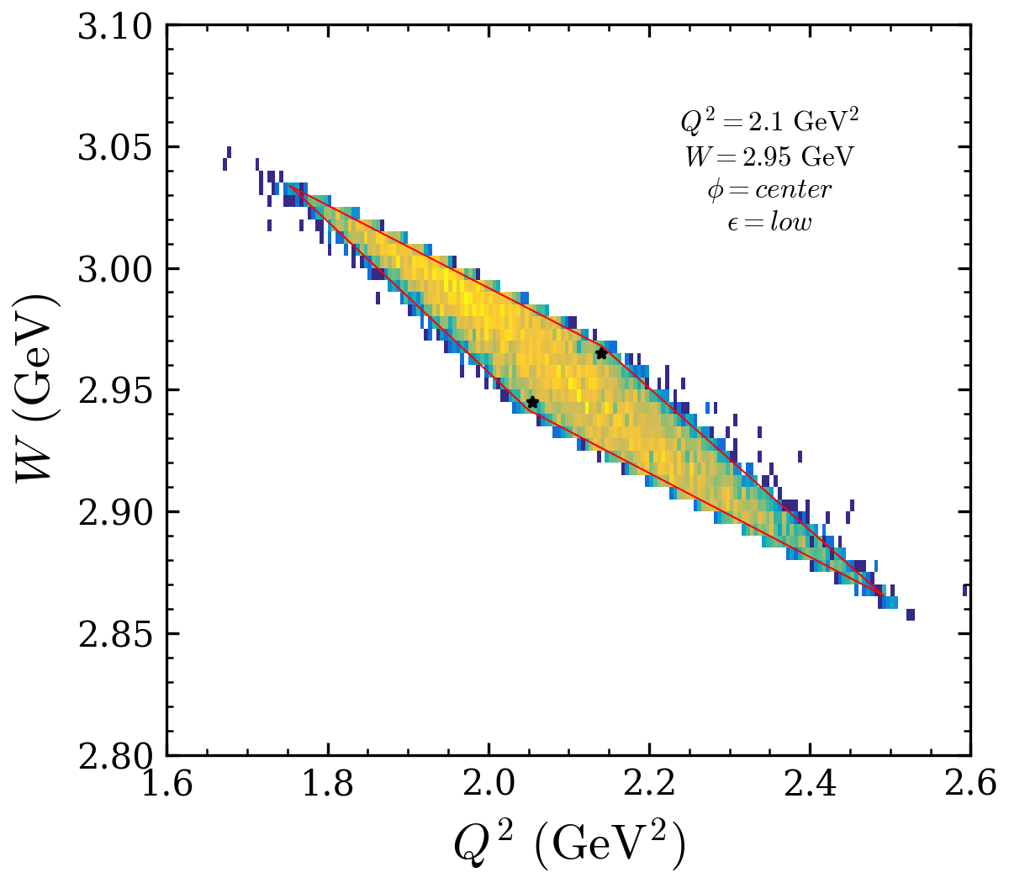

Diamond cut
$$Q^{2}=2.1, W=2.95$$

Slide 5
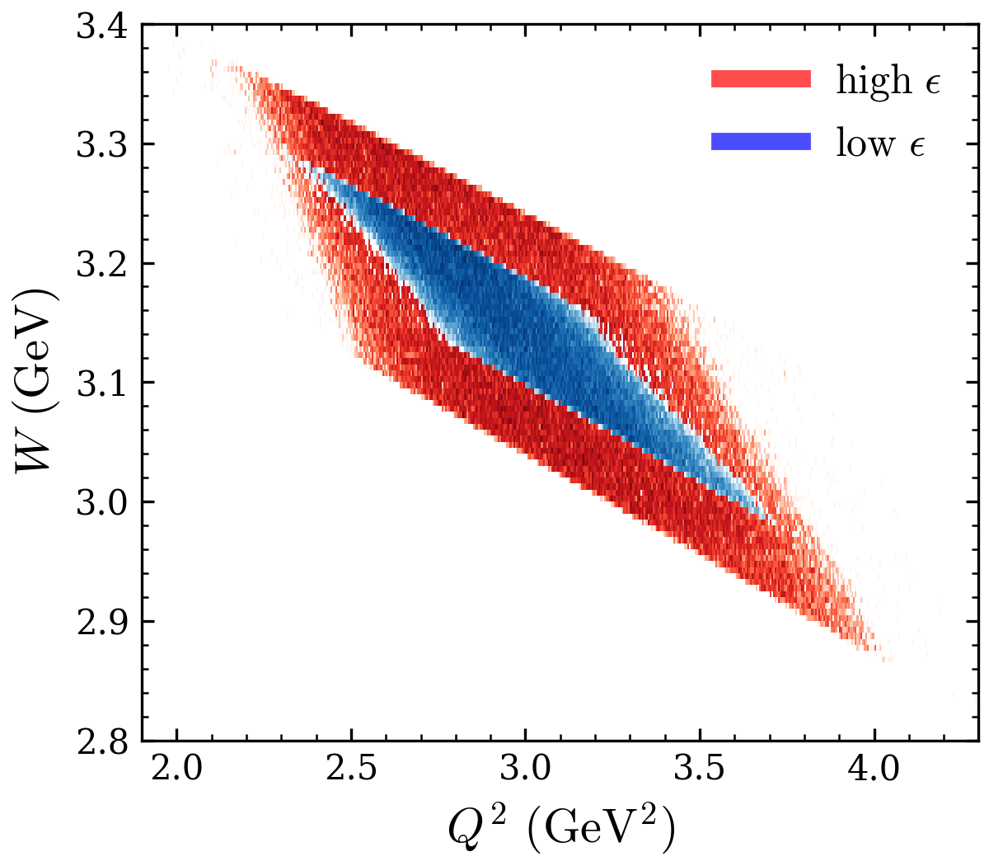

Slide 6
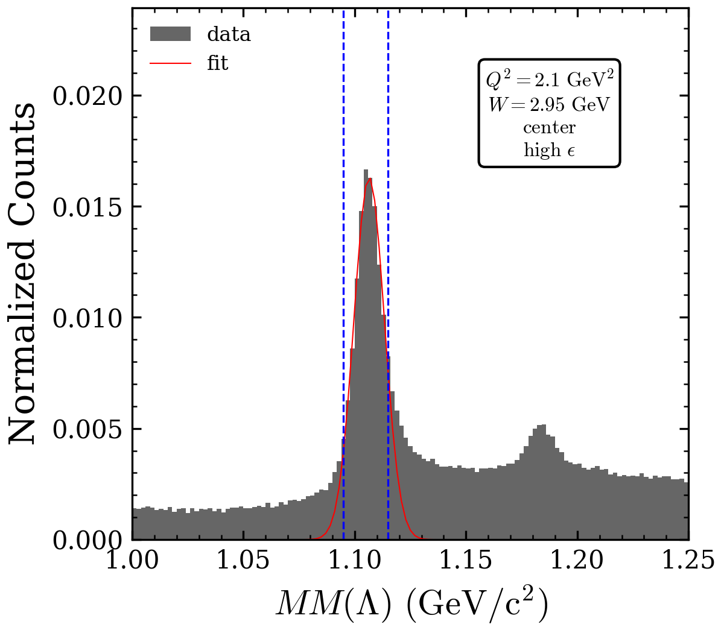
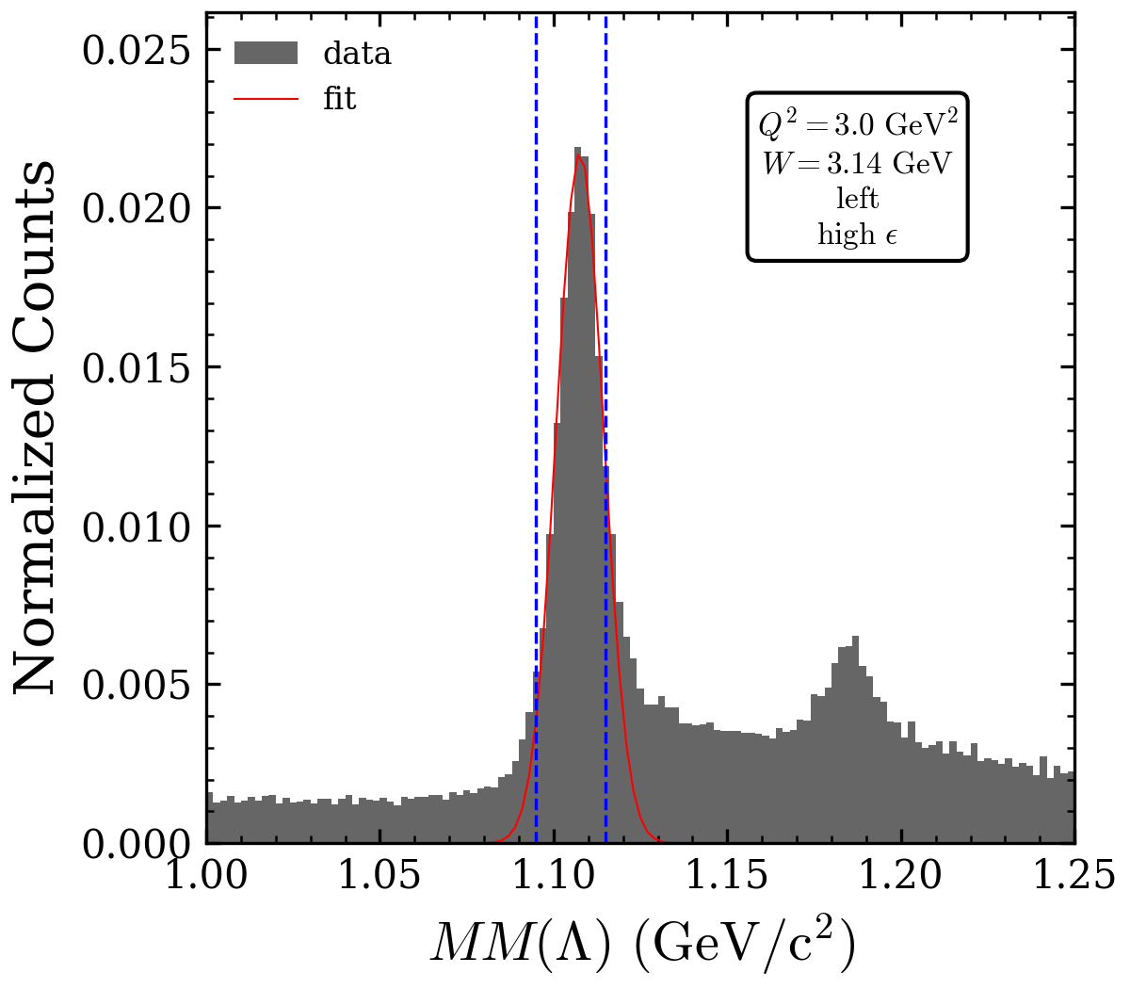
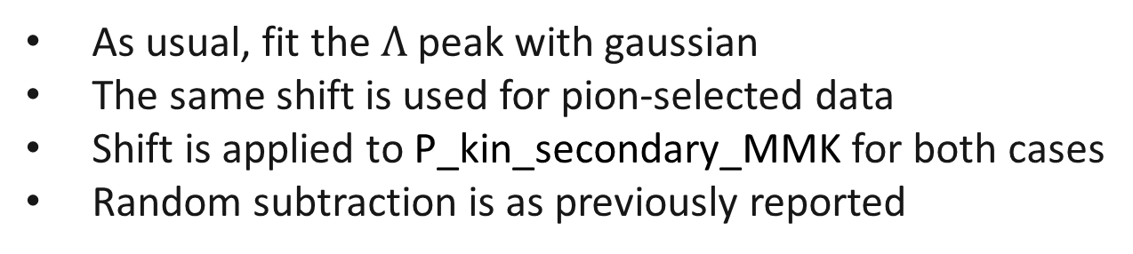
Missing Mass Fit
As usual, fit the $Λ$ peak with gaussian
The same shift is used for pion-selected data
Shift is applied to P_kin_secondary_MMK for both cases
Random subtraction is as previously reported

Slide 7
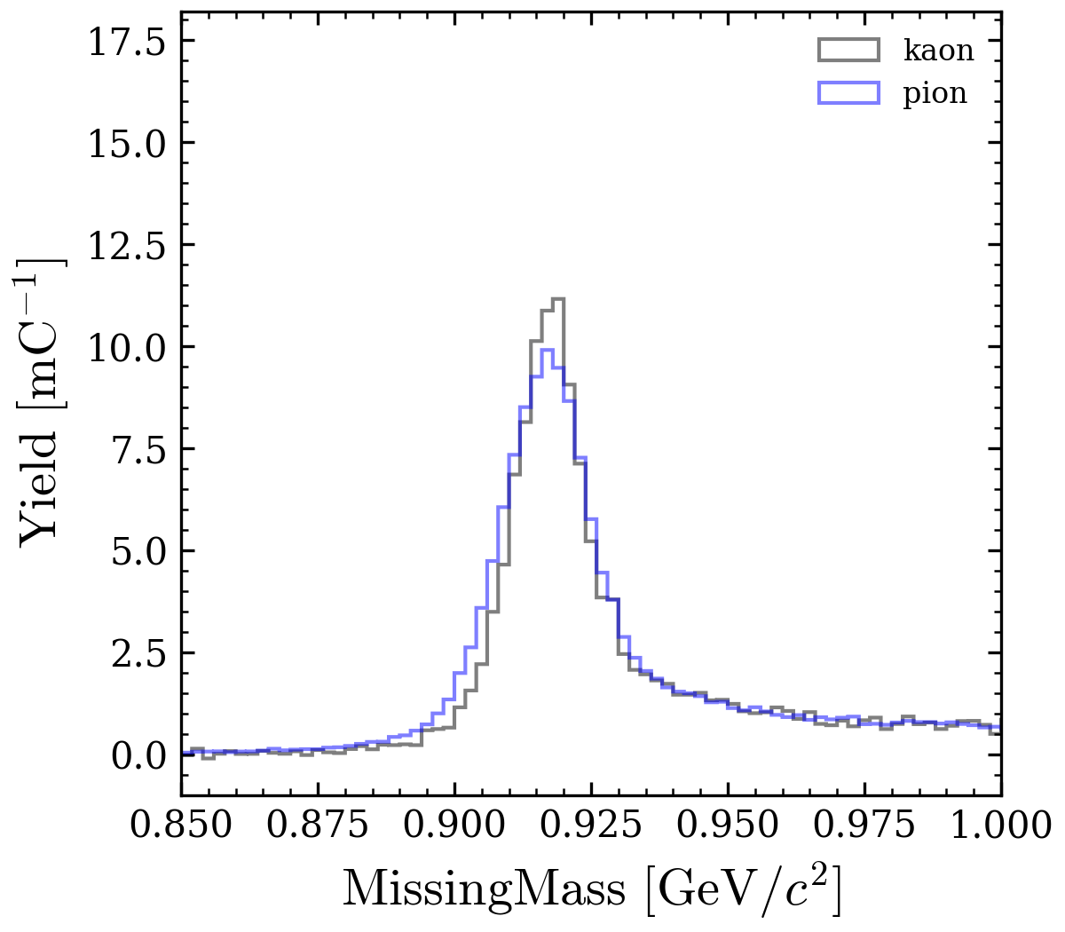
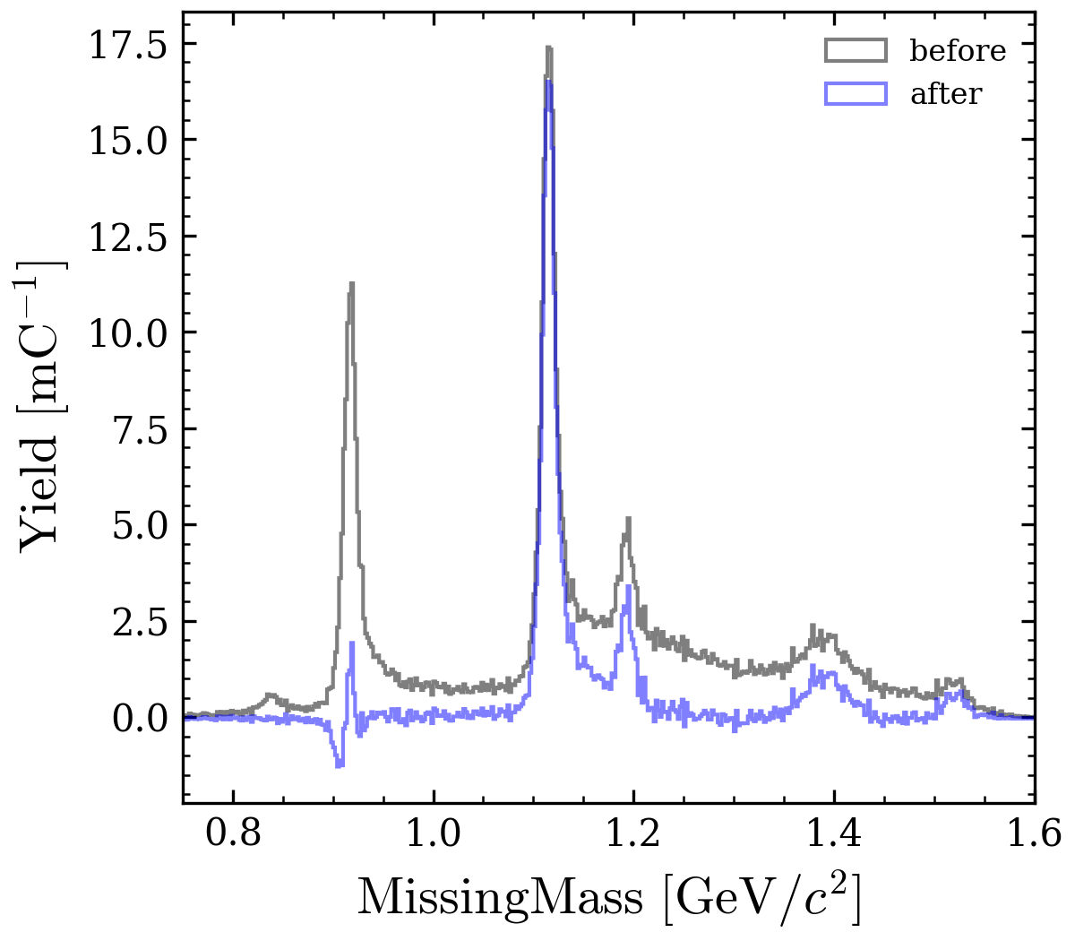
Pion background subtraction
Proton peaks align but differs in resolution
Scale according to integral under the peak
Deconvolve before subtraction ?

Slide 8
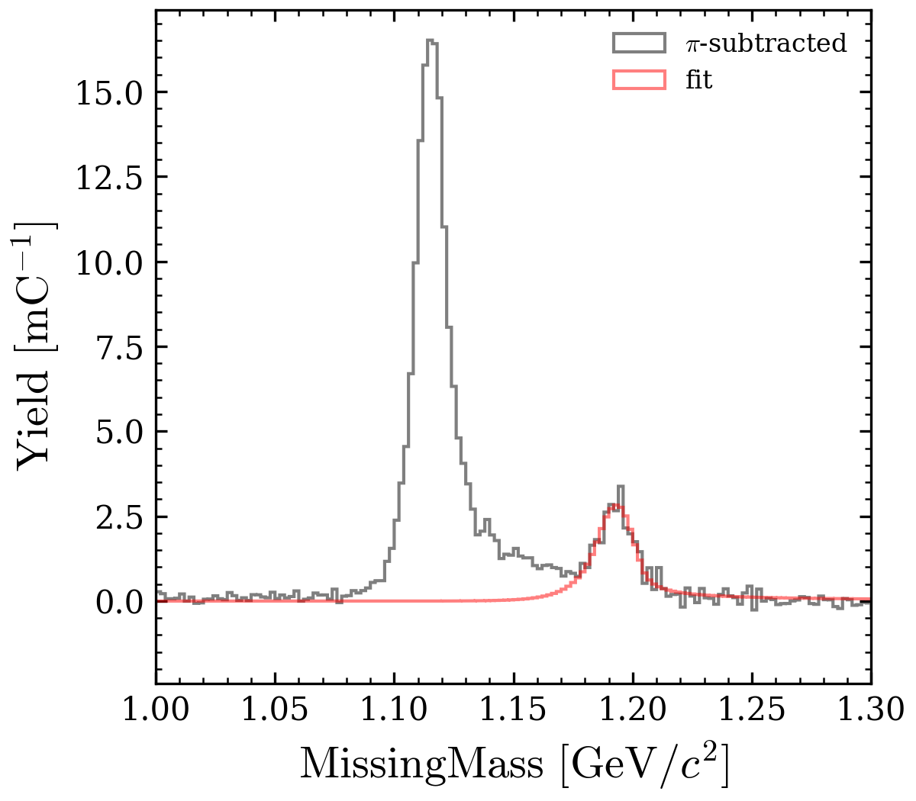
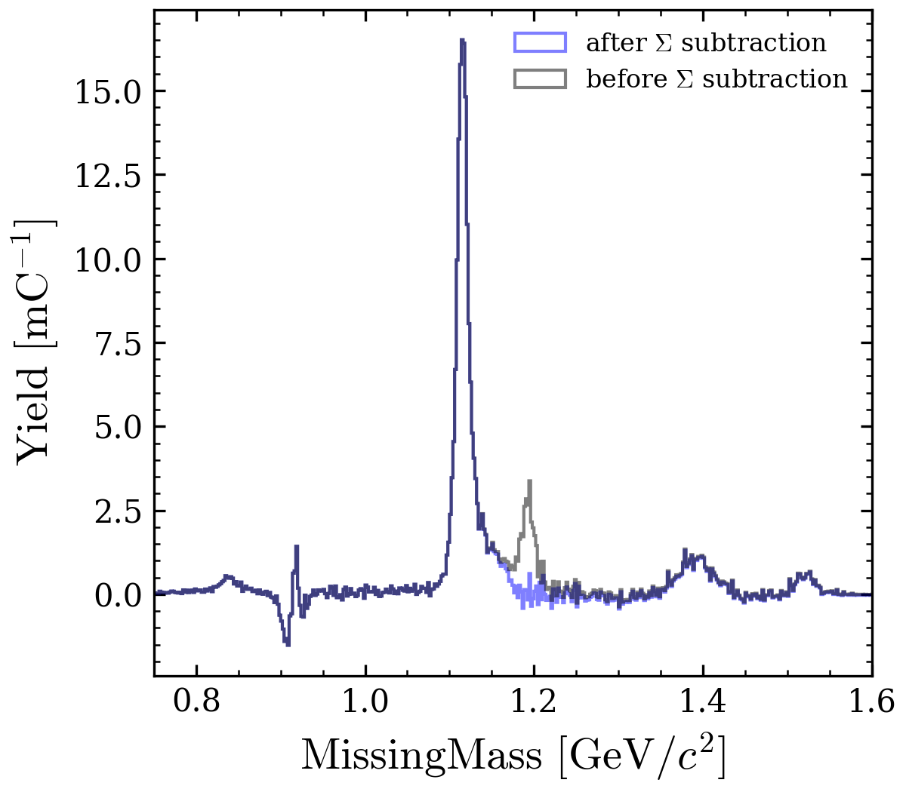
Sigma background subtraction

Slide 10
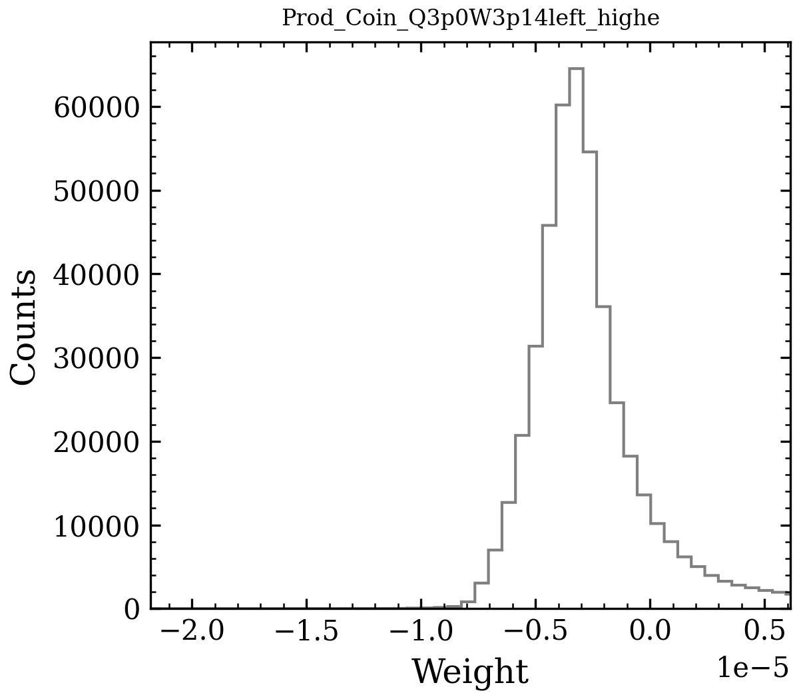
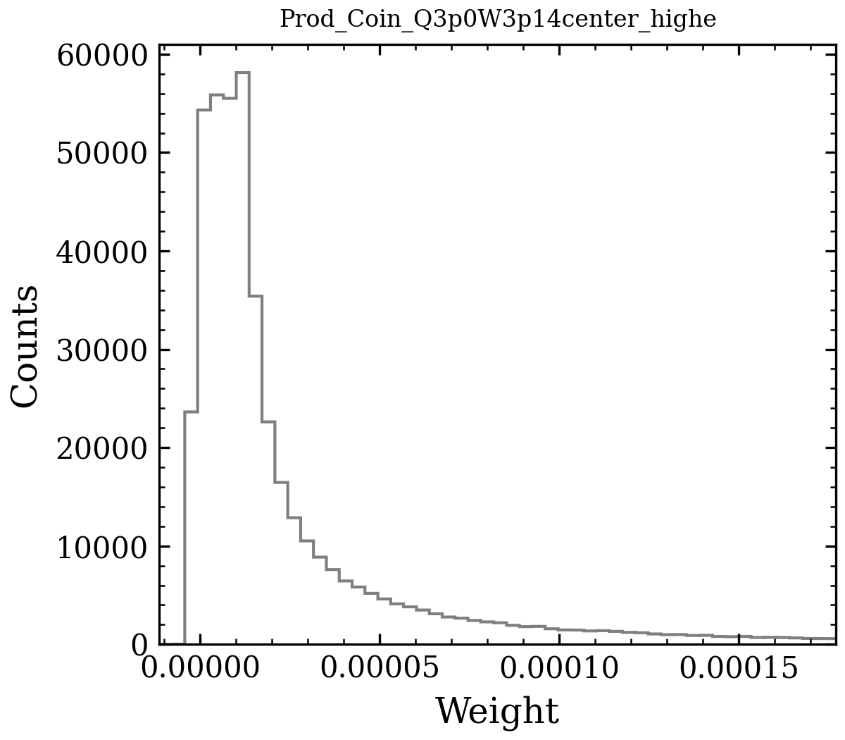
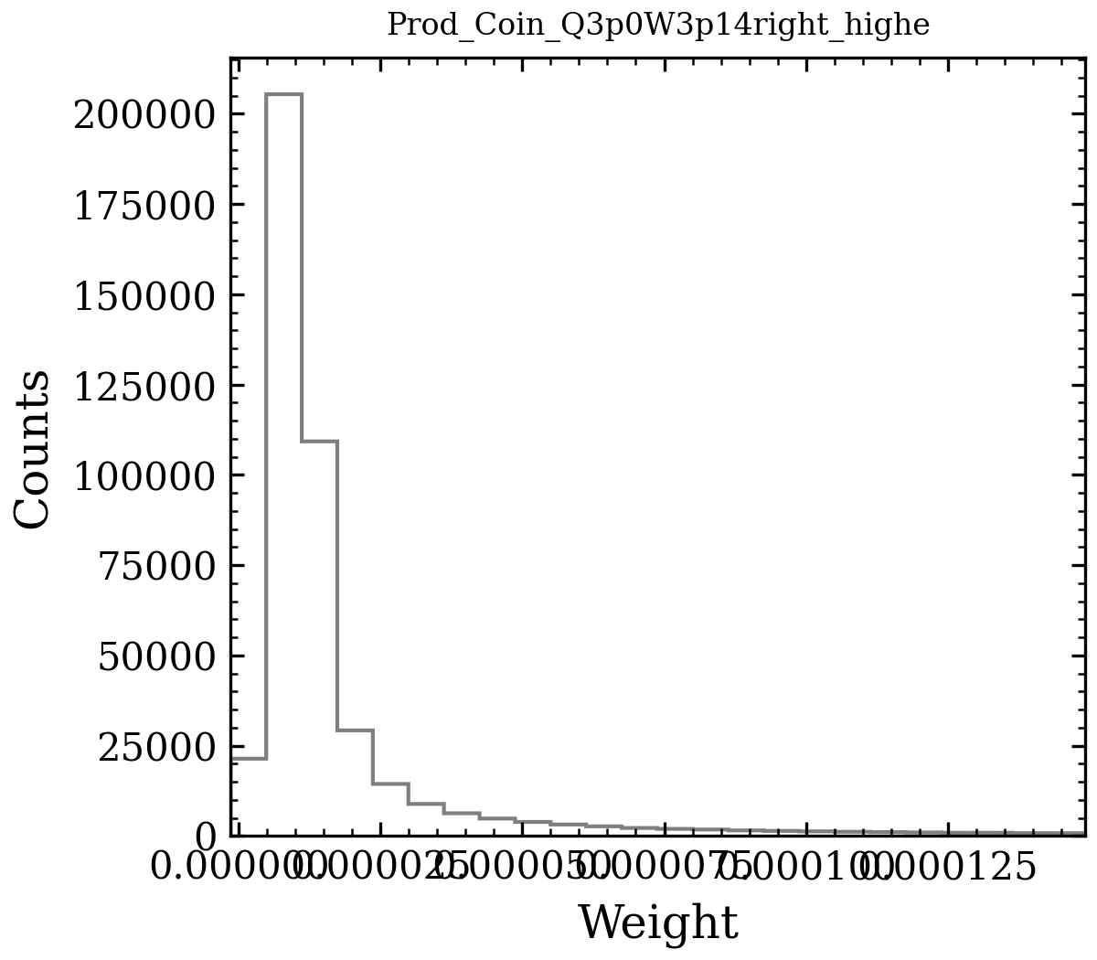
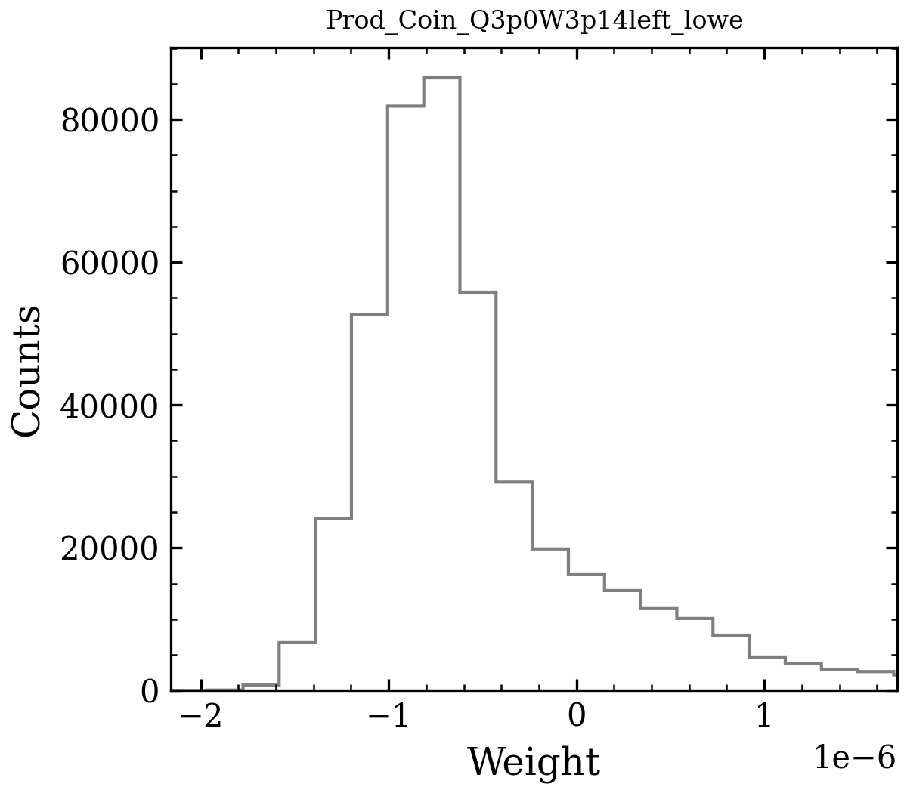
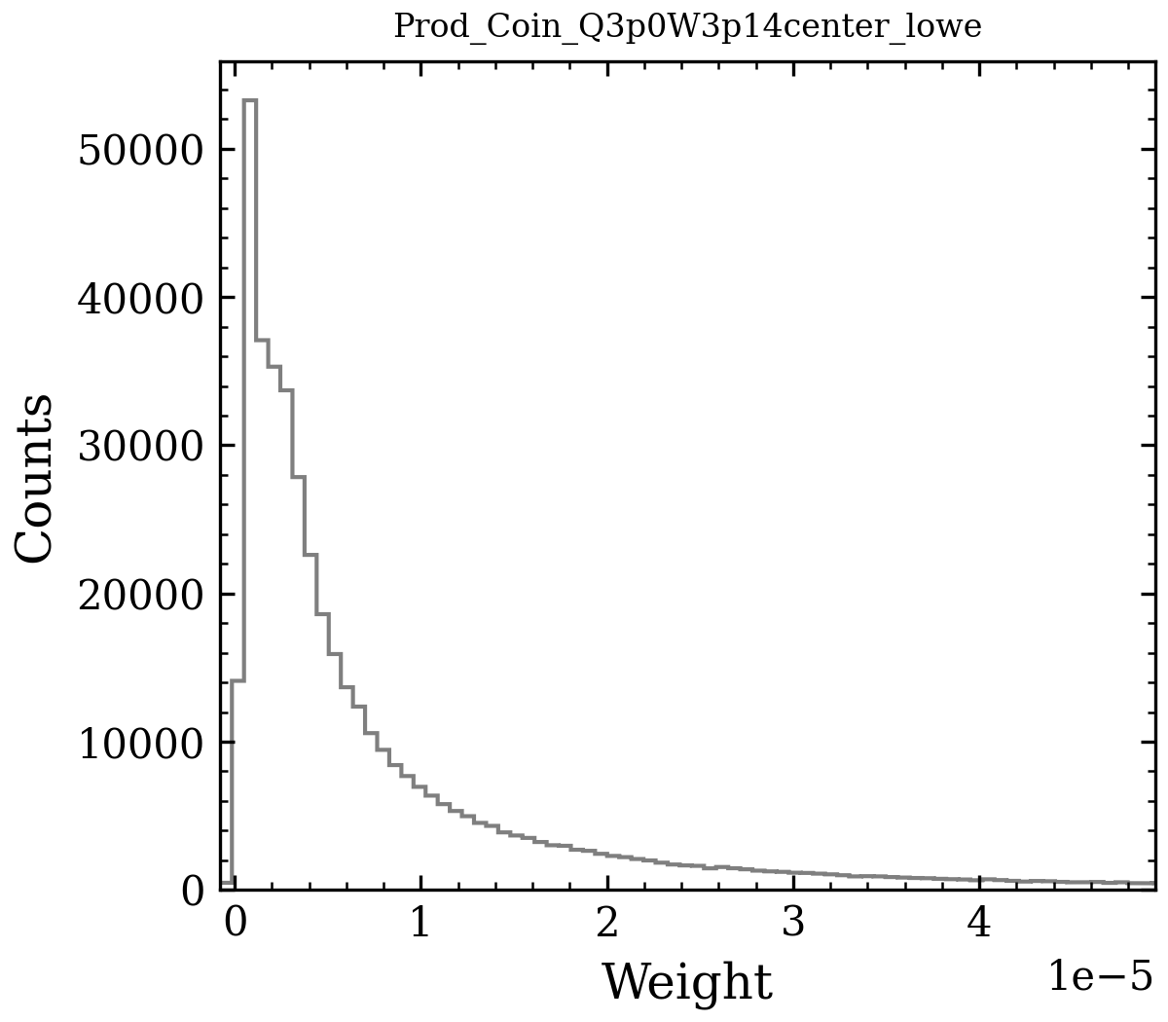
SIMC negative Weight
Only Left gives negative xsect.

Slide 11
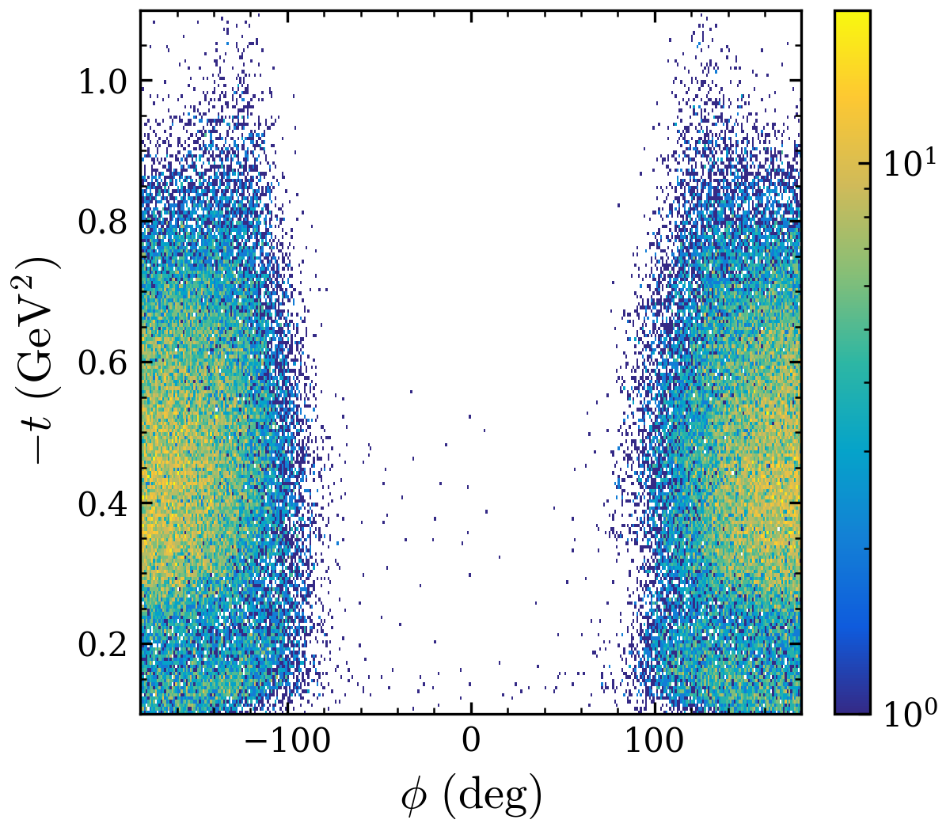
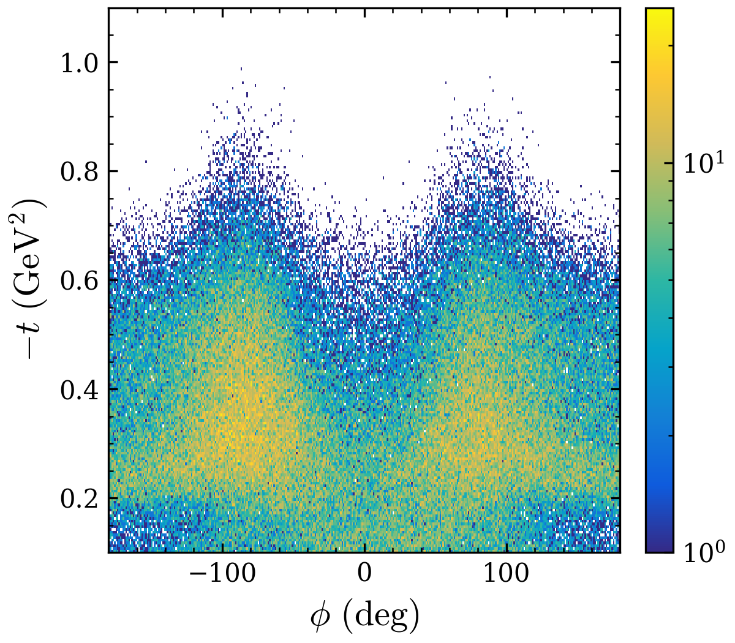
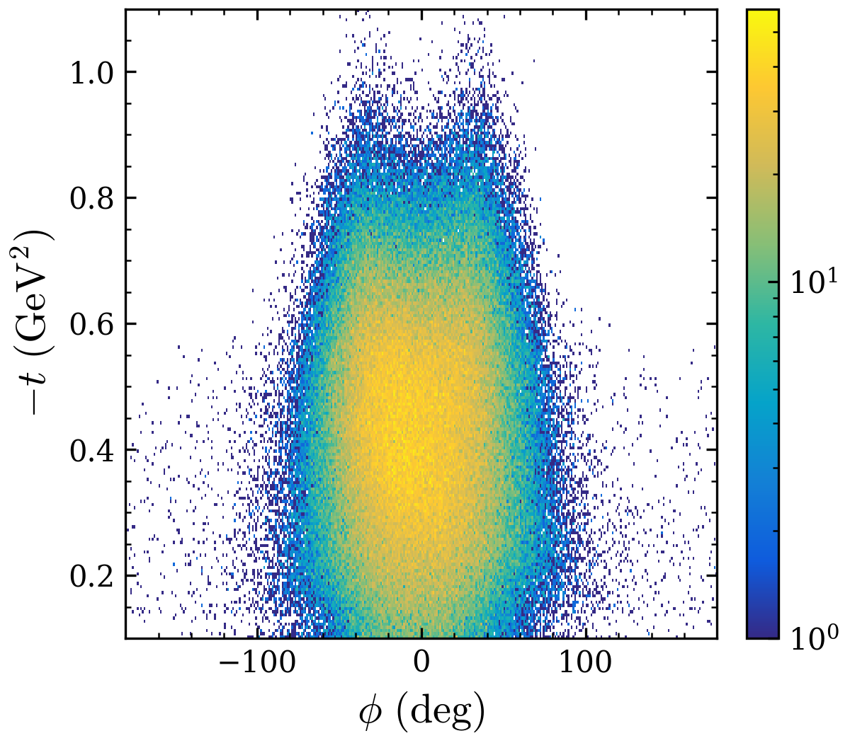
$t vs φ$ distribution $Q^{2}=3.0,W=3.14, high ε$
left
center
right
Only Left gives negative xsect.

Slide 12
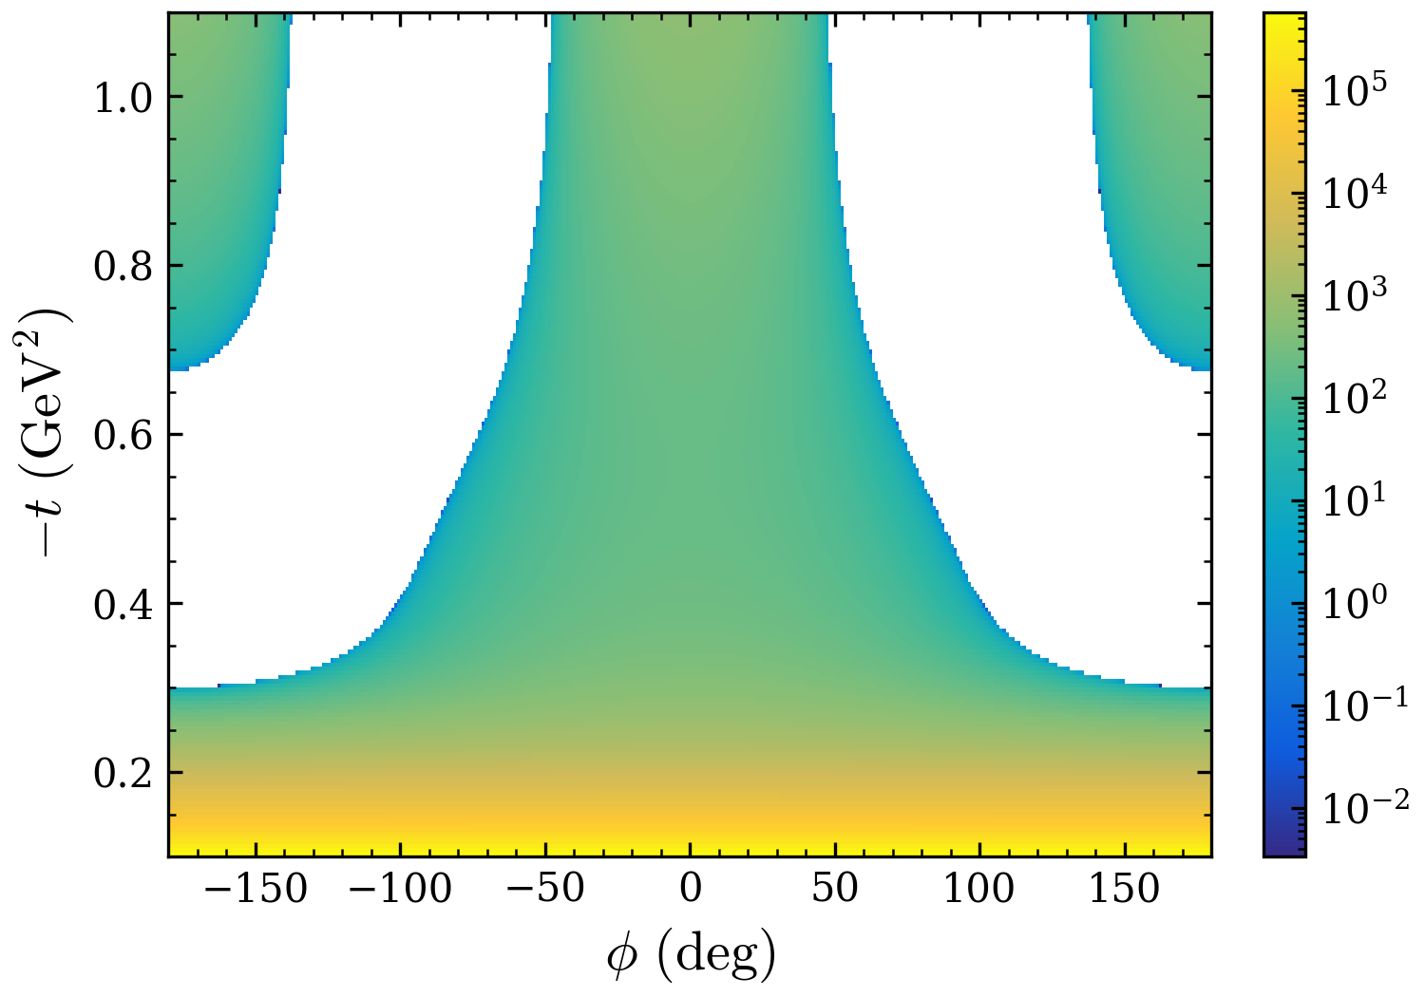
Xsect values

Slide 13
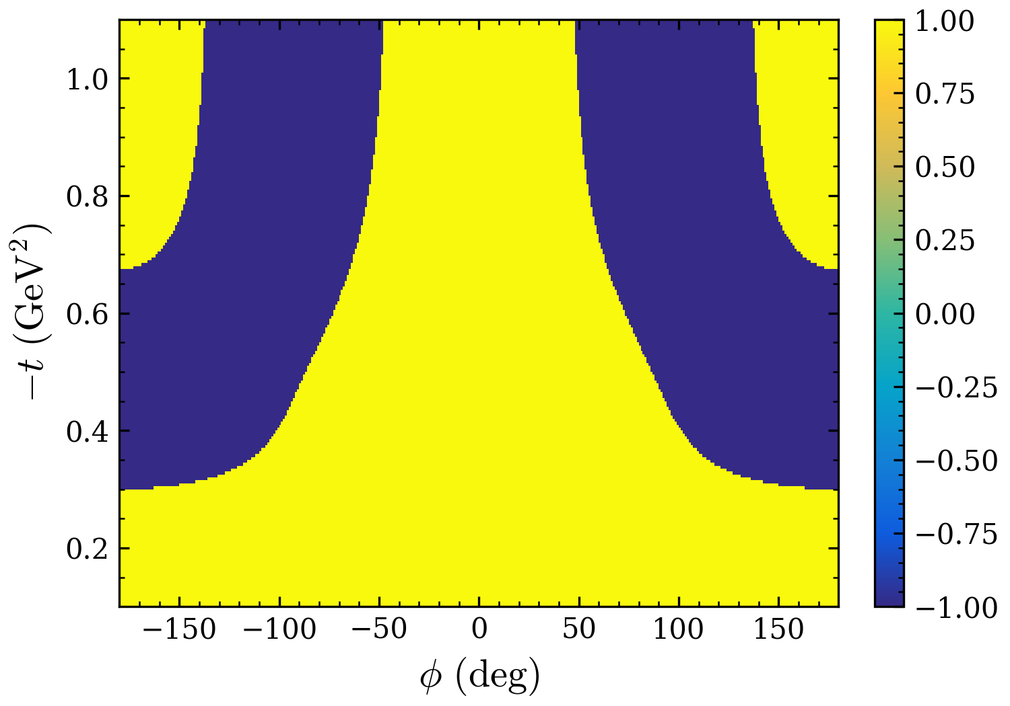
Xsect values
Need to modify the parameters in phi-dependent terms to make xsect positive
Everywhere ?

Slide 14
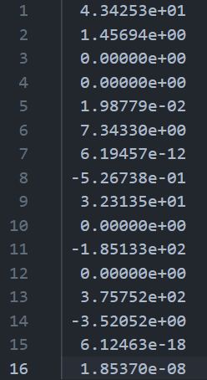
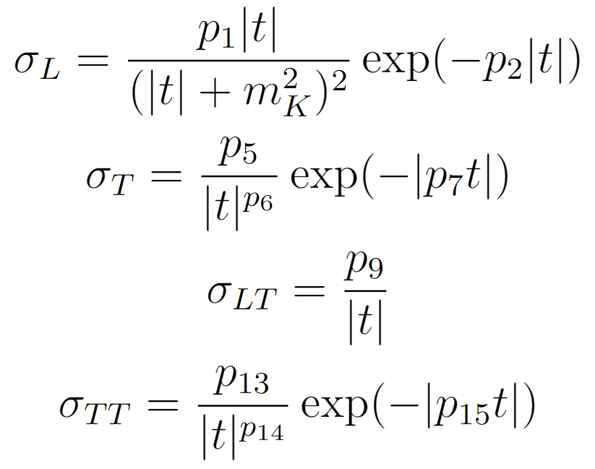
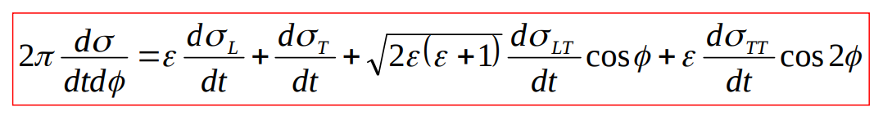
Parameterization
w factor always positive.

Slide 15
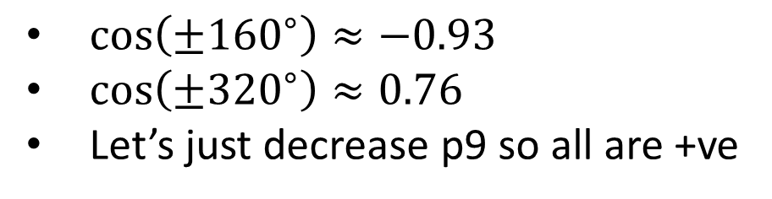
Parameterization
$\cos\left(±{160}^{∘}\right)≈−0.93$
$\cos\left(±{320}^{∘}\right)≈0.76$
Let’s just decrease p9 so all are +ve

Slide 16
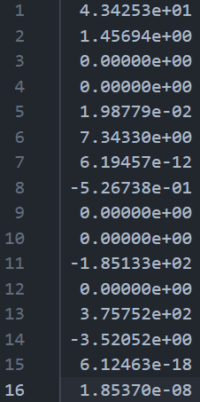
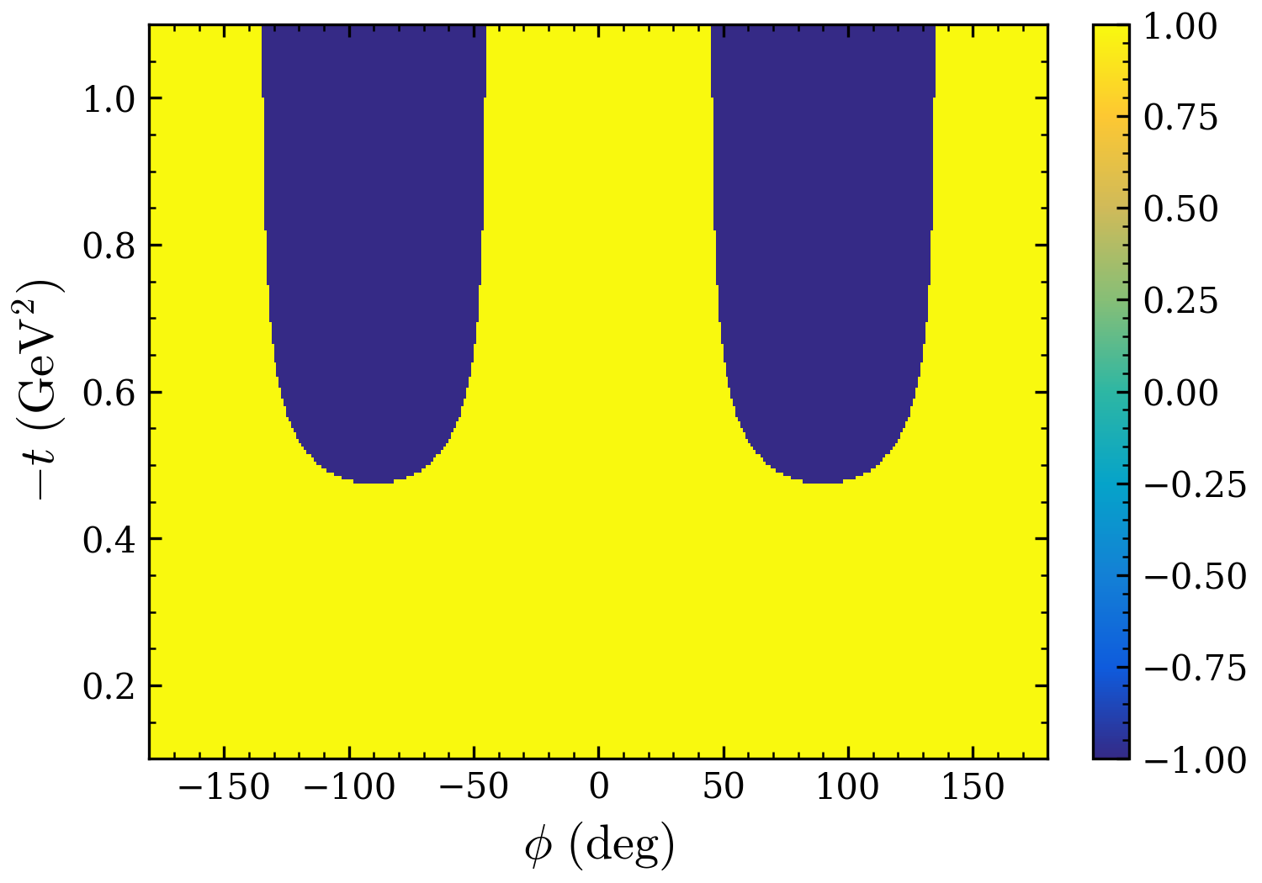
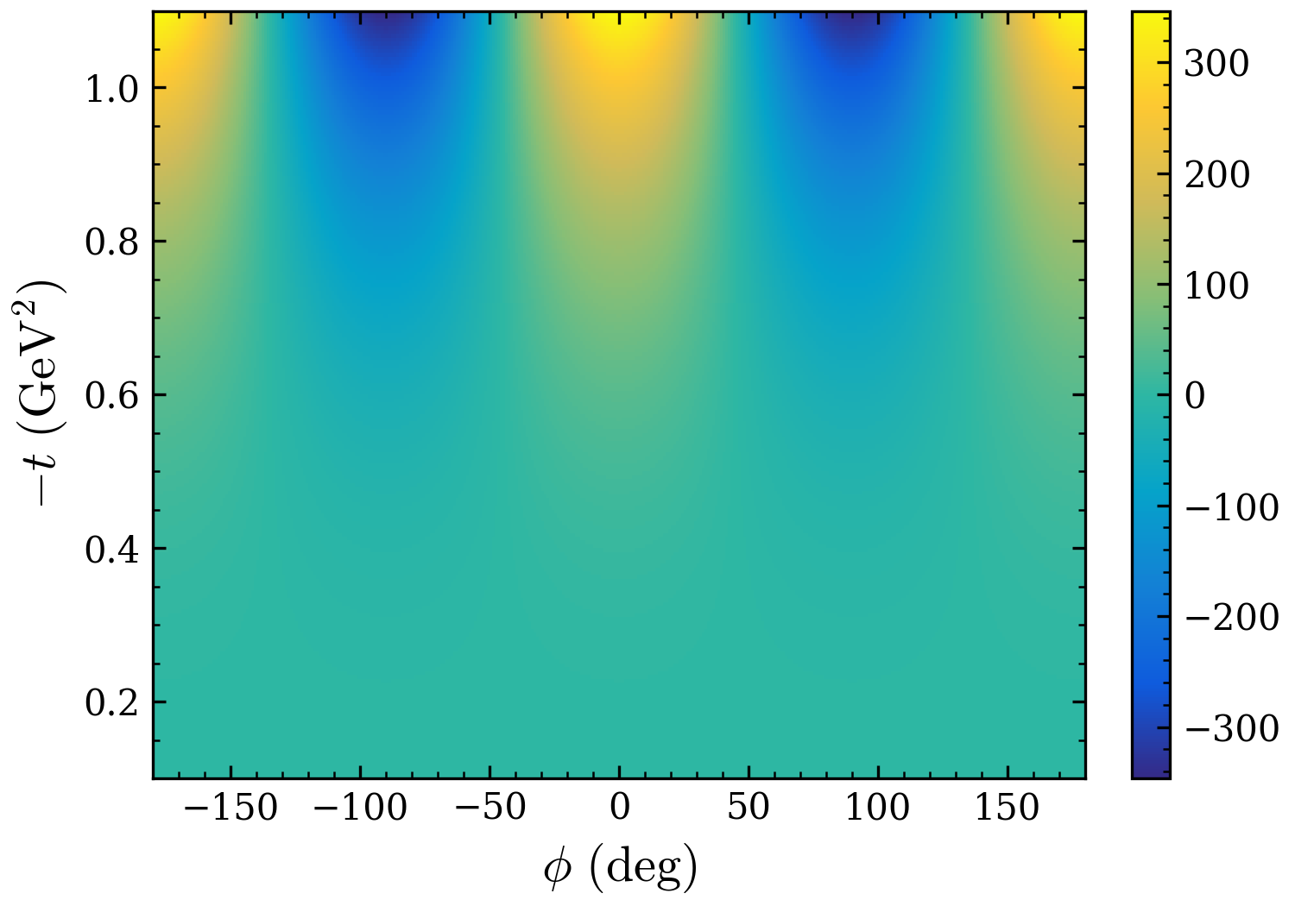
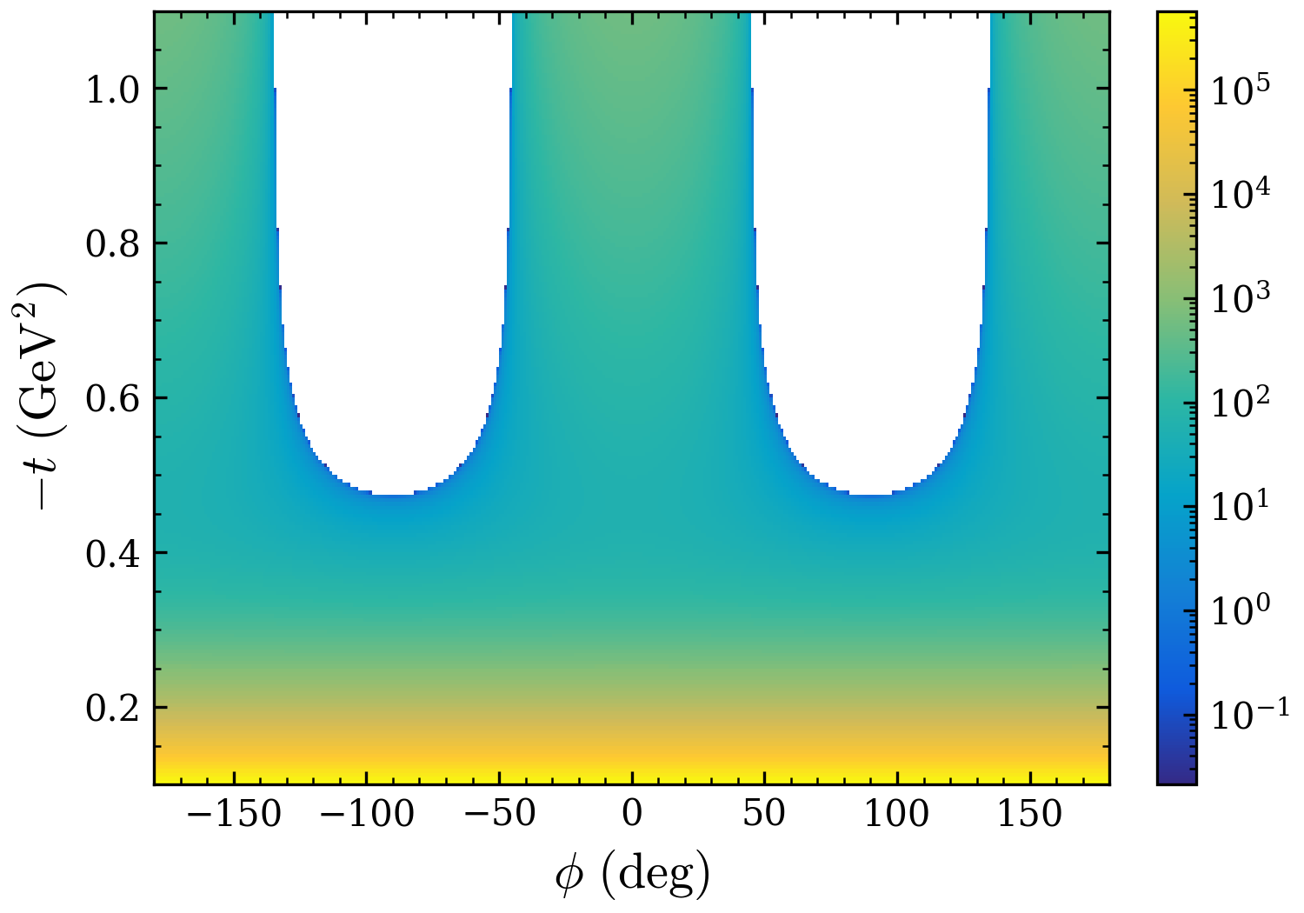
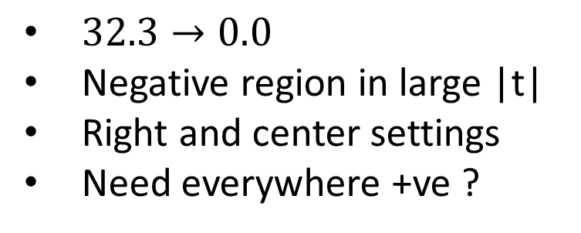
Total (sign)
$32.3→0.0$
Negative region in large |t|
Right and center settings
Need everywhere +ve ?
TT term
Total

Slide 17
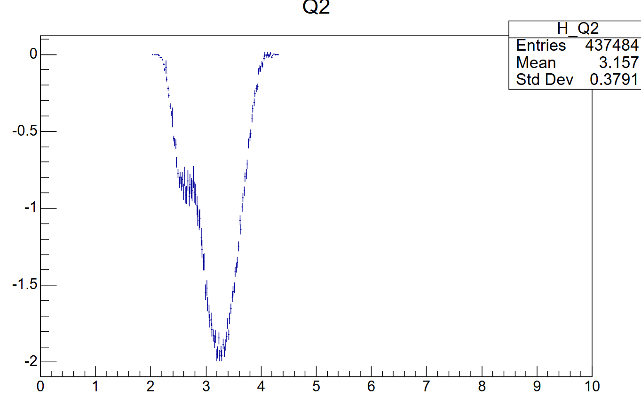
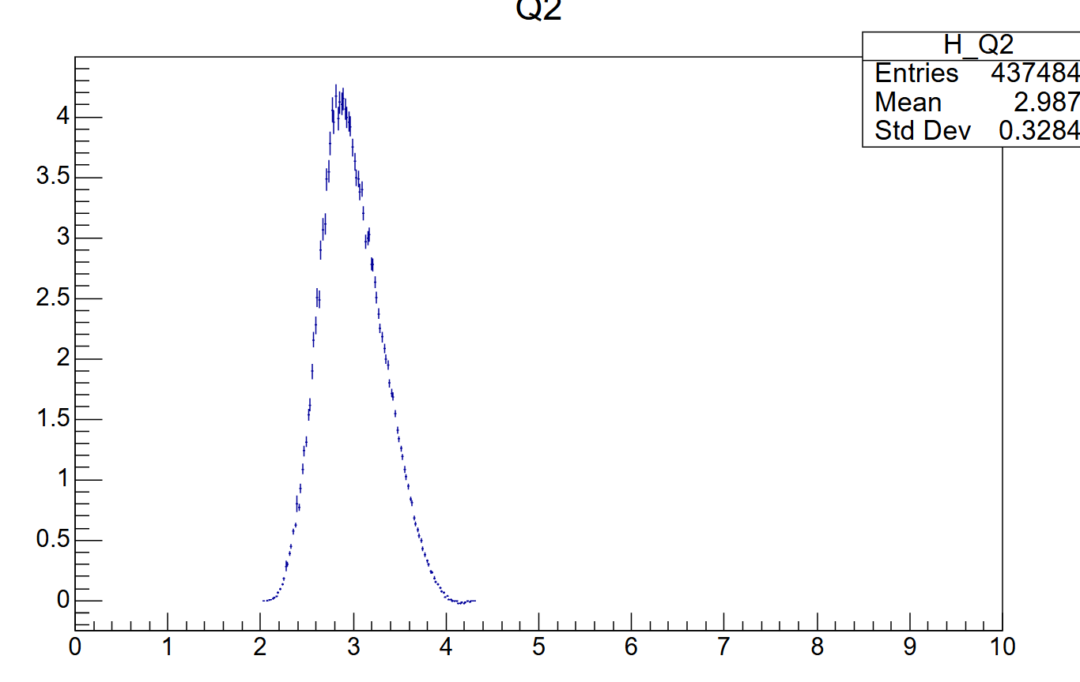
before
after

Slide 18
Next
Done : “Optimal” binning by simply making sure each bin has a minimum counts
Yield as a function of t/\phi for both data and simc
Check ratio for the 0-th iteration

